Slide 1


Preparing for Postsecondary Education
INvestEdIndiana.org

Slide 2


We’ll Discuss…
Benefits of Continuing Your Education
Choosing Your Career Path
Types of Financial Aid
FAFSA
Managing Costs
We’ll Help

Slide 3
Benefits of Continuing Education

Slide 4
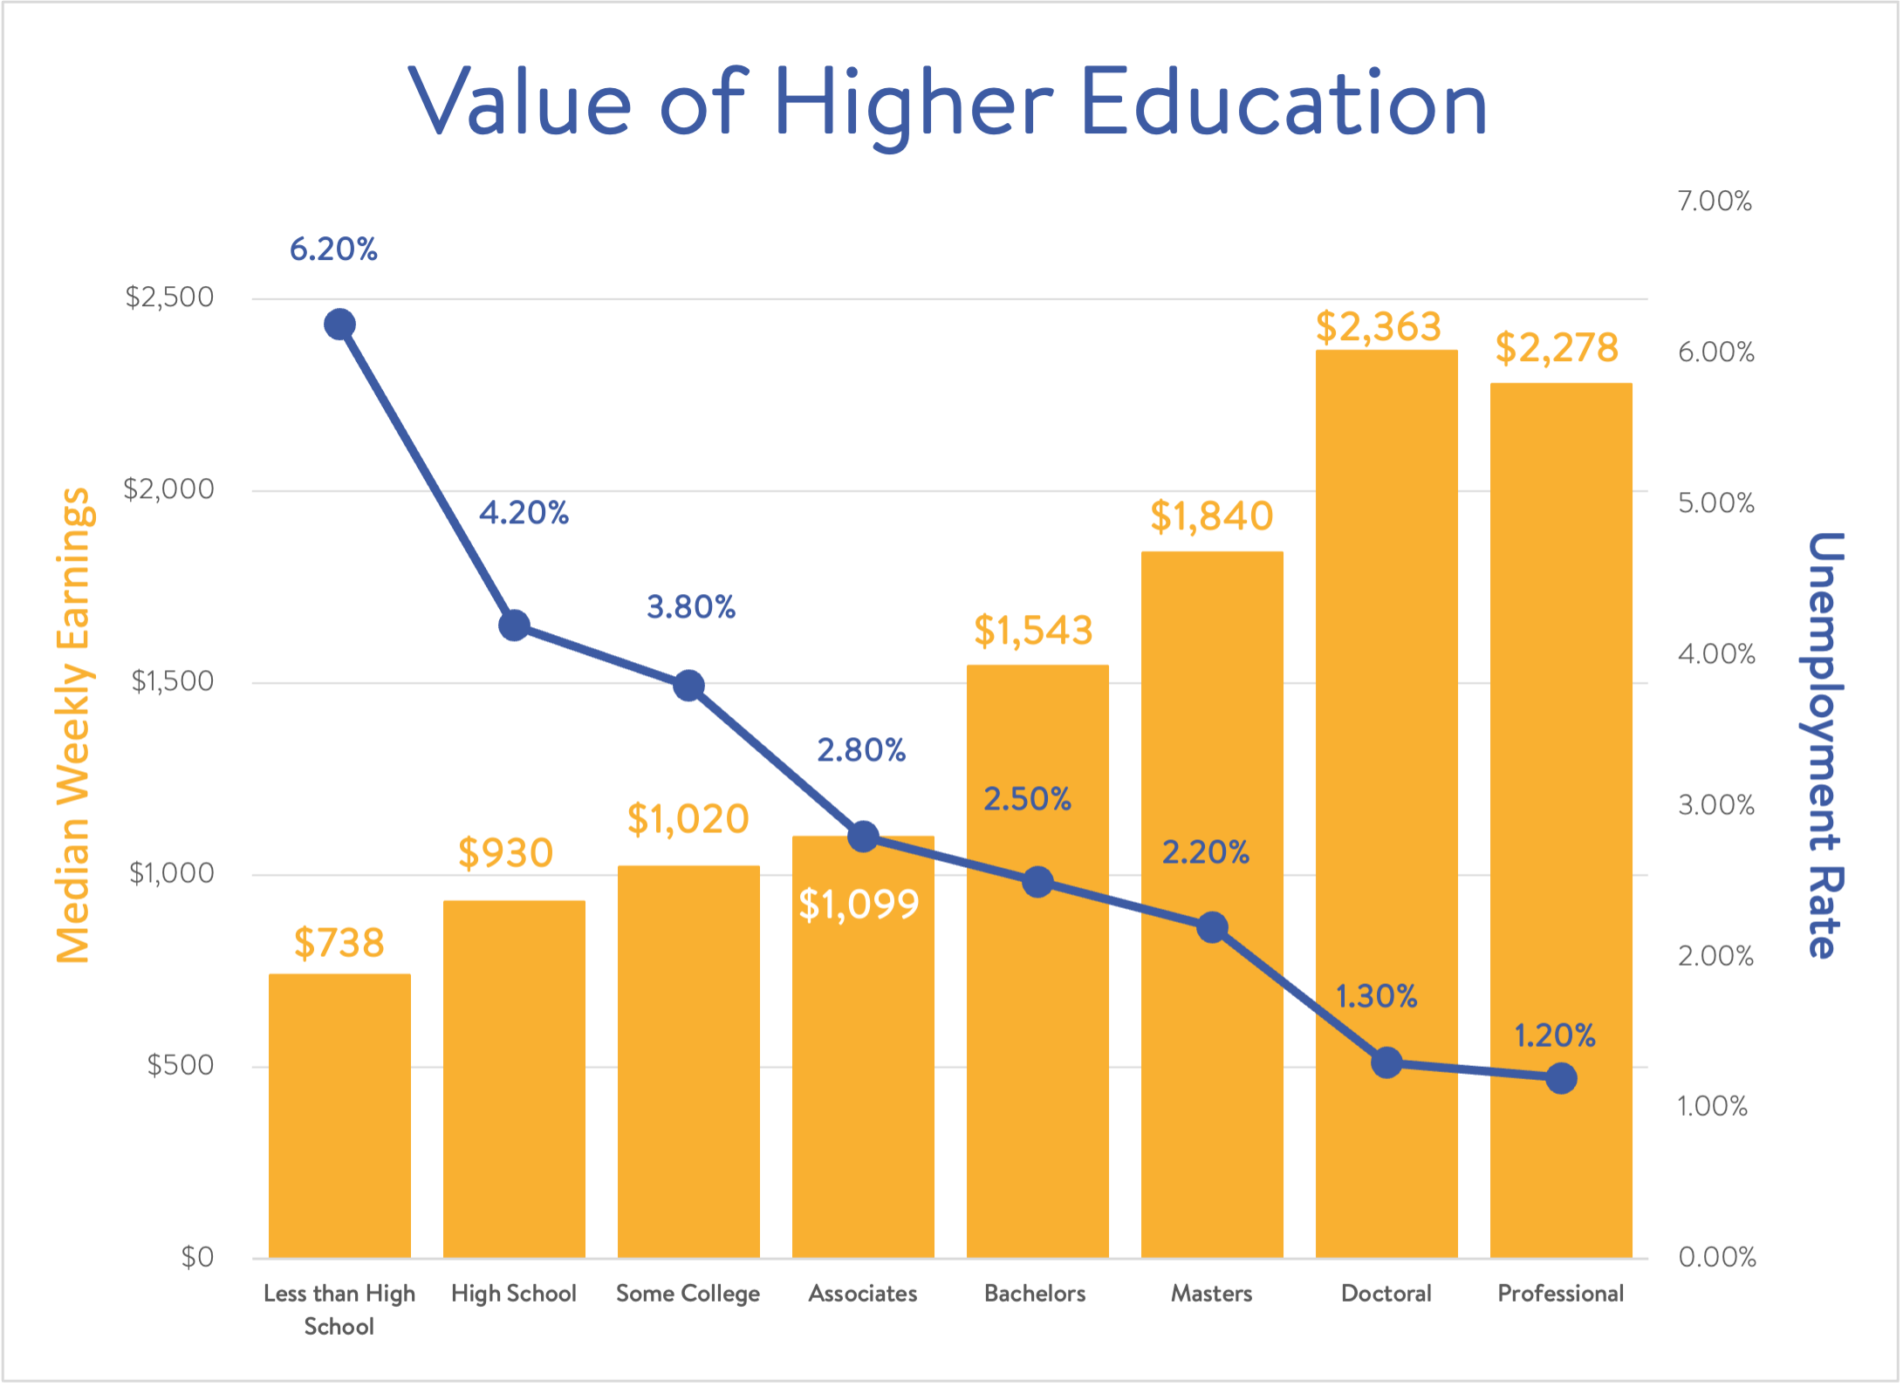
Value of Higher Education
(Source: Current Population Survey, U.S. Department of Labor, U.S. Bureau of Labor Statistics)

Slide 5

Higher Education Debt
61% of graduates have college-related debt
Averages
Student loan debt $42,673
Monthly payment $475
Total Student Loan Debt
Student loan debt over $1.83 trillion
Credit Card debt totals over $1.21 trillion
43 million people have student loan debt
Sources: https://ticas.org/wp-content/uploads/2023/12/Quick-Facts-About-Student-Loan-Debt-2023.pdf
https://educationdata.org/student-loan-debt-statistics
https://www.academybank.com/article/average-american-credit-card-debt-2025-statistics

Slide 6
Choosing Your Career Path

Slide 7

Choosing a Career Path
Finding the right fit
What are your interests & strengths?
What are your goals?
Gain experience
Job shadowing
Volunteering
Internships
Check out FREE resource & tools at:
INvestEdIndiana.org/Choosing

Slide 8

Career Research

Slide 9
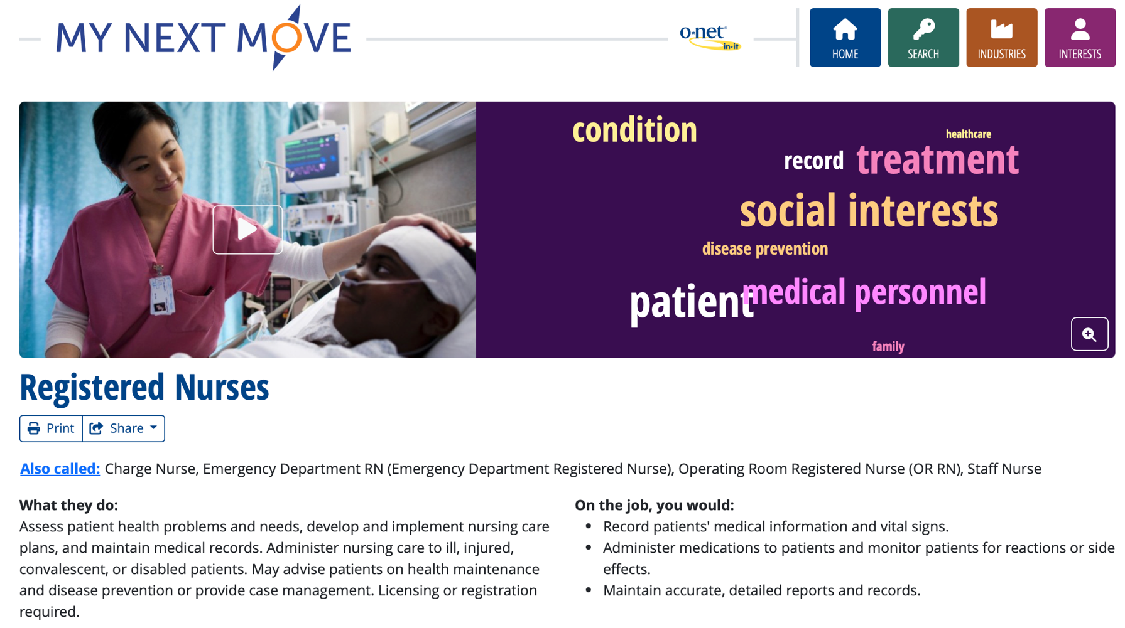
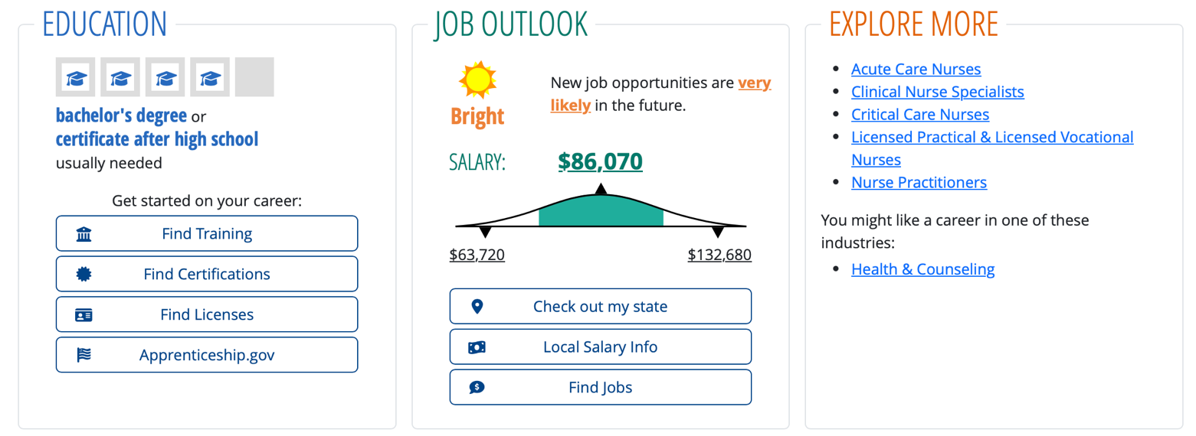
Career Research

Slide 10
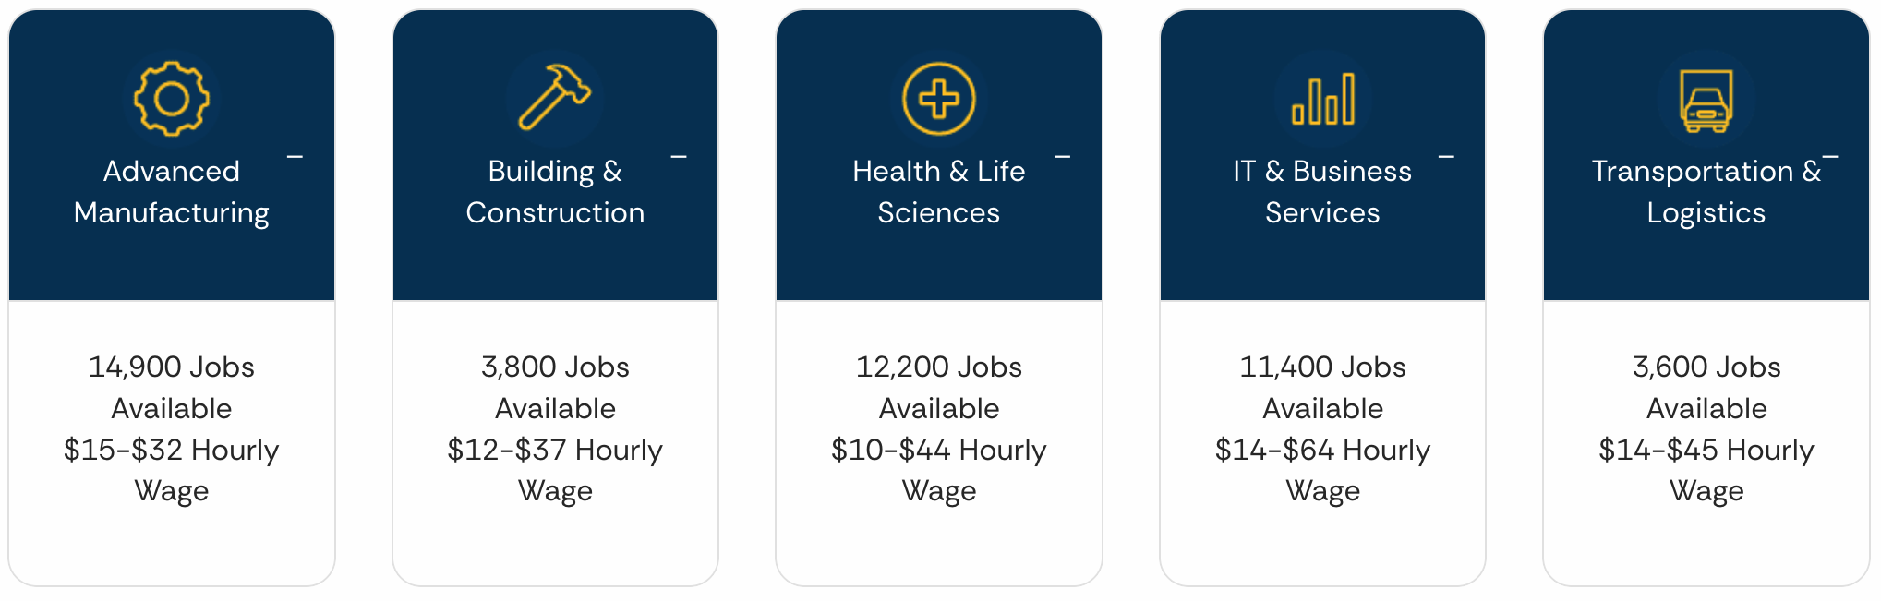

Indiana High-Growth & High-Income Jobs

Slide 11
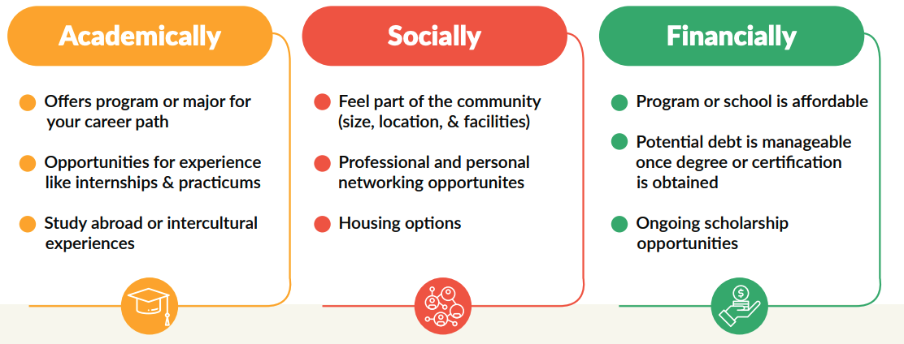
Find the Right Fit
Changing majors, programs or schools may add
Extra time to complete degree
Increased cost & student loan debt

Slide 12
Types of Financial Aid

Slide 13

Types of Financial Aid
Gift Aid
Grants
Scholarships
Self-Help Aid
Savings
Student Employment
Loans

Slide 14
Grants
Federal
Pell Grant - Max $7,395
Supplemental Educational Opportunity Grant (SEOG) - $100-$4,000
TEACH Grant - $3,772
State of Indiana
21st Century Scholars
Income-based grant for qualified students attending Indiana colleges
Frank O’Bannon Grant Programs
Freedom of Choice Award or Higher Education Award
Institutional Aid
Varies by college/university
Visit INvestEdIndana.org/Grants

Slide 15
Scholarships
Need Based vs. Merit Based
Where to look for scholarships
Visit INvestEdIndiana.org/Scholarships for more information
FREE National Search Sites
College/University
Local/Community
School Counselor
Community Foundation
Business & Employer
Church & Civic Organizations

Slide 16

Scholarship Tips
Create scholarship resume
Be compelling not just competitive
Quality not necessarily quantity
Demonstrate initiative not simply participation
Write sample essays
Tell your story
Answer the question
Concisely communicate challenges, successes, goals, and contributions
Write, read, edit, and repeat

Slide 17



Enter the INvestEd $1,000 Scholarship Giveaway!
No essay required
Need to be 16 or older
Not based on GPA
Must live in Indiana
Enter at: INvestEdIndiana.org/1000

Slide 18
Self-Help Aid

Slide 19

Saving for Education
Monetary Gifts
Job Earnings
529 Direct Savings Plan
20% tax credit up to $1,500
Account owner can change beneficiary
Coverdell Education Savings Account (ESA)
After-tax investment with tax free withdraws
Annual maximum contribution $2,000

Slide 20

Student Employment
Benefits
Earn money to pay for college & minimize student loans
Job & interview experience
Build time management skills
Options
Federal Work-Study
Part-Time Employment
Internships

Slide 21
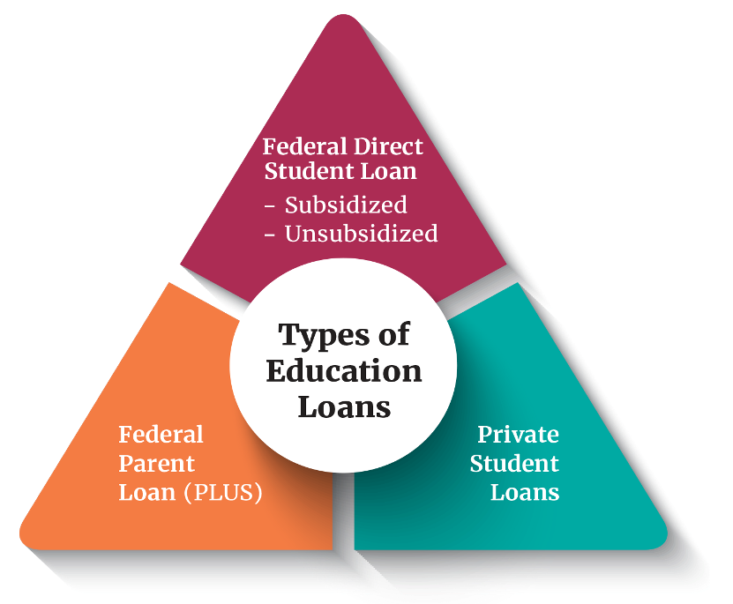
Education Loans
Federal Direct Loans Rate: 6.39% + 1.057% Fee
Student’s Loans
Subsidized & Unsubsidized
Annual Limits
Federal Direct PLUS Loans Rate: 8.94% + 4.228% fee
Parent’s Loans
New Limits ($20,000/yr & $65,000/lifetime)
Private Student Loans Rate: Based off credit,
Student and Cosigner’s Loan often no fees
Eligibility based on credit score and income

Slide 22
FAFSA

Slide 23
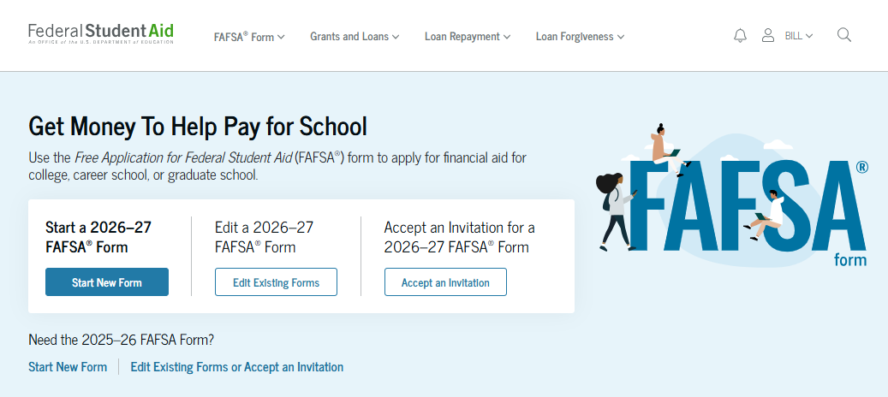
FAFSA
Free Application for Federal Student Aid
Annual Application for most types of financial aid
Basis for determining:
Federal Funds
Grants
Work-study
Loans
State of Indiana Grants
Some Institutional funds
Calculates Student Aid Index
Visit studentaid.gov

Slide 24
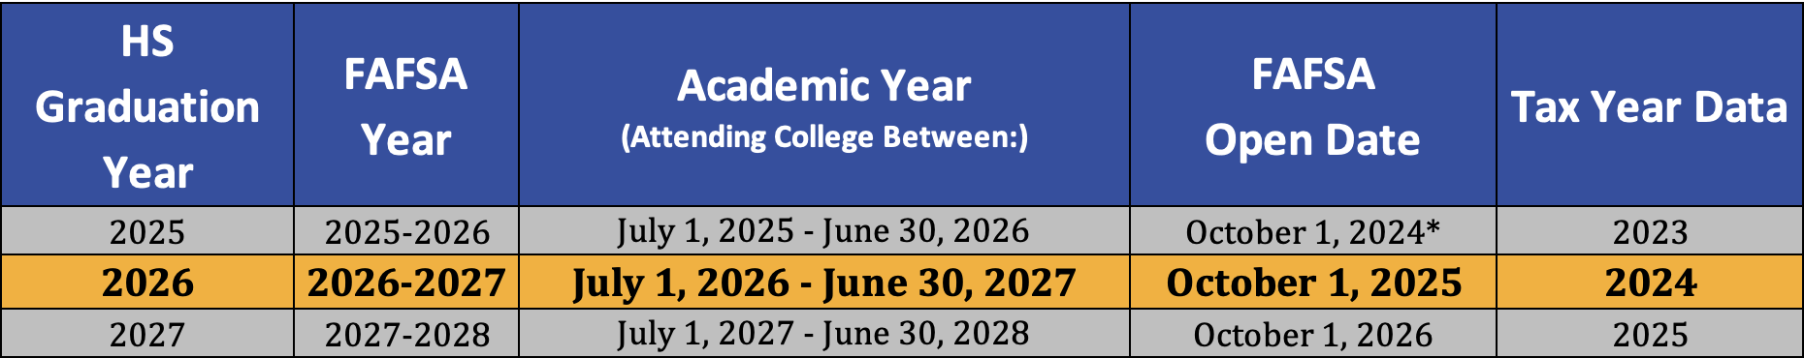
The FAFSA
Found at StudentAid.gov
• Opens on October 1st each year • Uses completed tax data (prior/prior)
Know deadline:
State of Indiana Priority Deadline – April 15th
Colleges – Ask individual colleges
APRIL
15th

Slide 25
Managing Costs

Slide 26



Managing Costs
Ways to limit college costs
Advanced placement (AP) & dual credit courses
Commuting versus living on campus
Summer and/or online courses
Estimate your financial aid & costs using a Net Price Calculator
Cost of Attendance
(tuition & fees, room & board, books & supplies, transportation & miscellaneous personal expenses)
FREE Money
(Grants & scholarships)
Net Price
(Remaining cost covered by: Outside scholarships, student employment, savings/out of pocket, or loan programs)

Slide 27
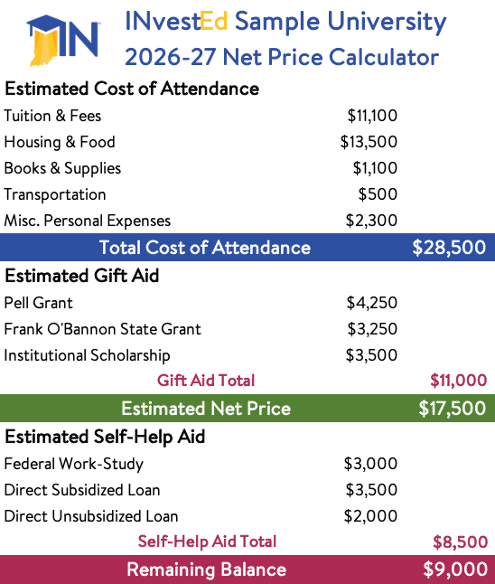
Net Price Calculator Example
Student Demographics
Middle/low income
Above average GPA & test scores
Results
Cost = $28,500
Net Price = $17,500
Remaining Cost = $9,000
For a link to any college’s calculator visit:
INvestEdIndiana.org/NPC

Slide 28
We’ll Help

Slide 29
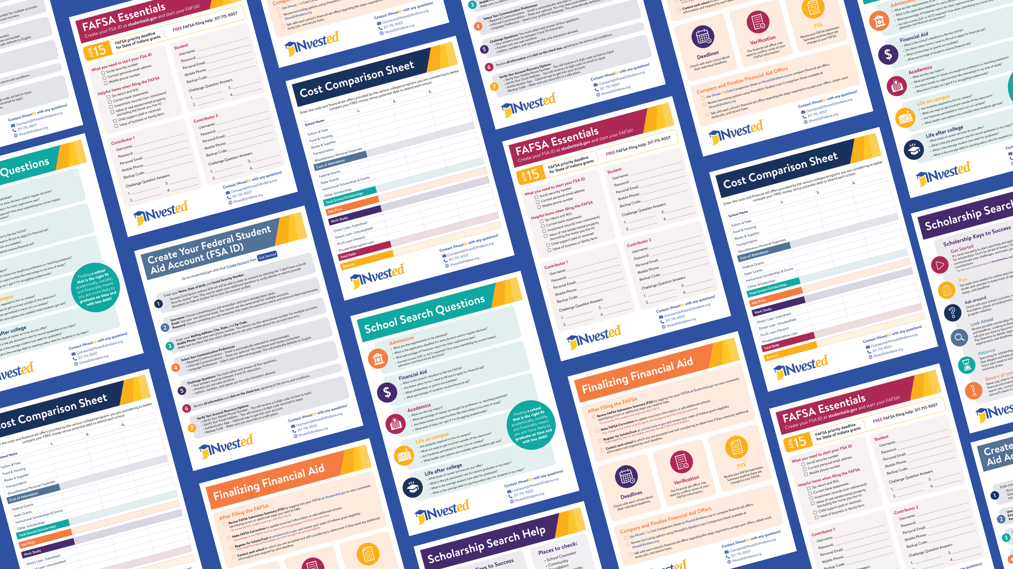
FREE Resources at:
INvestEdIndiana.org

Slide 30

The INvestEd College Planning Toolbox
College Planning Toolbox
Free resource to track college planning information for family or individual student
Tools to help:
Financial Center to track savings & costs
Calendar to set reminders
Scholarship Search Engine
INvestEdIndiana.org
Under “Resources”

Slide 31








Stay Connected With Us!
317.715.9007
Outreach@INvestEdIndiana.org
www.investedindiana.org
Follow @INvestEDIndiana
Join our mailing list:
InvestEdIndiana.org/mailing-list

