Slide 1


Navigating the Financial Aid Process
INvestEdIndiana.org

Slide 2


We’ll Discuss…
Types of Aid
First Steps & Info.
FAFSA Overview
After You Submit
We’ll Help

Slide 3
Types of Aid

Slide 4
Grants
Federal
  Pell Grant - Max $7,395
  Supplemental Educational Opportunity Grant (SEOG) - $100-$4,000
  TEACH Grant - $3,772
State of Indiana
  21st Century Scholars
  Frank O’Bannon Grant Programs
  William A. Crawford Minority Teacher Scholarship
  Workforce Ready Grant
  Visit INvestEdIndana.org/Grants

Slide 5
Credit Completion
On -Time
Full - Time
30
Credits
24
Credits
15 Credits – Fall
15 Credits – Spring
12 Credits – Fall
12 Credits – Spring
60
Credits
48
Credits
12 Credits – Fall
12 Credits – Spring
15 Credits – Fall
15 Credits – Spring
90
Credits
72
Credits
15 Credits – Fall
15 Credits – Spring
12 Credits – Fall
12 Credits – Spring
120
Credits
96
Credits
15 Credits – Fall
15 Credits – Spring
12 Credits – Fall
12 Credits – Spring
120
Credits
On-Time vs. Full-Time:
  Complete 30 credit hours per year to maintain
  maximum grant eligibility
12 Credits – Fall
12 Credits – Spring

Slide 6
Scholarships
Need Based vs. Merit Based
  Where to look for scholarships
  Visit INvestEdIndiana.org/Scholarships for more information
FREE National Search Sites
College/University
Local/Community
        School Counselor
        Community Foundation
        Business & Employer
        Church & Civic Organizations

Slide 8

Student Employment
Benefits
  Earn money to pay for college &
  minimize student loans
  Job & interview experience
  Build time management skills
Options
  Federal Work-Study
  Part-Time Employment
  Internships

Slide 9
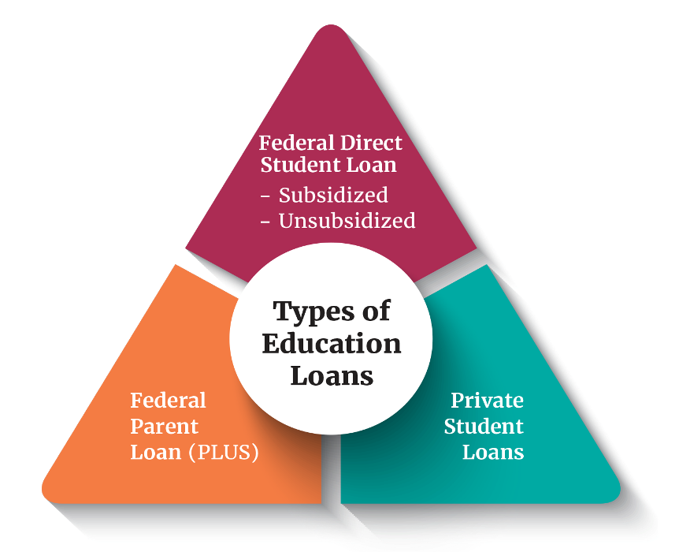
Education Loans
Federal Direct Loans
  Rate: 6.39% + 1.057% Fee
  Student’s Loans
  Subsidized & Unsubsidized
  Annual Limits
Federal Direct PLUS Loans
  Rate: 8.94% + 4.228% fee
  Parent’s Loans
  Eligibility impacted by adverse credit
Private Student Loans
  Rate: Based off credit, often no fees
  Student and Cosigner’s Loan
  Eligibility based on credit score and income

Slide 10


Education Loan - Trends
Online Searches and AI compile results based on many sites including those that offer “Top Picks” or “10 Best…”
Sponsored sites appear first
“As low as” Marketing
  Rates shown in ads emphasize lowest rates,
  but actual rate is often in the double digits
INvestEd Team can help
  Review specifics of loan types
  Discuss options for students/parents
  Answer questions

Slide 11
First Steps & Info.

Slide 12
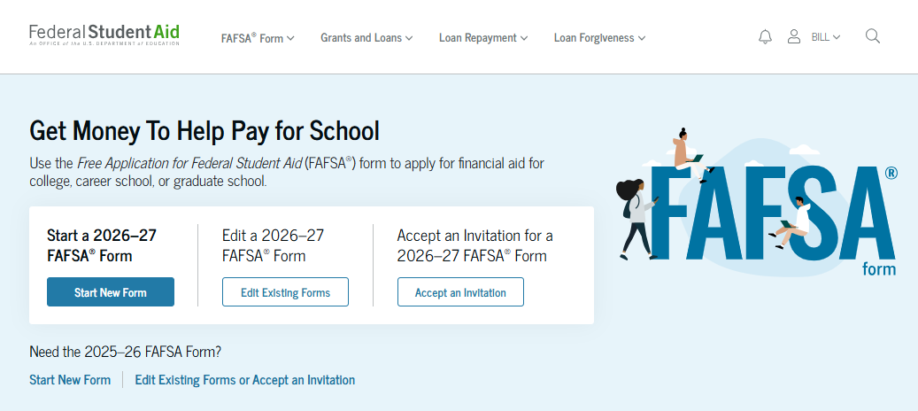
FAFSA
Free Application for Federal Student Aid
  Annual Application for most types of financial aid
  Basis for determining:
    Federal Funds
      Grants
      Work-study
      Loans
    State of Indiana Grants
    Some Institutional funds
  Calculates Student Aid Index
Visit studentaid.gov Or INvestEdIndiana.org/FAFSA

Slide 13
StudentAid.gov Account
User account unique to each person
  Student
    Use to login to FAFSA & sign electronically
  Contributors (parent, parent’s spouse, student’s spouse)
    Use to accept invitation and sign in electronically
  Student & Contributors can NOT use the same email or phone number (used for two-step verification)
Need help creating your StudentAid.gov Account?
Visit INvestEdIndiana.org/FAFSA

Slide 14
FAFSA Overview

Slide 15
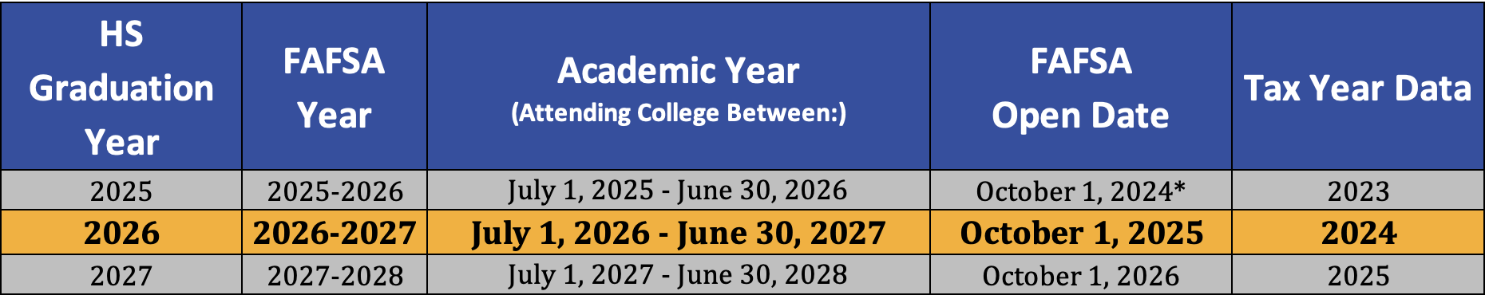
The FAFSA
Found at StudentAid.gov
  • Opens on October 1st each year • Uses completed tax data (prior/prior)
Know deadline:
  State of Indiana Priority Deadline – April 15th
  Colleges – Ask individual colleges
APRIL
15th

Slide 16
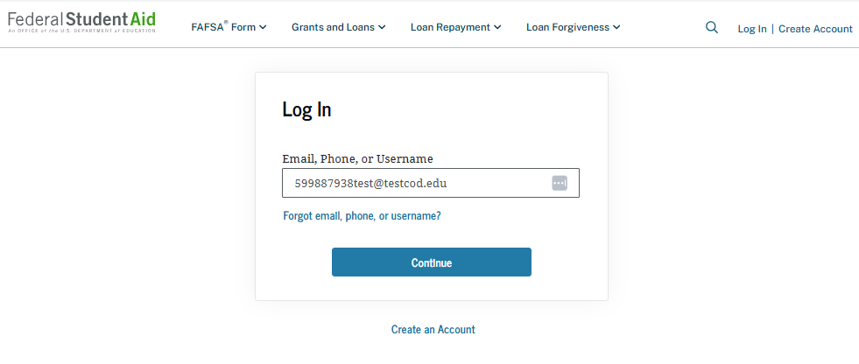
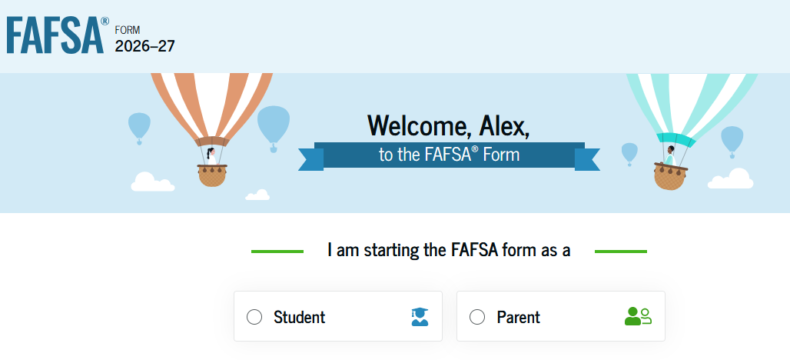
Start the FAFSA
StudentAid.gov
Login - Using your StudentAid.gov Account
Select Role
  Student
  Contributor (Parent)
FAFSA Onboarding

Slide 17
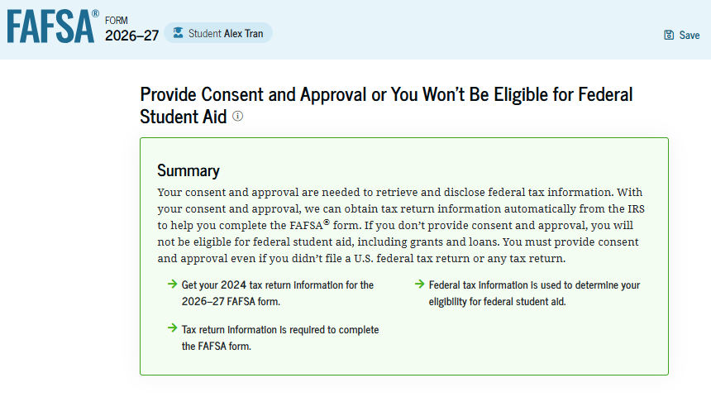
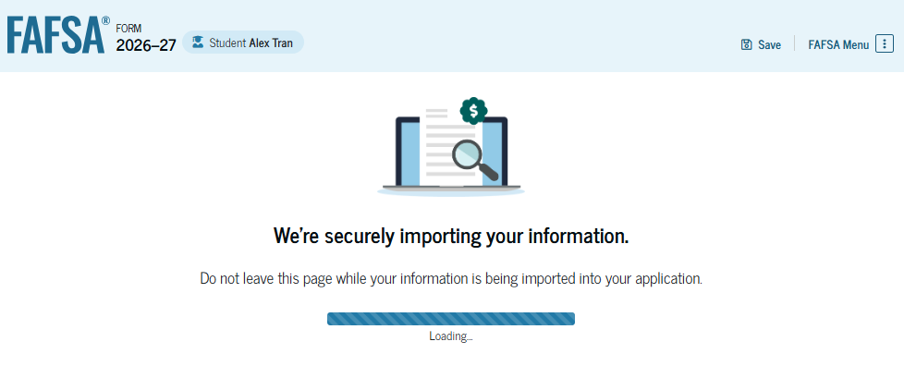
Confirmation and Consent
Confirmation Info.
  Check Identity Info (SSN, Address, etc)
Provide Consent
  Providing consent from both student and parent contributor(s) is required to receive aid
  Consent allows the FAFSA to automatically import IRS tax data
After Consent
  IRS Data is automatically imported into your FAFSA

Slide 18
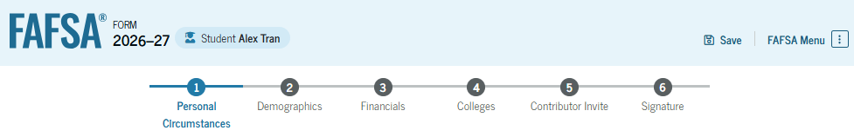
Student Sections
Personal Circumstances
Demographics
Financials
Colleges
Contributor Invite
Signature

Slide 19
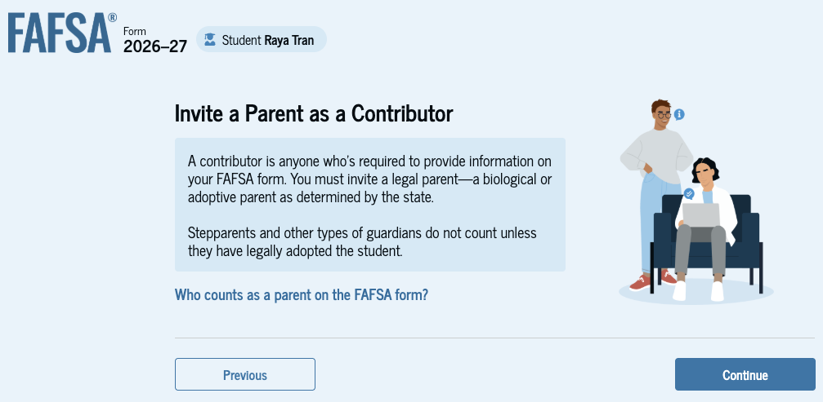
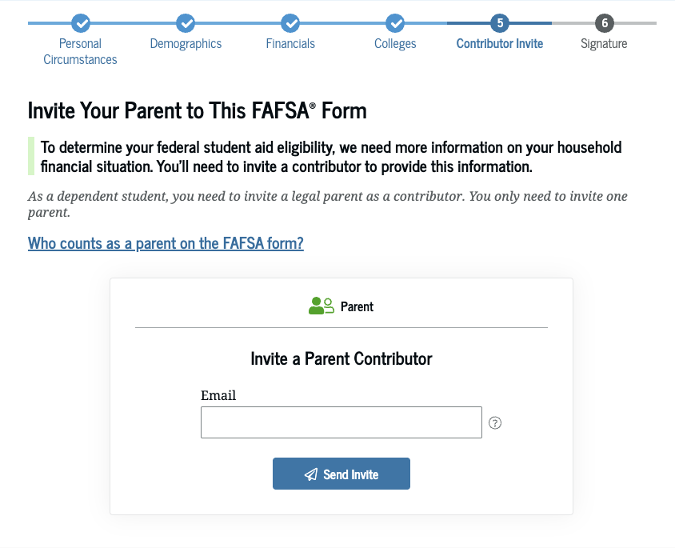
Inviting Contributors

Slide 20
Who is the Parent
Biological or adoptive parents
Married or unmarried & living together
Divorced, separated or unmarried & not living together
Widowed &
not remarried
Who provided more financial support the last 12 months?
If equal, which parent has the greater income & assets the last 12 months?
Both parents listed on the FAFSA
If parent single, then only person listed on the FAFSA
If parent remarried, then parent & step-parent listed on the FAFSA
Single parent listed on the FAFSA

Slide 21
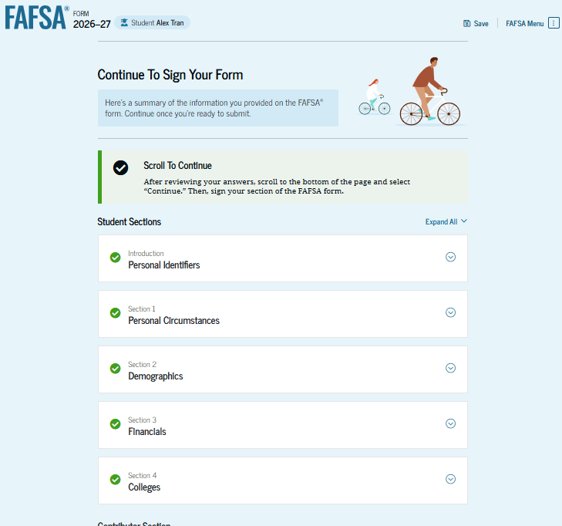
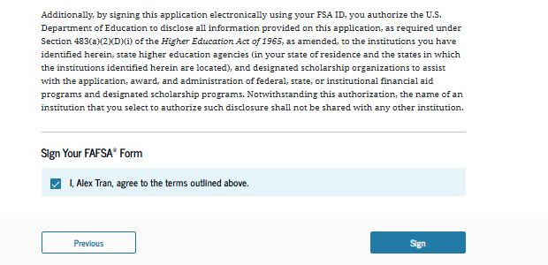
Review, Sign, & Submit
Student reviews all entered information
Student agrees and signs their part of the FAFSA

Slide 22
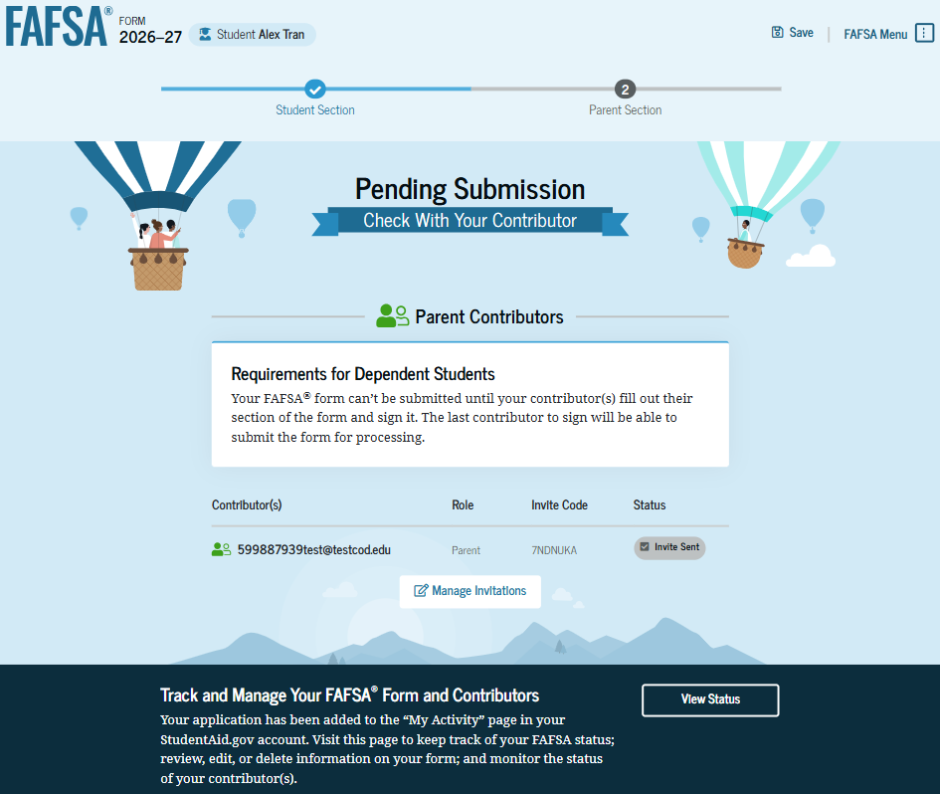
Student Section Complete
Next steps for student: The form is not completed until the contributor(s) complete and sign their sections of the form

Slide 23
Parent Info.

Slide 24
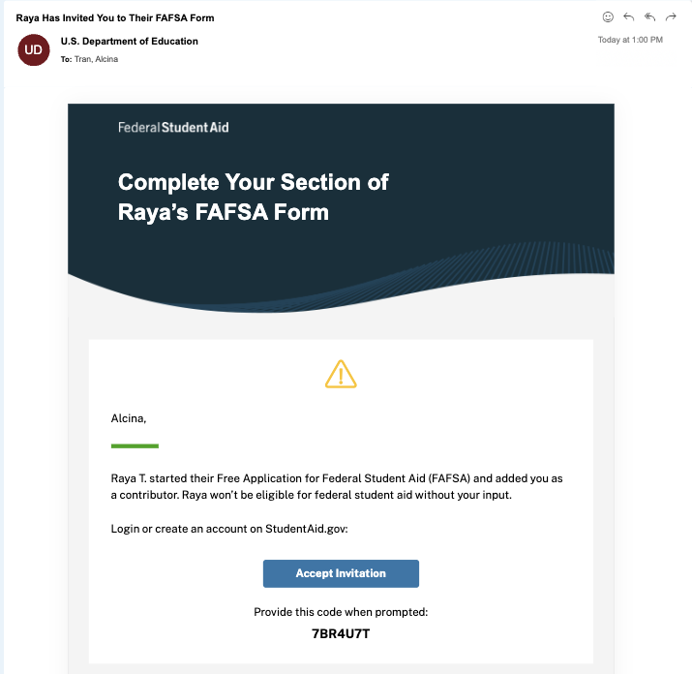
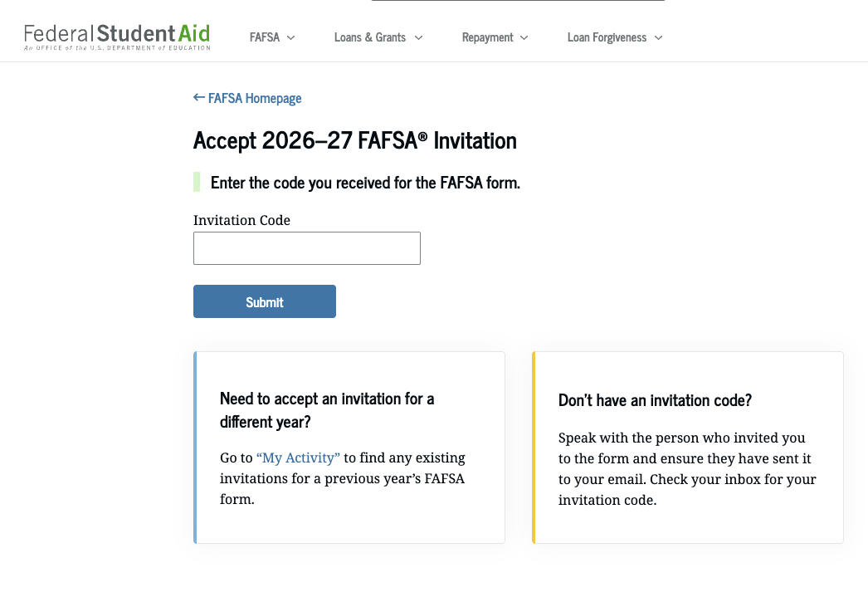
Contributor / Parent Info.
Invitation Email
  Log in / Accept invitation

Slide 25
Confirmation and Consent
Confirmation Info.
  Check Identity Info (SSN, Address, etc)
Provide Consent
  Providing consent from both student and parent contributor(s) is required to receive aid
  Consent allows the FAFSA to automatically import IRS tax data
After Consent
  IRS Data is automatically imported into your FAFSA

Slide 26
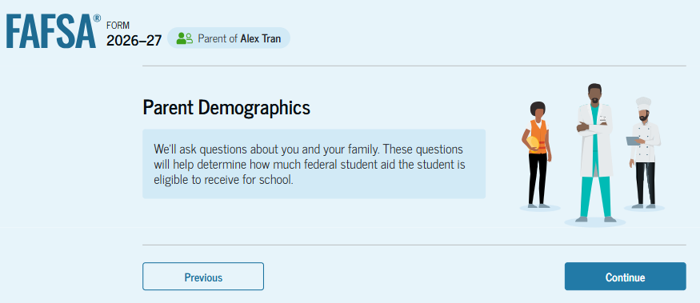
Parent Demographic Information
Marital Status
State of Residence

Slide 27
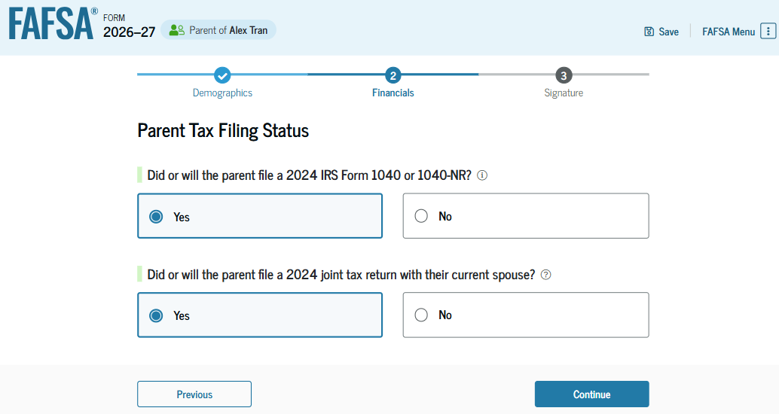
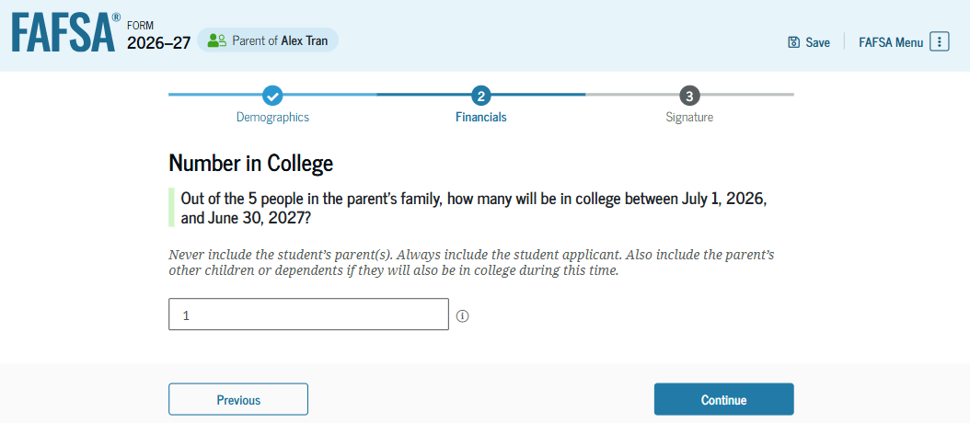
Parent Financials
Federal Benefits Received
Tax Filing Status
  Determines if one or both contributors need an StudentAid.gov Account to sign and submit
Family Size
  Could need adjusting if different from 2024 tax forms
Number in College

Slide 28
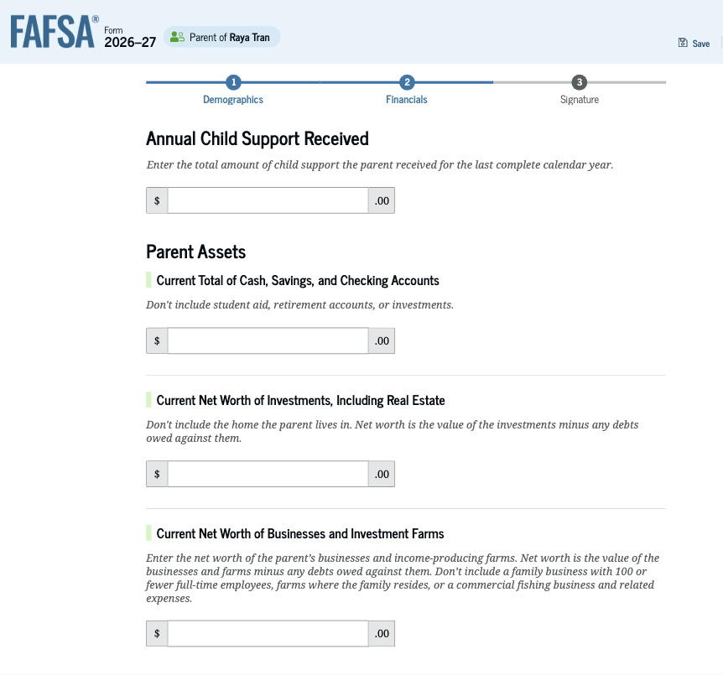
Parent Asset Information
Assets do NOT include:
  The home you live in
  Qualified retirement plans
  Businesses with less than 100 full-time
  equivalent employees
Assets DO include:
  Cash, savings, and checking accounts
  Real estate
  Stocks, Bonds, and other investments
  529 College Savings Plans
    Education savings plans are counted as an asset
    of the account owner ONLY if the account is
    designated for the student whose FAFSA is
    being completed

Slide 29
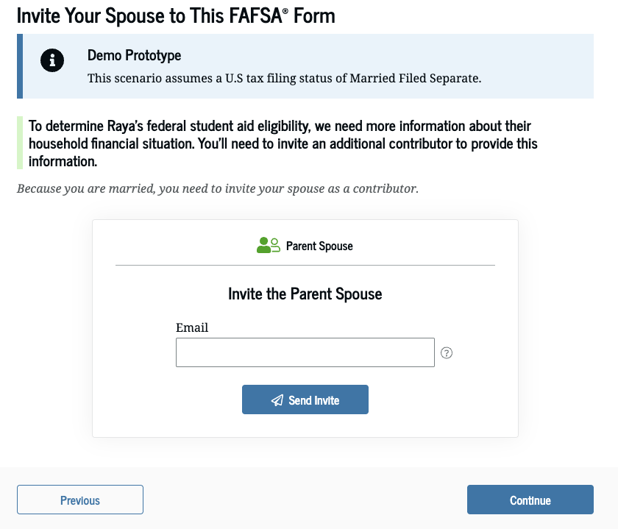
Other Parent Info
Refers to the spouse of the parent contributor
  Includes married stepparent
Information needed
  Email address
  Date of Birth
May be asked for FSA ID depending on tax filing status

Slide 30
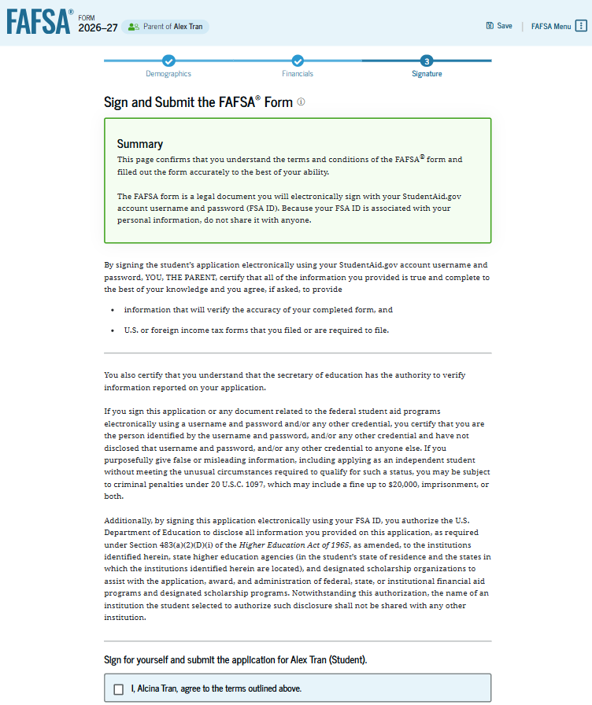
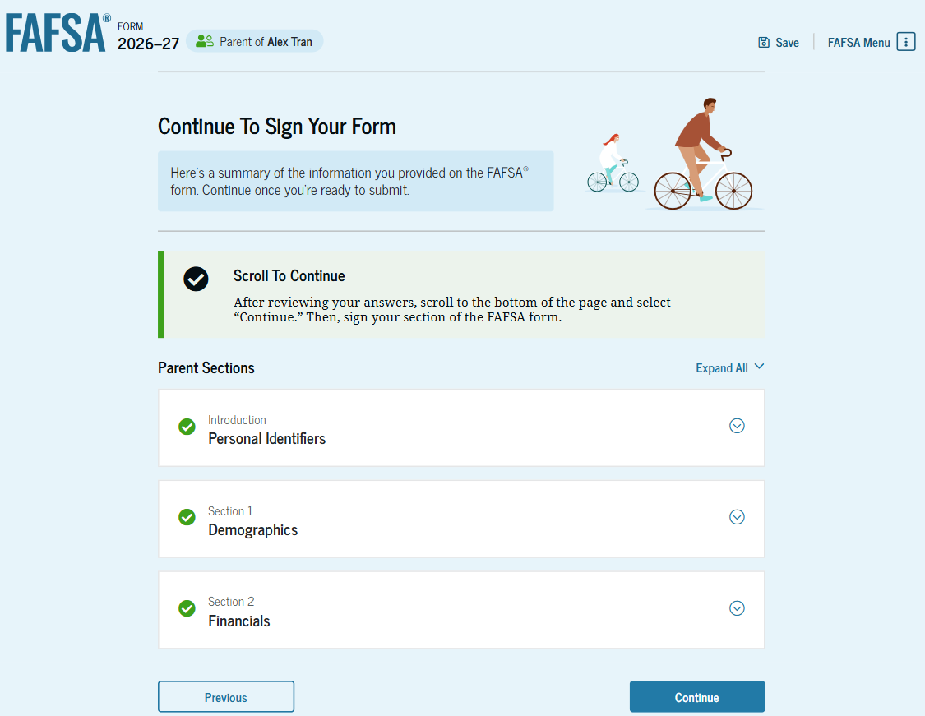
Review, Sign, and Submit
Review all entered information
Contributor agrees, signs and submits
the FAFSA

Slide 31
After You Submit

Slide 32
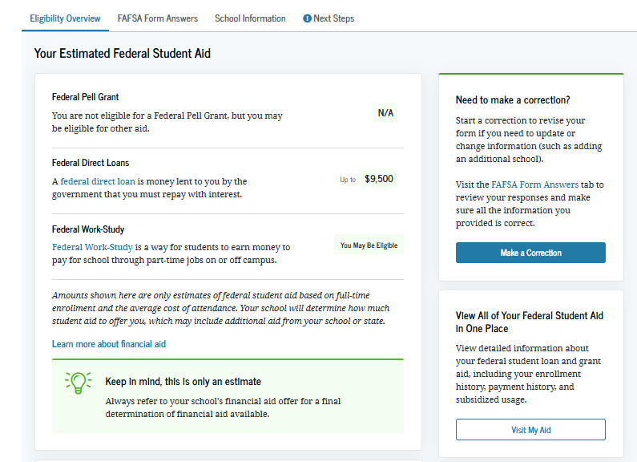
FAFSA Submission Summary
Eligibility Overview
  Includes Student Aid Index (SAI)
  FAFSA Form Answers
  Next Steps
    Correct any errors
    Update school info
    Make sure school has needed
    documents
      Dependency paperwork (if needed)
      Additional financial aid forms
All other aid determined by the college’s Financial Aid Office

Slide 33
Special Circumstances
Changes to your situation not represented on the FAFSA may include:
  Change in employment or income status
  Medical expenses not covered by insurance
  Change in parent marital status
  Unusual dependent care expenses
  Student unable to obtain parent information
If a special circumstance occurs, contact the college’s Financial Aid Office

Slide 34
Financial Aid Offer
Each college provides a financial aid offer outlining:
  Cost of attendance
  Financial aid amounts (grants, scholarships, work-study, and loans)
  Options to pay remaining balance
Timing and delivery of offer varies by college
What you should do:
  Review costs and financial aid offers
  Clearly understand your obligations
  Ask questions

Slide 35
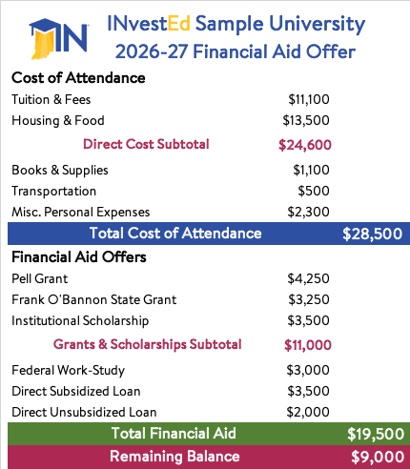
Sample Financial Aid Offer
Typical Sections
  Cost
  Grants and Scholarships
  Work-study
  Student Loans
  Remaining Balance
    Outside Scholarships
    Out of Pocket
      Payment Plan
      PLUS (Parent) Loan
      Private Loan

Slide 36
We’ll Help

Slide 37
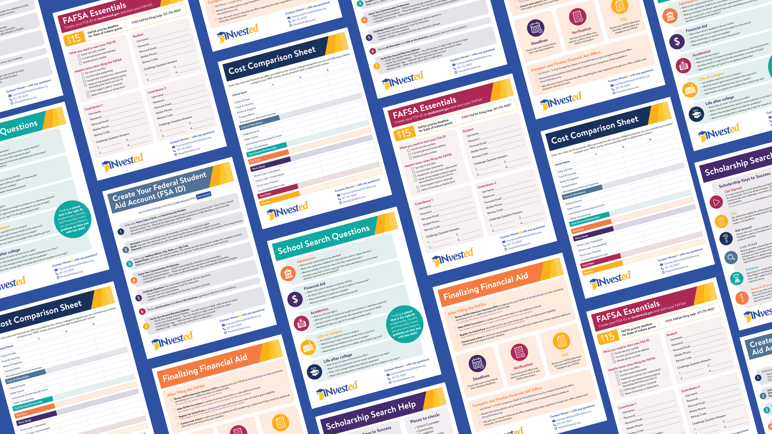
FREE Resources at:
INvestEdIndiana.org

Slide 38








Stay Connected With Us!
317.715.9007
Outreach@INvestEdIndiana.org
www.investedindiana.org
Follow @INvestEDIndiana
Join our mailing list:
InvestEdIndiana.org/mailing-list

