Slide 1


Finalizing Your Funding Plan
INvestEdIndiana.org

Slide 2


We’ll Discuss…
FAFSA Submission Summary & Verification
Indiana State Grant Portal
Financial Aid Offers
Comparing Offers
Next Steps & Help

Slide 3
FAFSA Submission Summary
& Verification

Slide 4
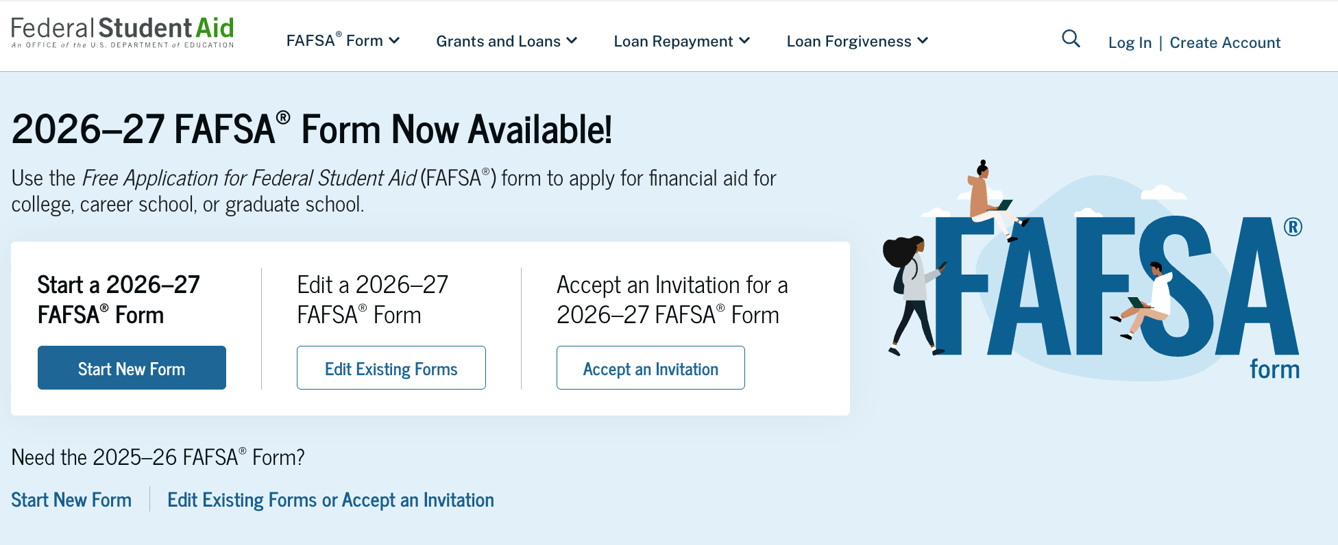
Review Your FAFSA
STUDENT logs in to the FAFSA with their account
(username & password)
studentaid.gov

Slide 5
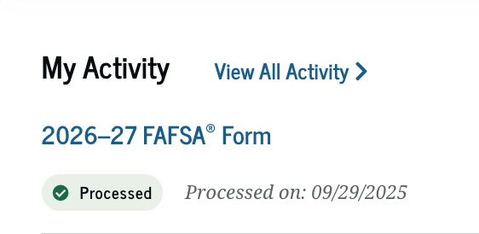
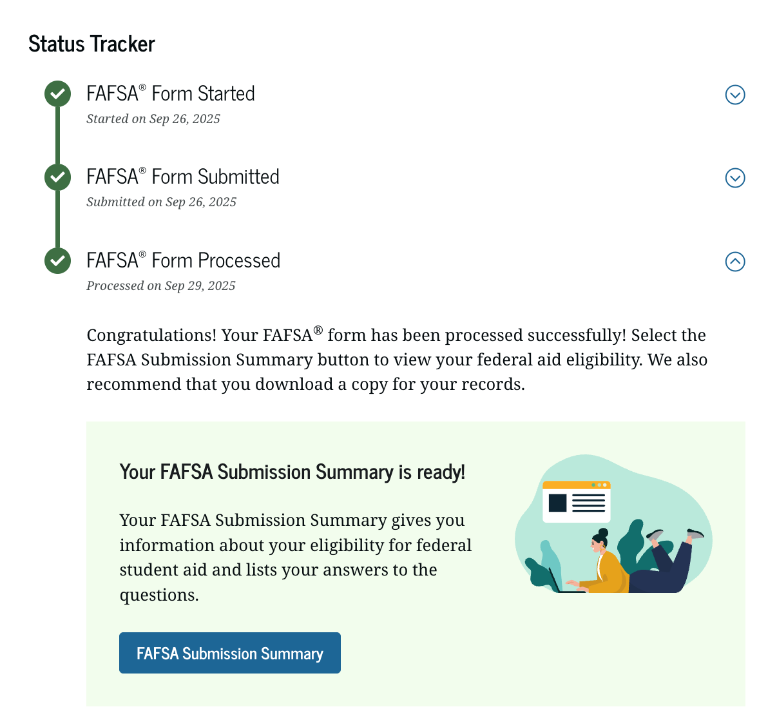
FAFSA Processing Results
Application Status
Questions? Connect with us at:
317.715.9007
Outreach@INvestEdIndiana.org
Processed
✓
In Progress
!
In Review
!
Action Needed
!

Slide 6
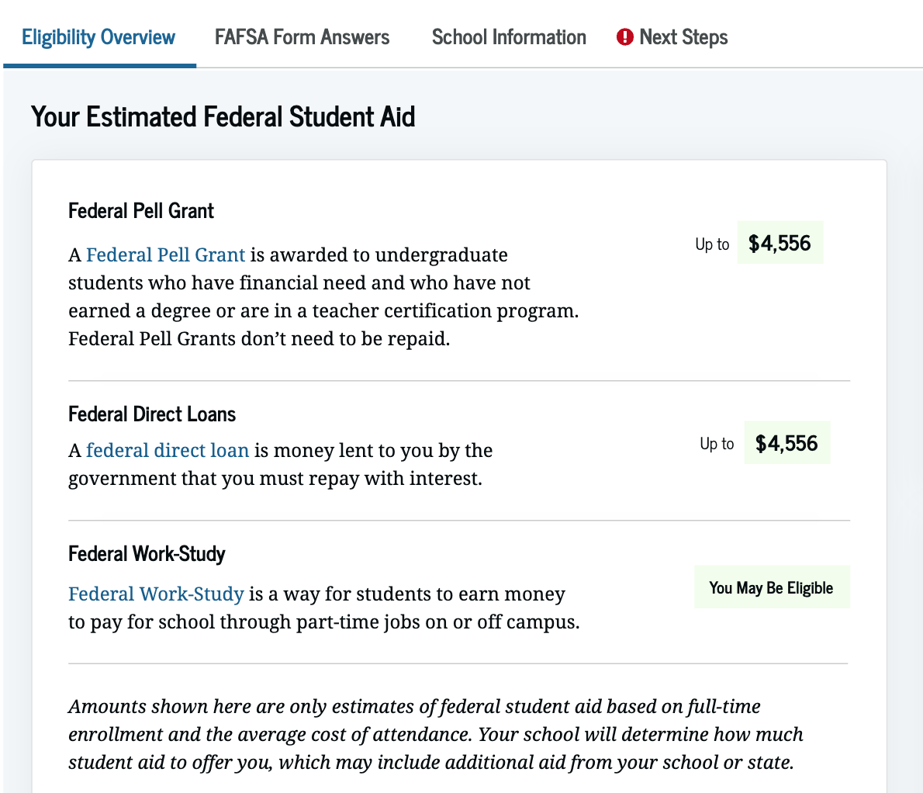
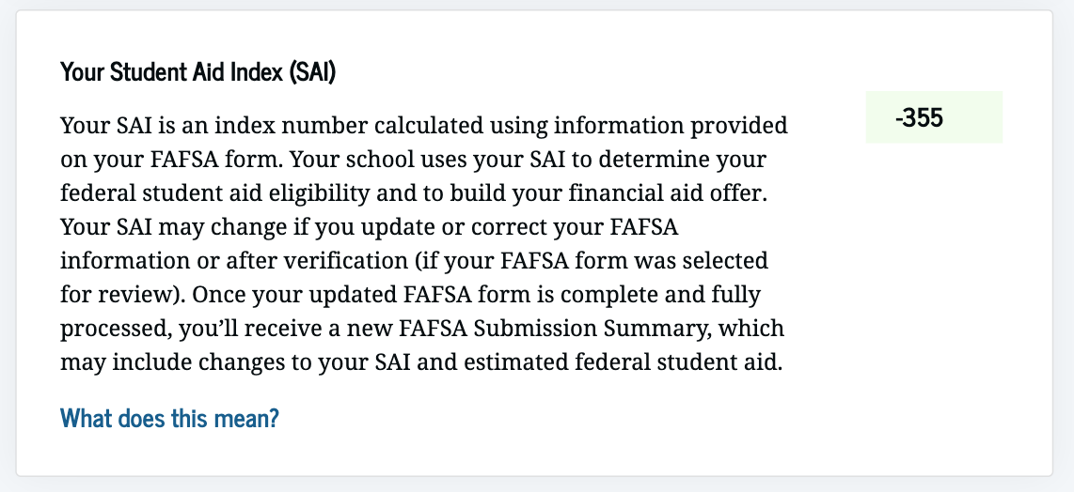
FAFSA Submission Summary (FSS)
Eligibility Overview
General information from processor
  Provides calculated student aid index (SAI)
  Possible federal aid eligibility
  Indicates if selected for verification

Slide 7
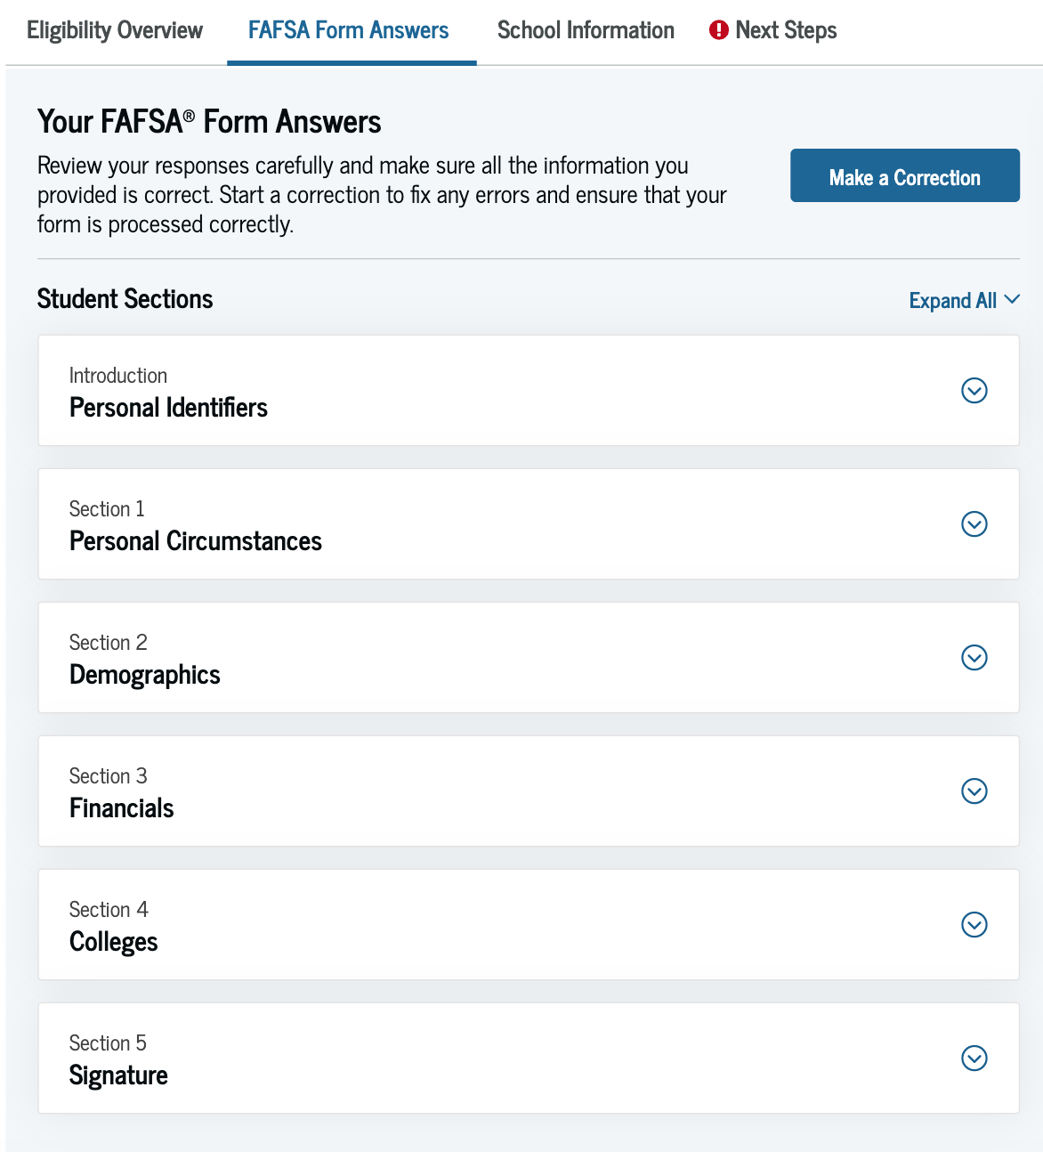
FAFSA Submission Summary (FSS)
FAFSA Form Answers
  Review submitted answers
  Will not show numbers transferred from IRS
  Make corrections
School Information
  Data points on selected schools listed on FAFSA

Slide 8
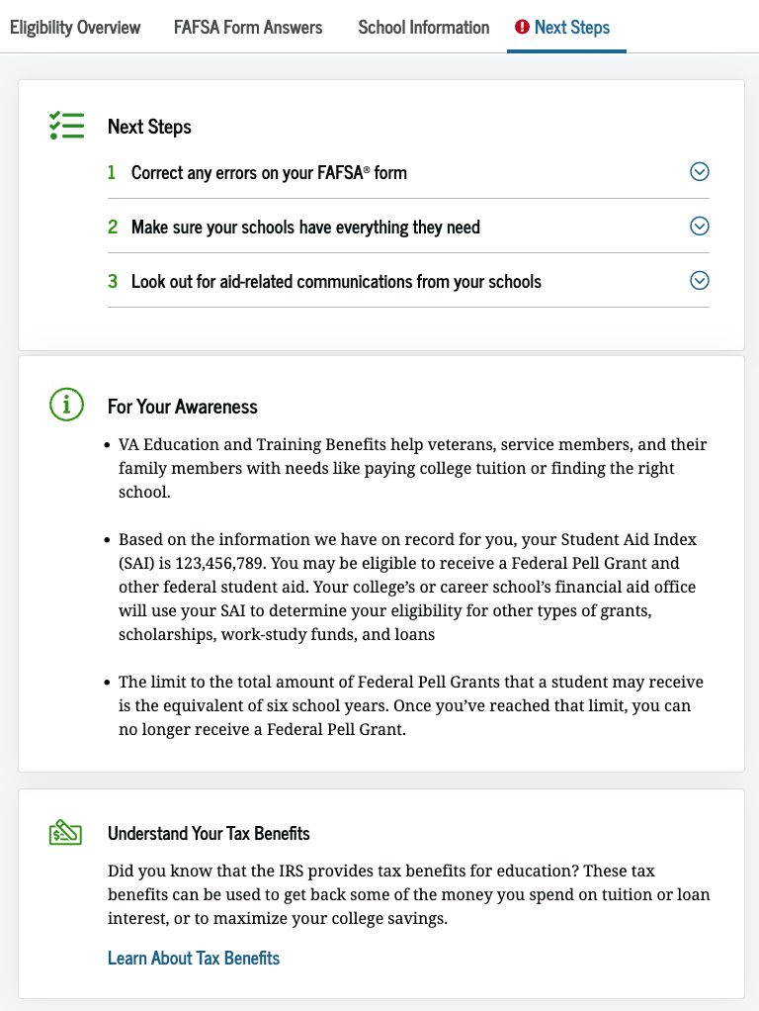
FAFSA Submission Summary (FSS)
Next Steps
  Provides steps on making corrections & communication with schools
  Gives more detail of student SAI
  Dives into Federal Aid the student potentially could qualify for

Slide 9
Verification
Comment on FAFSA Submission Summary (FSS)
Selection determined by:
  Federal government algorithm
  College/university
Typical verification items:
  2024 taxes
  Family size
  Untaxed income
Your FAFSA has been selected for a review process called verification. Your school has the authority to request copies of certain financial documents from you and your parent(s).

Slide 10
Special Circumstances
Changes to your situation not represented on the FAFSA may include:
  Change in employment or income status
  Medical expenses not covered by insurance
  Change in parent marital status
  Unusual dependent care expenses
  Student unable to obtain parent information
If a special circumstance occurs, contact the college’s Financial Aid Office

Slide 11
Indiana State Grant Portal

Slide 12
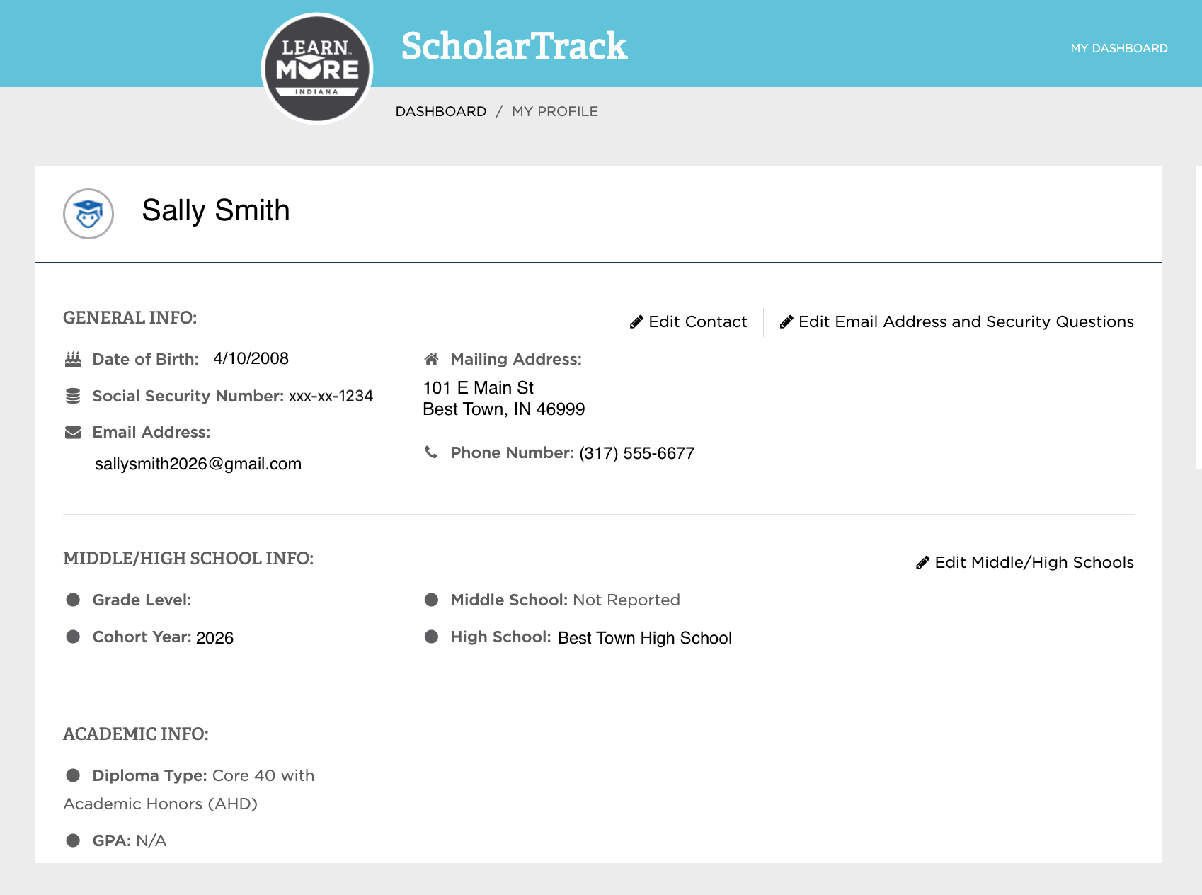

ScholarTrack Dashboard
Overview tab
  Student contact info
  High school info
  Opportunity to submit state grant appeals
Scholar success program tab
  Progress on 21st Century Scholars required tasks
ScholarTrack.in.gov

Slide 13
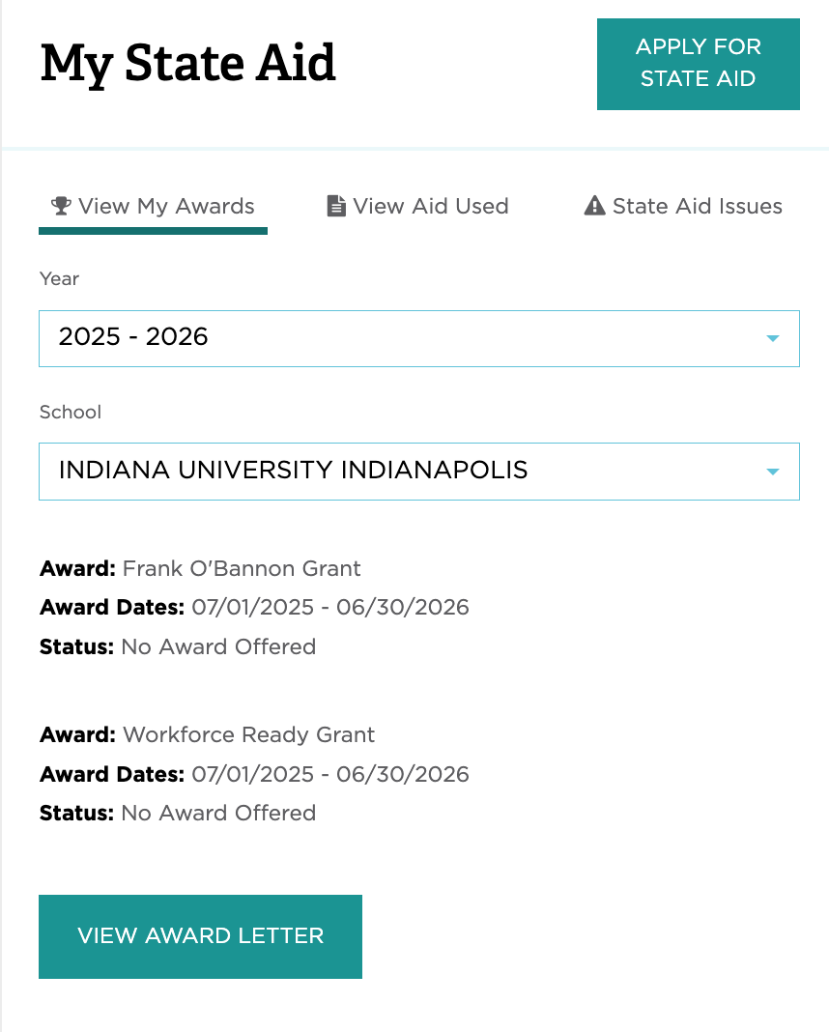
ScholarTrack Dashboard
State aid tab
  Shows state grant offers based on
    Specific college/university
    Award year

Slide 14
Financial Aid Offer

Slide 15



Financial Aid Offer
Each college provides a financial aid offer outlining
  Cost of attendance
  Financial aid amounts (Grants, scholarships, work-study & loans)
  Options to pay remaining balance
  Timing & delivery of offer varies by college
  What you should do
    Review costs and financial aid offers
    Clearly understand your obligations
    Ask questions

Slide 16
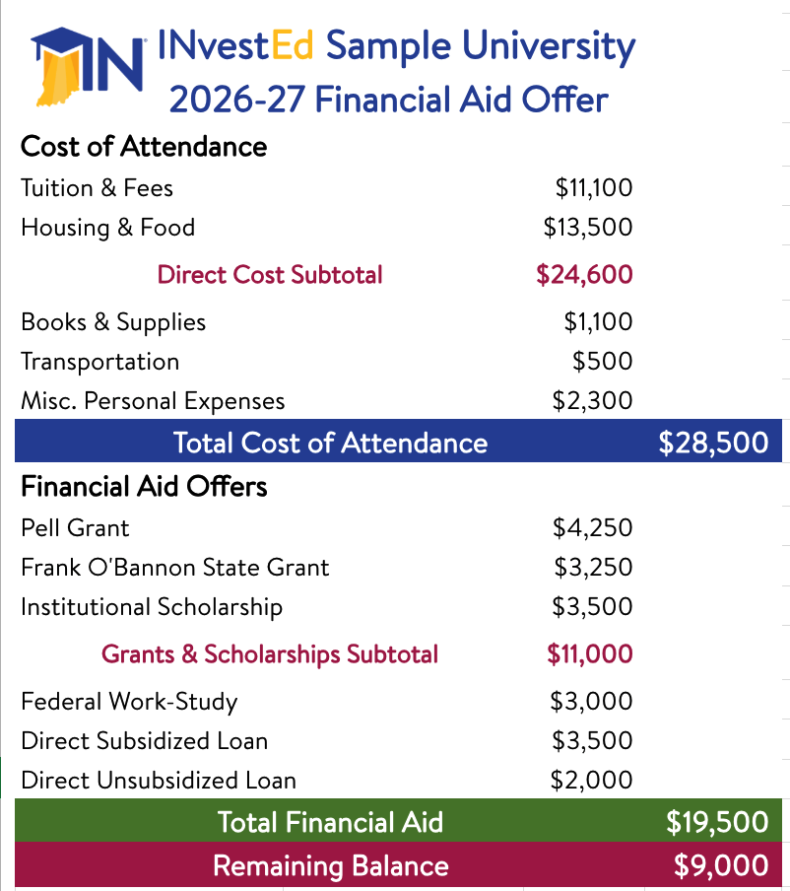
Financial Aid Offer
Typical Sections
Cost
Grants & Scholarships
Work Study
Student Loans
Remaining Balance

Slide 17

Remaining Balance
Options
  Outside scholarships
  Out of pocket/payment plan
  Loans
    Federal PLUS (Parent) loan
    Private loan
You can do a combination of options
  Scholarships & out of pocket payments help to minimize student loan debt

Slide 19
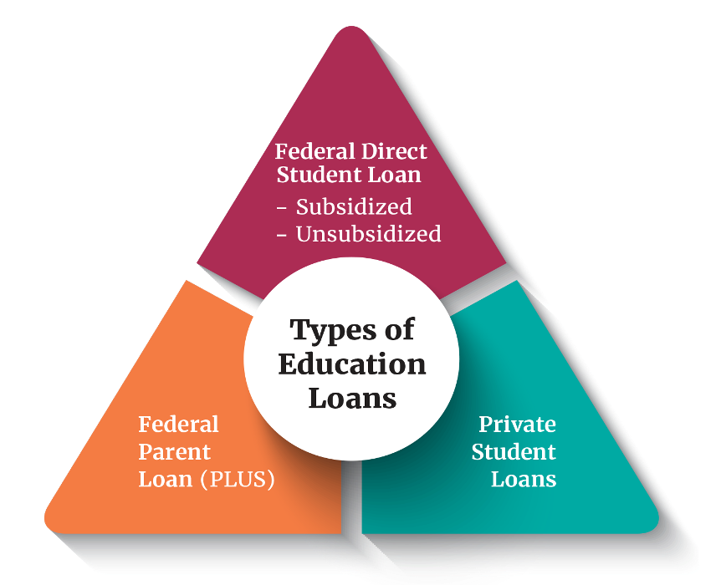
Education Loans
Federal Direct Loans Rate: 6.39% + 1.057% Fee
  Student’s Loans
  Subsidized & Unsubsidized
  Annual Limits
Federal Direct PLUS Loans Rate: 8.94% + 4.228% fee
  Parent’s Loans
  New Limits ($20,000/yr & $65,000/lifetime)
Private Student Loans Rate: Based off credit,
  Student and Cosigner’s Loan often no fees
  Eligibility based on credit score and income

Slide 20
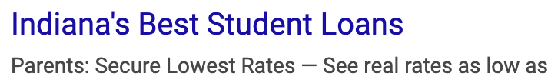

Education Loan - Trends
Online Searches and AI compile results based on many sites including those that offer “Top Picks” or “10 Best…”
Sponsored sites appear first
“As low as” Marketing
  Rates shown in ads emphasize lowest rates,
  but actual rate is often in the double digits
INvestEd Team can help
  Review specifics of loan types
  Discuss options for students/parents
  Answer questions

Slide 21
Comparing Offers

Slide 22
Comparison Basics
Federal Aid is typically the same at each school
  Subsidized & Unsubsidized loan amounts could vary based on:
    School cost
    Other financial aid received
State aid varies based on:
  School classification (Public, Private, Ivy Tech, or Proprietary)
  Program (Frank O’Bannon, 21st Century Scholars, Workforce Ready Grant)
Institutional aid based on each college/university
?
Considering living off-campus?
Check with the financial aid office to review impact on cost & financial aid

Slide 23
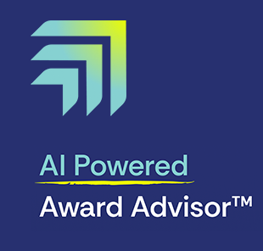
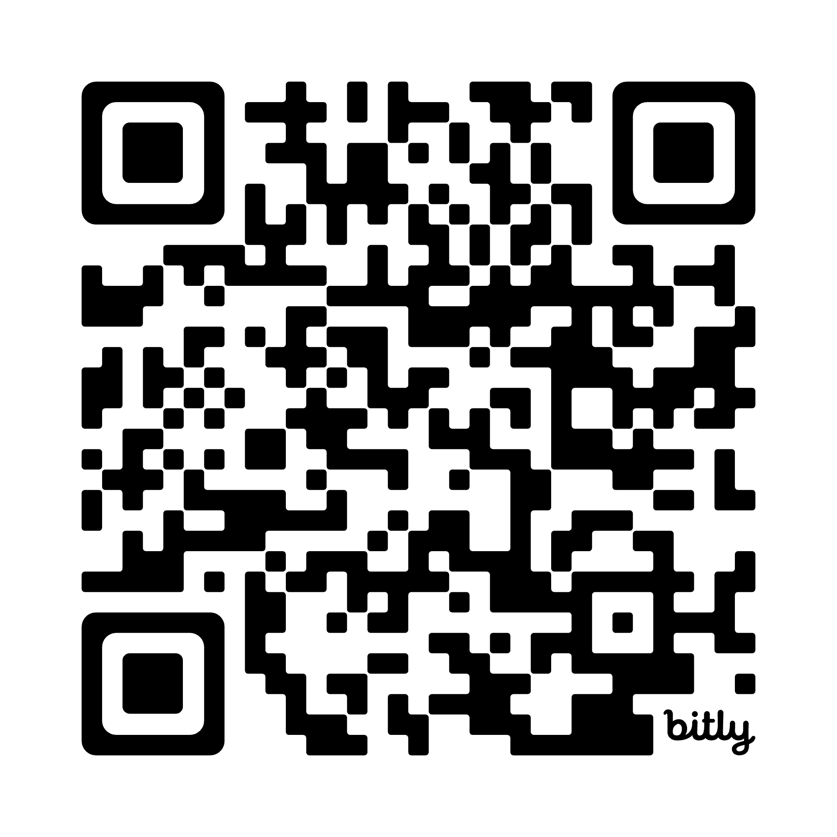
Award Advisor™
Free tool to help students and families understand and compare financial aid offers
Step-by-step process for evaluating college costs
Share standardized award letters and comparison results with family, counselors, or advisors
INvestEdIndiana.org/AwardAdvisor

Slide 24
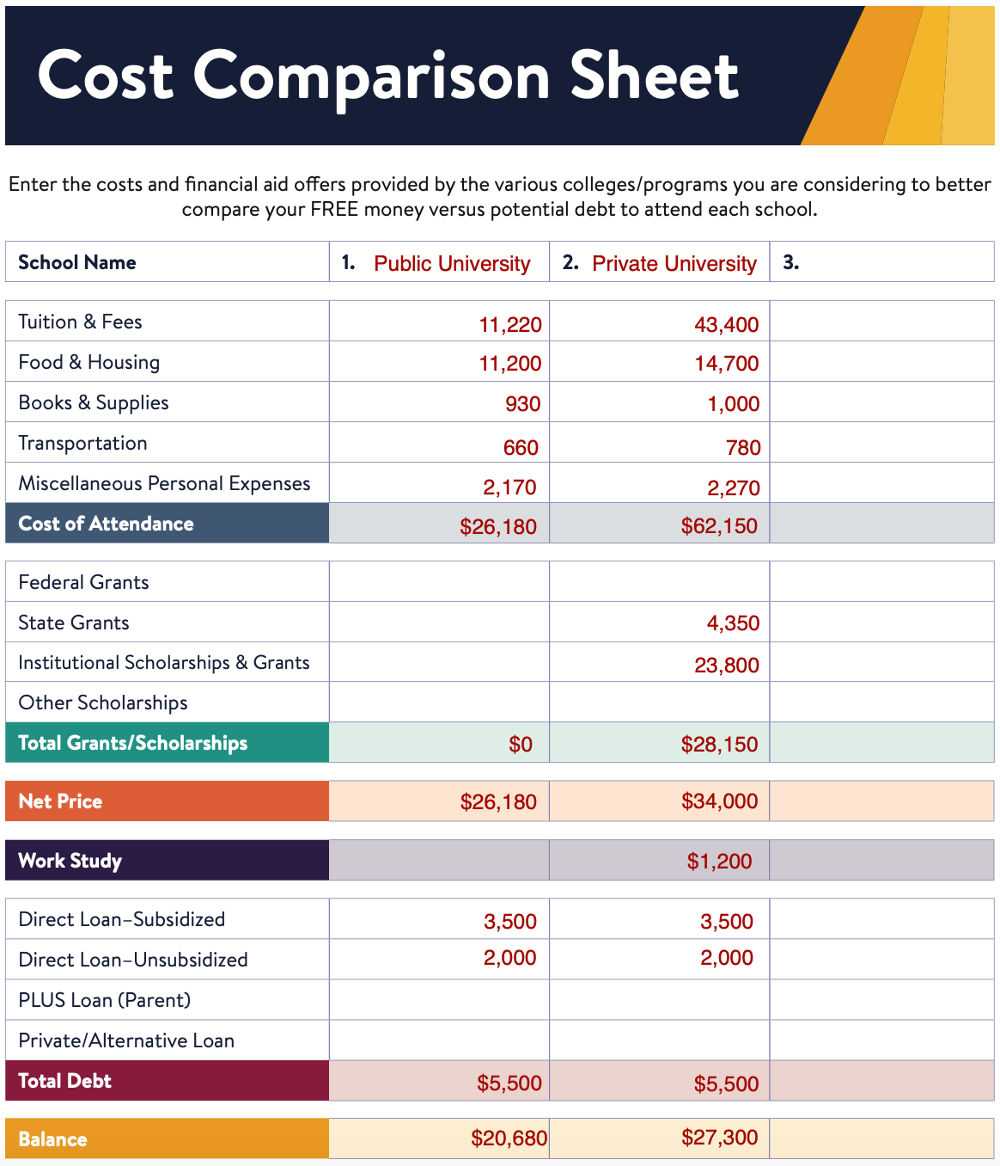
Comparison Worksheet
Benefits of side-by-side comparison
  Clearly identify
    Costs
    FREE money (scholarships/grants)
    Work study/student employment
    Loans (must be repaid)
      Student vs. Parent (PLUS) vs. Private
    Understand remaining balance
  Available on resources tab at INvestEdIndiana.org

Slide 25
Next Steps & Help

Slide 26

Finalize Your Funding Plan
Plan for full year
  Financial aid offers are for the academic year
  Billing is done by term
Confirm how outside scholarships are applied
  Split between the terms or all in one?
If you need to borrow to fill a gap
  Shop to determine best option
  Estimate amount for full year
    You can always reduce before disbursement
    to minimize loan debt

Slide 27

Communication is Key
Financial Aid Office
  Note any action items required to secure awards offered, renewal requirements & deadlines
  Share ALL outside scholarships you receive
  Notify of any changes to your family situation
Other Offices
  Housing forms & deposits
  Payment deadline for first term
  Freshman registration & orientation
  Work study process

Slide 28
We’ll Help!

Slide 29
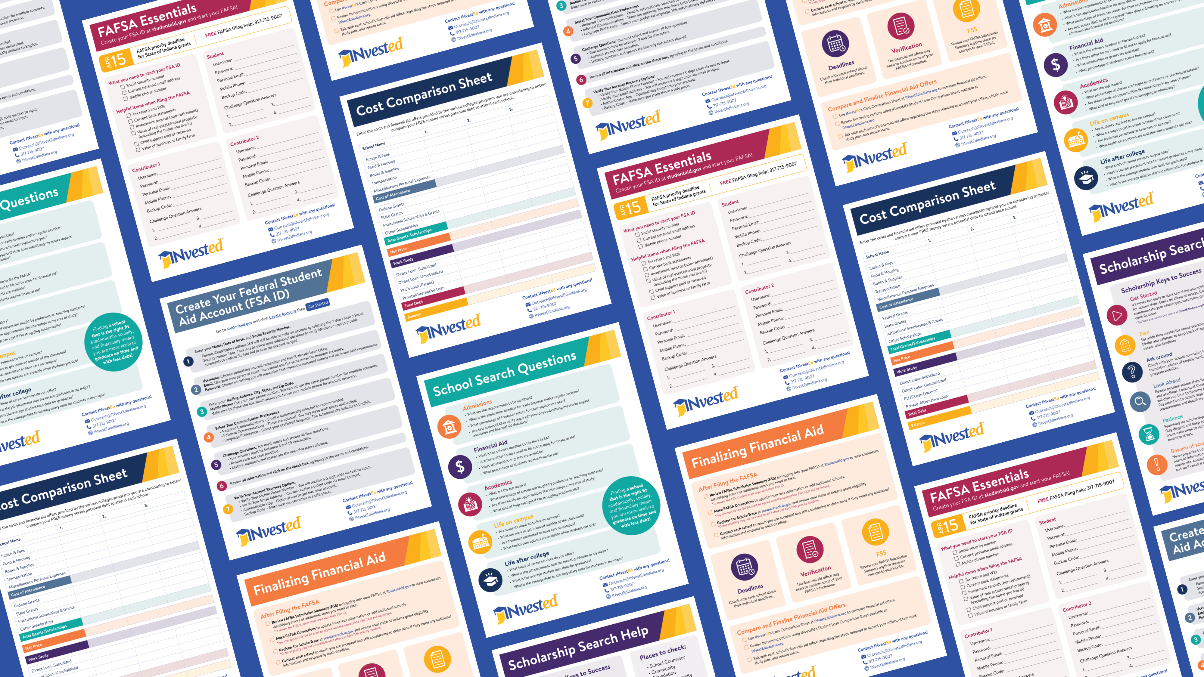
FREE Resources at:
INvestEdIndiana.org

Slide 30








Stay Connected With Us!
317.715.9007
Outreach@INvestEdIndiana.org
www.investedindiana.org
Follow @INvestEDIndiana
Join our mailing list:
InvestEdIndiana.org/mailing-list

