Slide 1


Navigating the Financial Aid Process
INvestEdIndiana.org

Slide 2


We’ll Discuss…
Types of Aid
First Steps & Info.
FAFSA Overview
After You Submit
We’ll Help

Slide 3
Types of Aid

Slide 4
Grants
Federal
Pell Grant - Max $7,395
Supplemental Educational Opportunity Grant (SEOG) - $100-$4,000
TEACH Grant - $3,772
State of Indiana
21st Century Scholars
Frank O’Bannon Grant Programs
William A. Crawford Minority Teacher Scholarship
Workforce Ready Grant
Visit INvestEdIndana.org/Grants

Slide 5
Credit Completion
On -Time
Full - Time
30
Credits
24
Credits
15 Credits – Fall
15 Credits – Spring
12 Credits – Fall
12 Credits – Spring
60
Credits
48
Credits
12 Credits – Fall
12 Credits – Spring
15 Credits – Fall
15 Credits – Spring
90
Credits
72
Credits
15 Credits – Fall
15 Credits – Spring
12 Credits – Fall
12 Credits – Spring
120
Credits
96
Credits
15 Credits – Fall
15 Credits – Spring
12 Credits – Fall
12 Credits – Spring
120
Credits
On-Time vs. Full-Time:
Complete 30 credit hours per year to maintain maximum grant eligibility
12 Credits – Fall
12 Credits – Spring

Slide 6
Scholarships
Need Based vs. Merit Based
Where to look for scholarships
Visit INvestEdIndiana.org/Scholarships for more information
FREE National Search Sites
College/University
Local/Community
School Counselor
Community Foundation
Business & Employer
Church & Civic Organizations

Slide 8

Student Employment
Benefits
Earn money to pay for college & minimize student loans
Job & interview experience
Build time management skills
Options
Federal Work-Study
Part-Time Employment
Internships

Slide 9
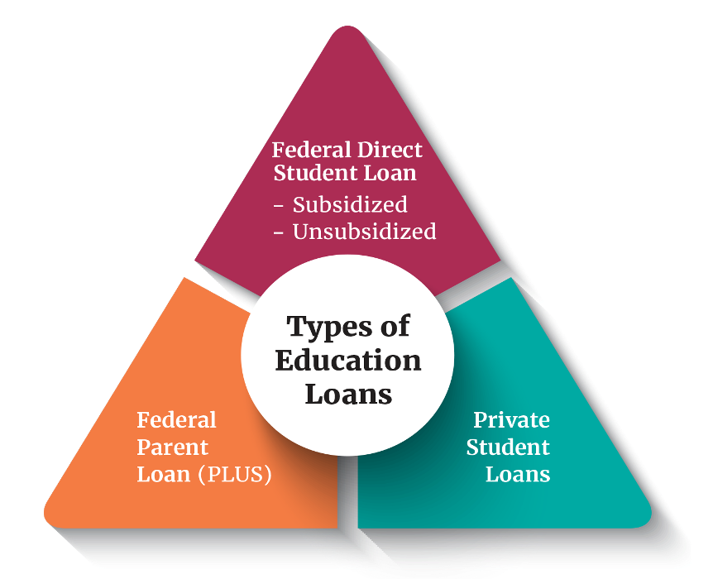
Education Loans
Federal Direct Loans
Rate: 6.39% + 1.057% Fee
Student’s Loans
Subsidized & Unsubsidized
Annual Limits
Federal Direct PLUS Loans
Rate: 8.94% + 4.228% fee
Parent’s Loans
Eligibility impacted by adverse credit
Private Student Loans
Rate: Based off credit, often no fees
Student and Cosigner’s Loan
Eligibility based on credit score and income

Slide 10


Education Loan - Trends
Online Searches and AI compile results based on many sites including those that offer “Top Picks” or “10 Best…”
Sponsored sites appear first
“As low as” Marketing
Rates shown in ads emphasize lowest rates, but actual rate is often in the double digits
INvestEd Team can help
Review specifics of loan types
Discuss options for students/parents
Answer questions

Slide 11
First Steps & Info.

Slide 12
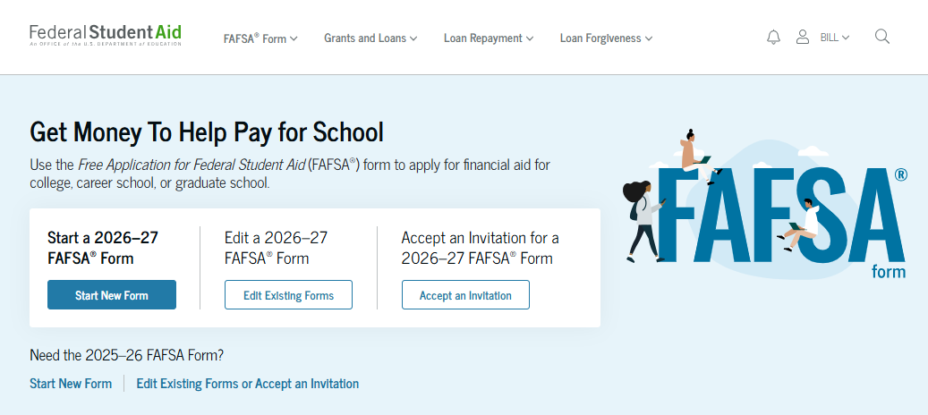
FAFSA
Free Application for Federal Student Aid
Annual Application for most types of financial aid
Basis for determining:
Federal Funds
Grants
Work-study
Loans
State of Indiana Grants
Some Institutional funds
Calculates Student Aid Index
Visit studentaid.gov

Slide 13
Student Aid Index
SAI
Parent(s) Assets
Parent(s) Income
Student Income
Student Assets
FAFSA Calculation
Based on income and assets
Used by the college to calculate your financial aid offer
Visit INvestEdIndiana.org/FAFSA

Slide 14
StudentAid.gov Account
User account unique to each person
Student
Use to login to FAFSA & sign electronically
Contributors (parent, parent’s spouse, student’s spouse)
Use to accept invitation and sign in electronically
Student & Contributors can NOT use the same email or phone number (used for two-step verification)
Need help creating your StudentAid.gov Account?
Visit INvestEdIndiana.org/FAFSA

Slide 15
FAFSA Overview

Slide 16
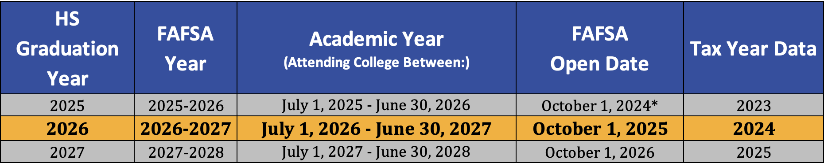
The FAFSA
Found at StudentAid.gov
• Opens on October 1st each year • Uses completed tax data (prior/prior)
Know deadline:
State of Indiana Priority Deadline – April 15th
Colleges – Ask individual colleges
APRIL
15th

Slide 17
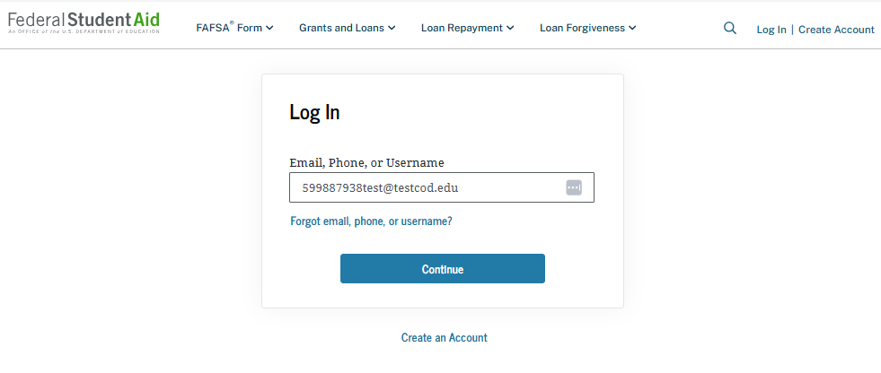
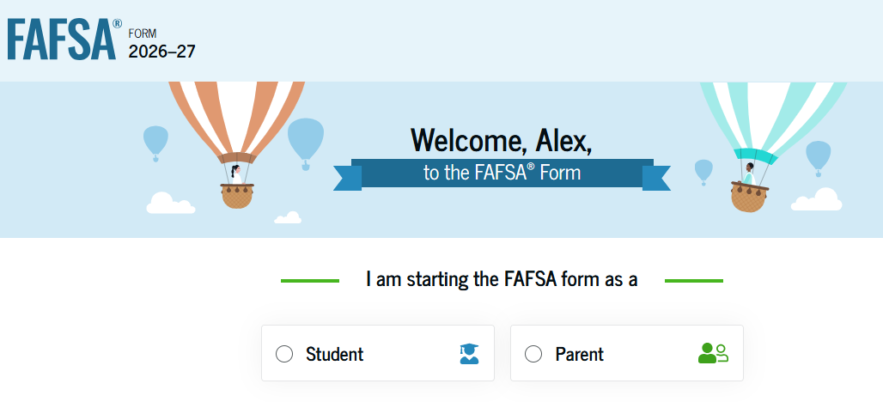
Start the FAFSA
StudentAid.gov
Login - Using your StudentAid.gov Account
Select Role
Student
Contributor (Parent)
FAFSA Onboarding

Slide 18
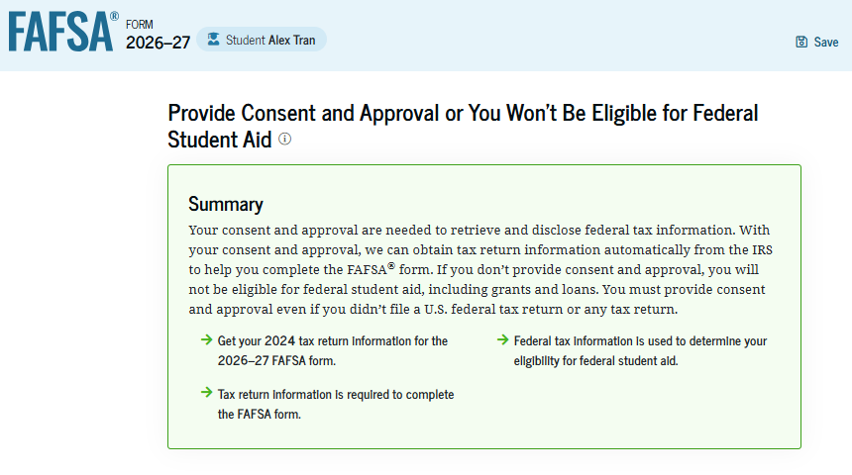
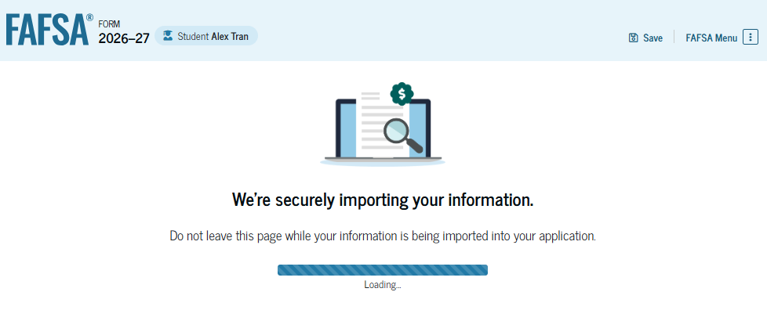
Confirmation and Consent
Confirmation Info.
Check Identity Info (SSN, Address, etc)
Provide Consent
Providing consent from both student and parent contributor(s) is required to receive aid
Consent allows the FAFSA to automatically import IRS tax data
After Consent
IRS Data is automatically imported into your FAFSA

Slide 19
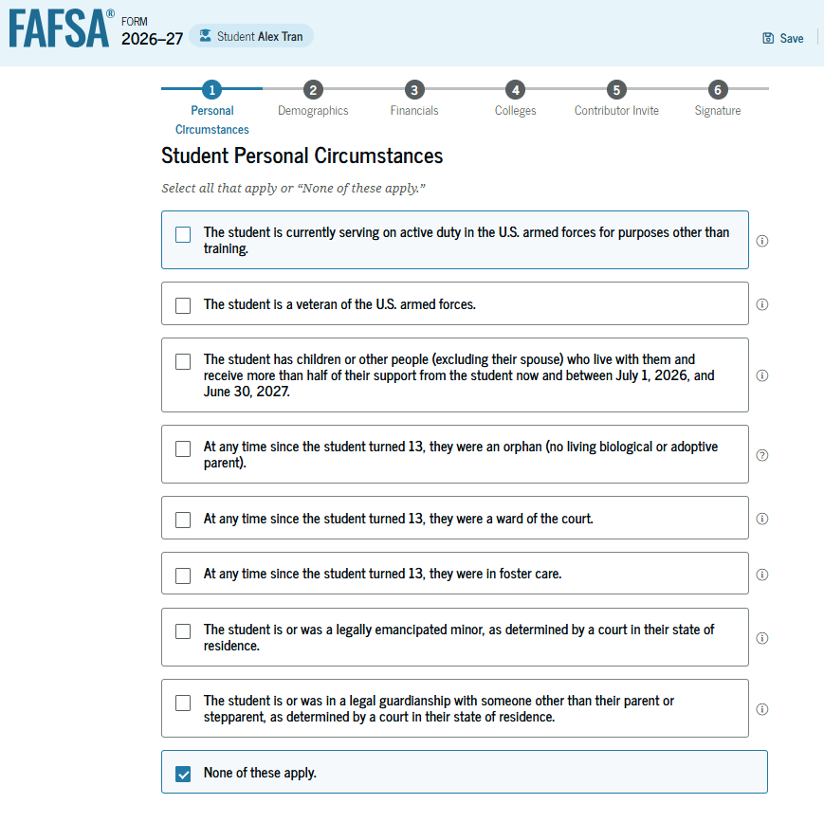
Student Personal Circumstances
Marital Status
For the Student
College Plans
Year in college for 2026 - 2027
Dependency Determination
Born before January 1st, 2003
Graduate/Professional student
Student marital status
At risk of being homeless
Additional situations

Slide 20
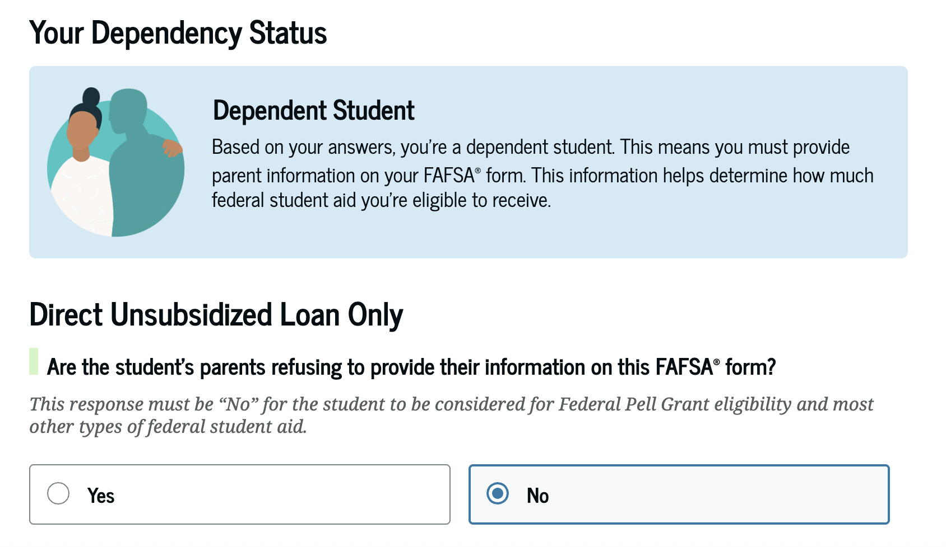
Student Dependency Status
FAFSA determines eligibility for a variety of aid types, which includes federal loans
Answering ”Yes” here means a student could miss out on other aid

Slide 21
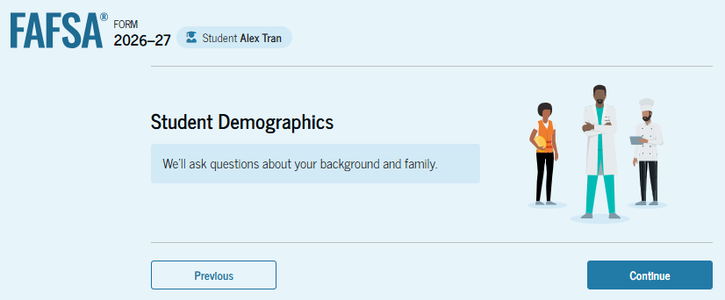
Student Demographic Information
Sex, Race, & Ethnicity
Citizenship
Parent’s education
Student’s high school information

Slide 22
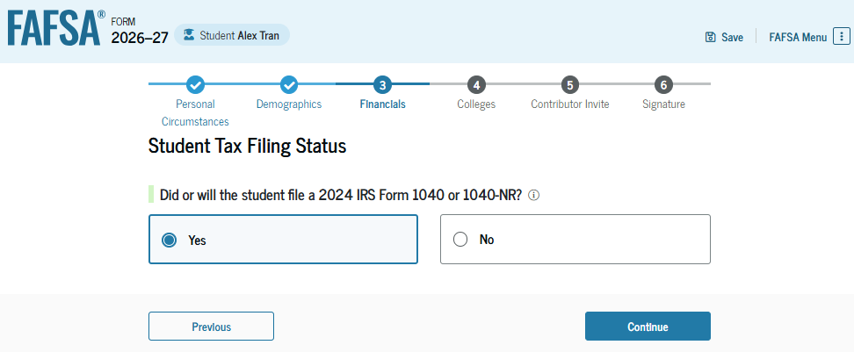
Student Financials
All questions answered through the Direct Data Exchange (DDX) are not shown
Only questions that need manual entry will appear

Slide 23
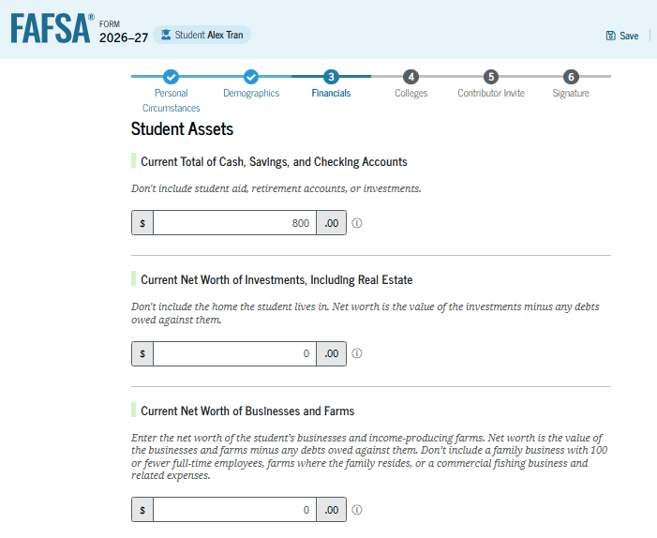
Student Asset Information
Assets DO NOT include:
The home you live in
Qualified retirement plans
Value of life insurance
Businesses with less than 100 full-time equivalent employees
Assets DO include:
Cash, savings, and checking accounts
Real estate
Stocks, Bonds, and other investments
529 College Savings Plans
Education savings plans are counted as an asset of the account owner ONLY if the account is designated for the student whose FAFSA is being completed

Slide 24
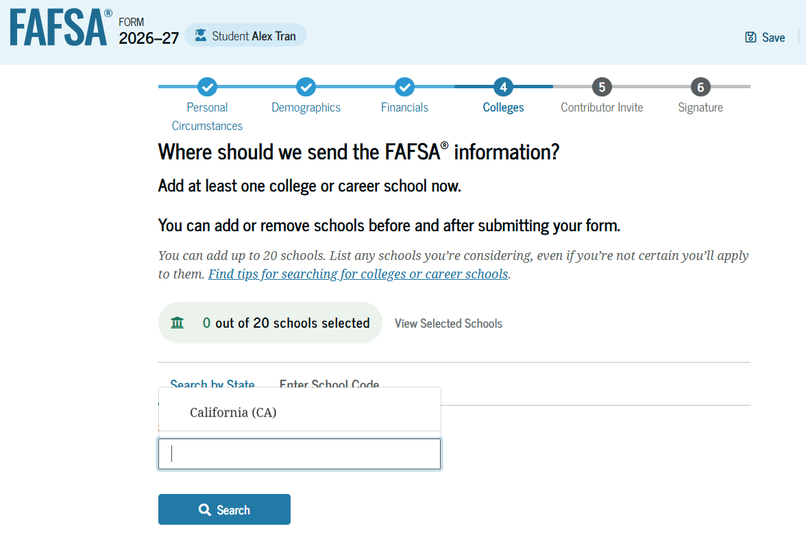
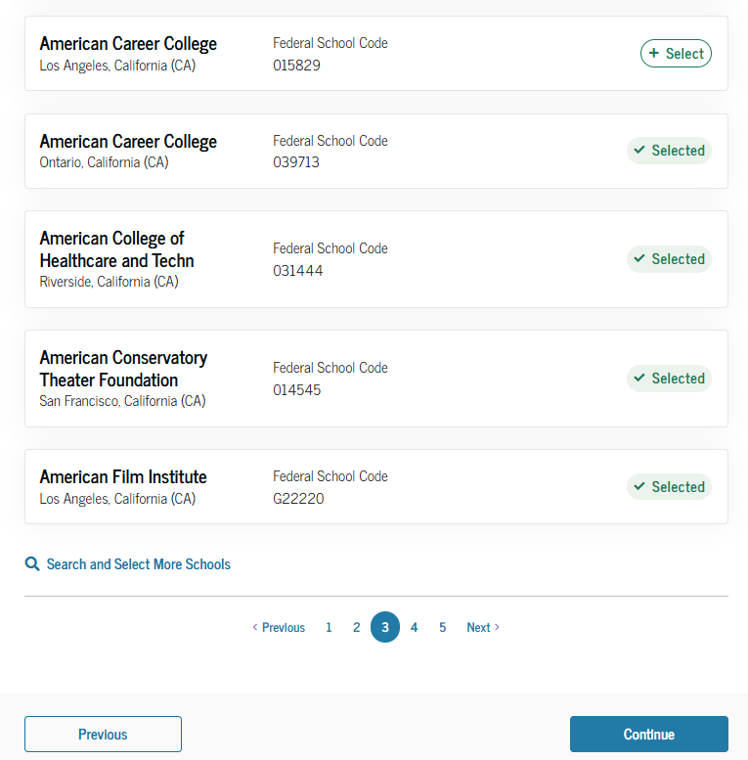
School Selection
Select colleges you want to receive your FAFSA info.
List up to 20 colleges
Encouraged to list at least one college in Indiana
Can always add / update schools

Slide 25
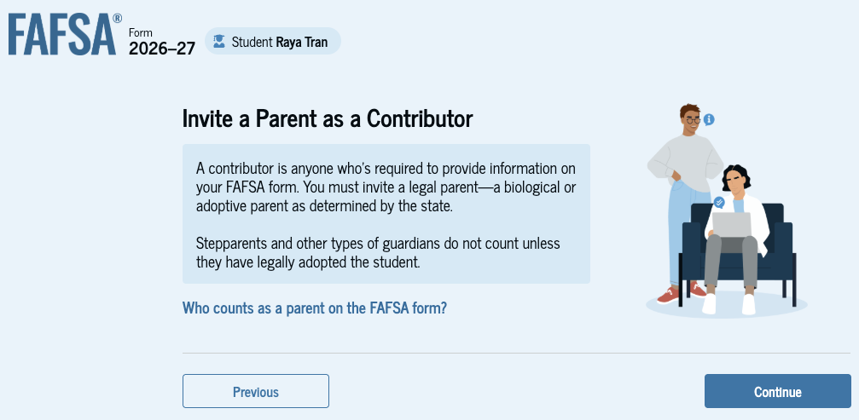
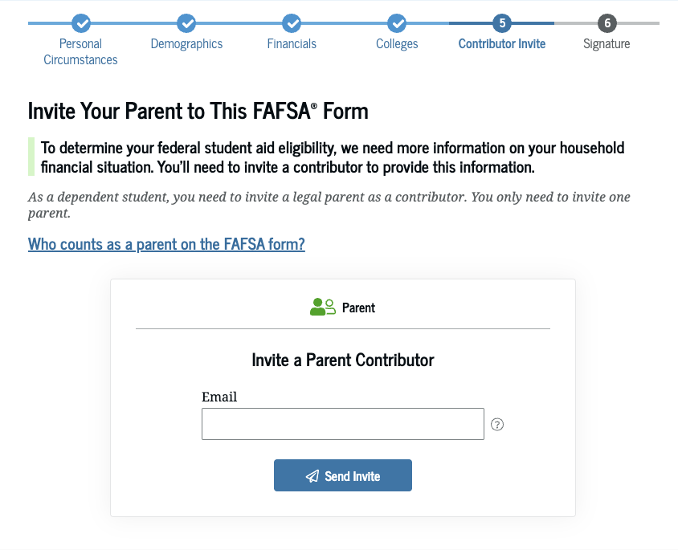
Inviting Contributors

Slide 26
Who is the Parent
Biological or adoptive parents
Married or unmarried & living together
Divorced, separated or unmarried & not living together
Widowed &
not remarried
Who provided more financial support the last 12 months?
If equal, which parent has the greater income & assets the last 12 months?
Both parents listed on the FAFSA
If parent single, then only person listed on the FAFSA
If parent remarried, then parent & step-parent listed on the FAFSA
Single parent listed on the FAFSA

Slide 27
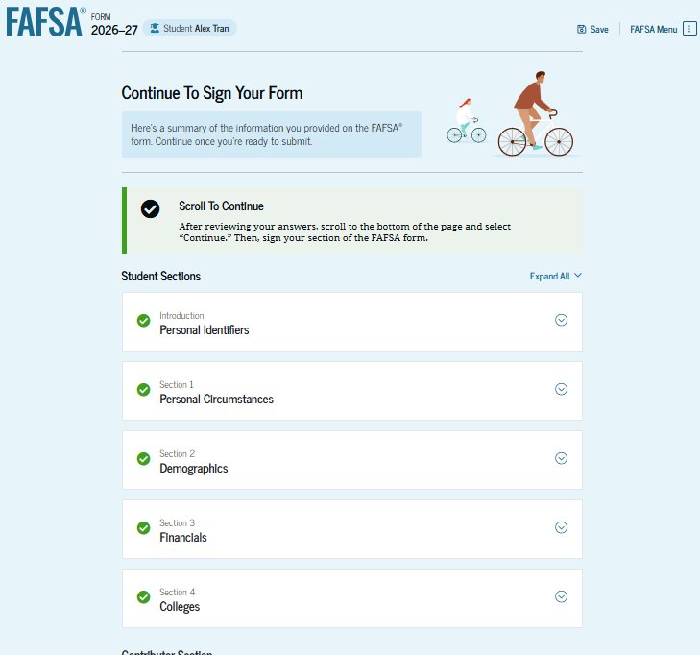
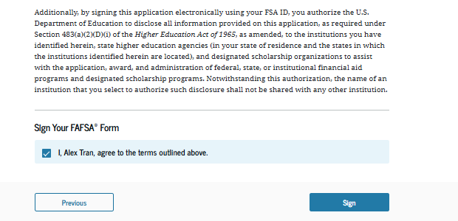
Review, Sign, & Submit
Student reviews all entered information
Student agrees and signs their part of the FAFSA

Slide 28
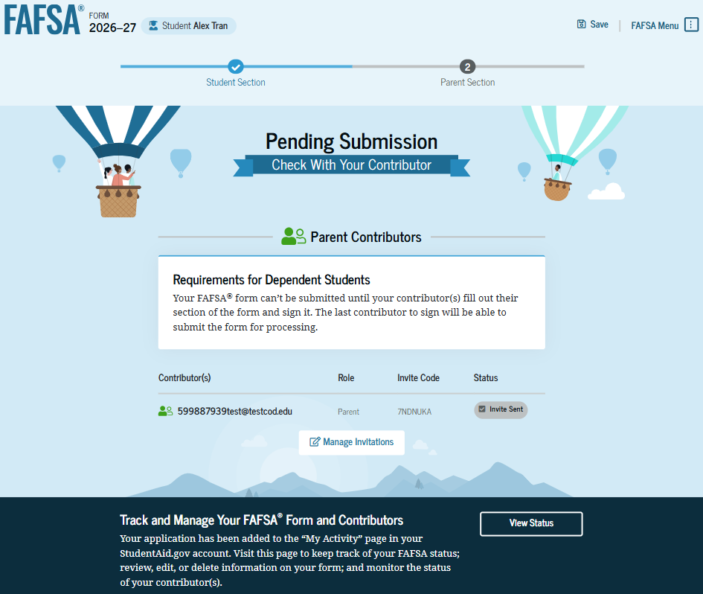
Student Section Complete
Note: The FAFSA is not submitted until the contributor(s) complete and sign their sections of the form.

Slide 29
Parent Info.

Slide 30
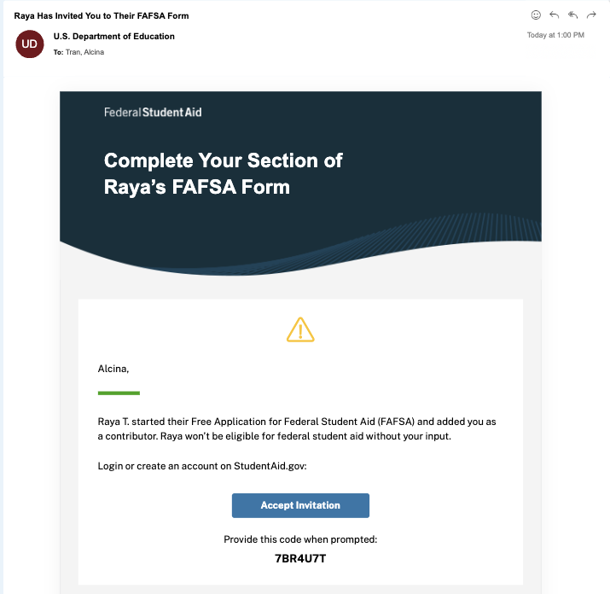
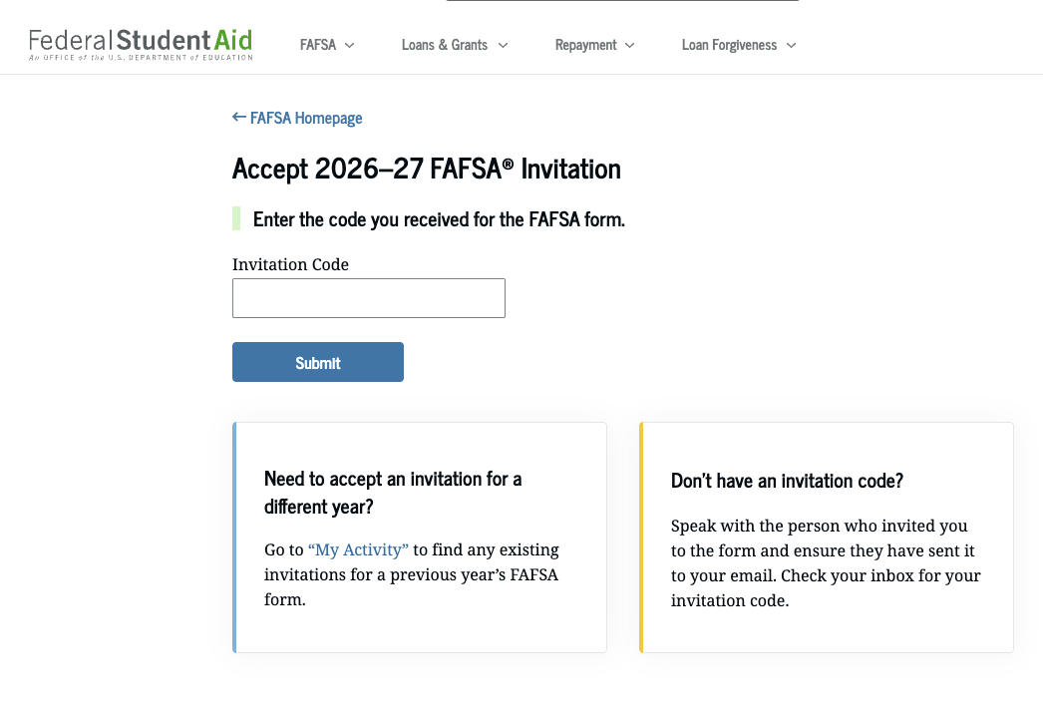
Contributor / Parent Info.
Invitation Email
Log in / Accept invitation

Slide 31
Confirmation and Consent
Confirmation Info.
Check Identity Info (SSN, Address, etc)
Provide Consent
Providing consent from both student and parent contributor(s) is required to receive aid
Consent allows the FAFSA to automatically import IRS tax data
After Consent
IRS Data is automatically imported into your FAFSA

Slide 32
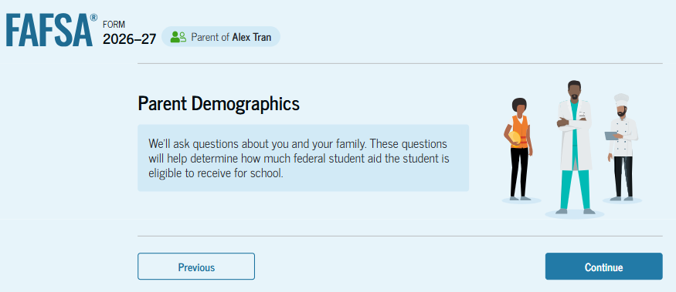
Parent Demographic Information
Marital Status
State of Residence

Slide 33
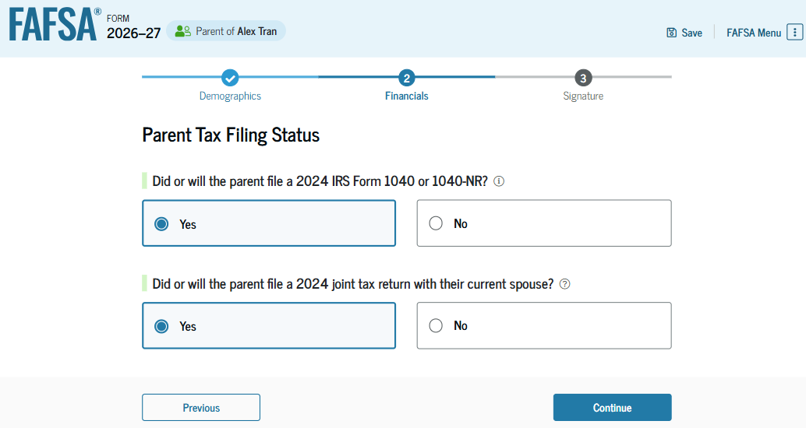
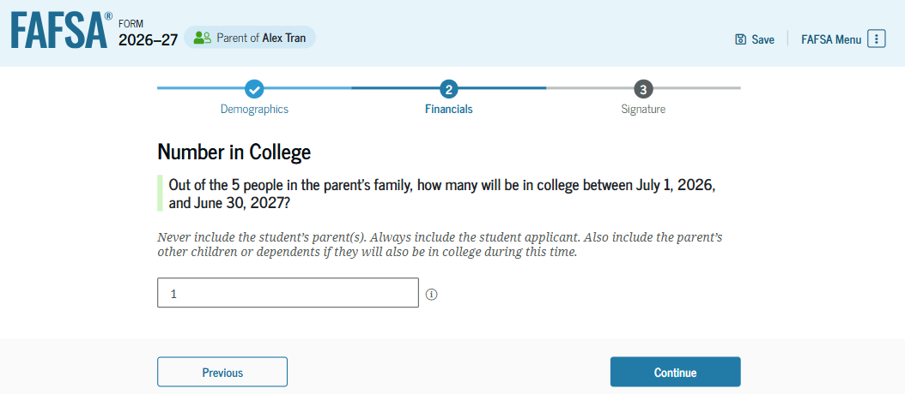
Parent Financials
Federal Benefits Received
Tax Filing Status
Determines if one or both contributors need an StudentAid.gov Account to sign and submit
Family Size
Could need adjusting if different from 2024 tax forms
Number in College

Slide 34
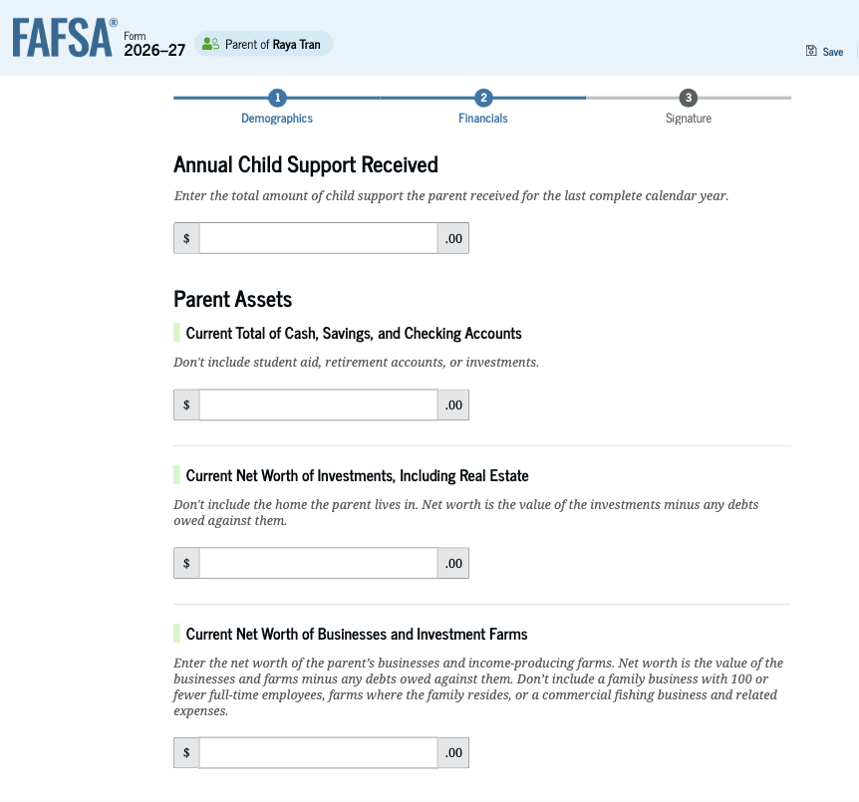
Parent Asset Information
Assets do NOT include:
The home you live in
Qualified retirement plans
Businesses with less than 100 full-time equivalent employees
Assets DO include:
Cash, savings, and checking accounts
Real estate
Stocks, Bonds, and other investments
529 College Savings Plans
Education savings plans are counted as an asset of the account owner ONLY if the account is designated for the student whose FAFSA is being completed

Slide 35
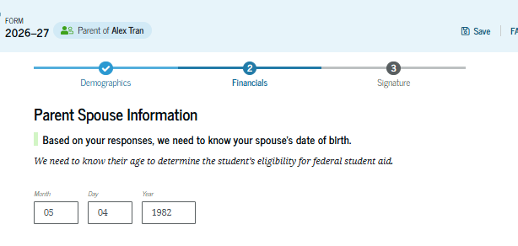
Other Parent Info
Refers to the spouse of the parent contributor
Includes married stepparent
Information needed
Date of Birth
Only needed for joint tax filers
- OR –
Email address
To send invite

Slide 36
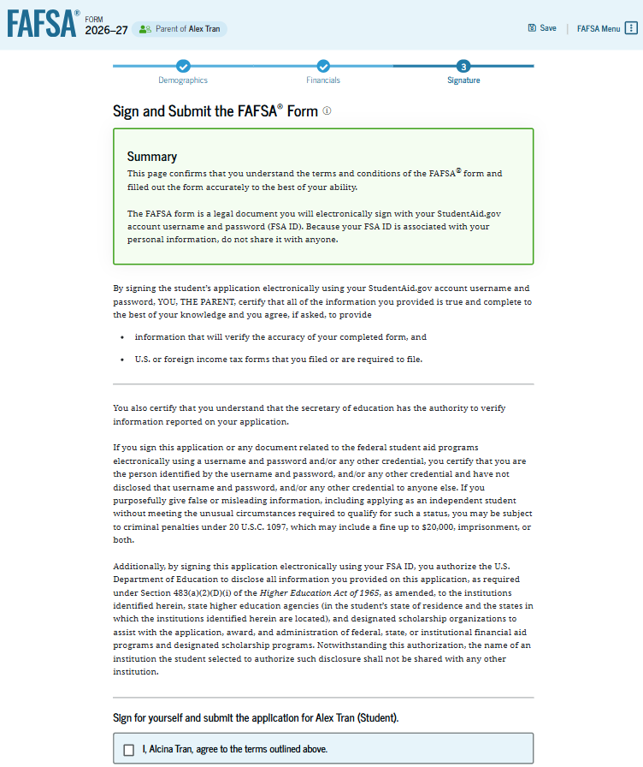
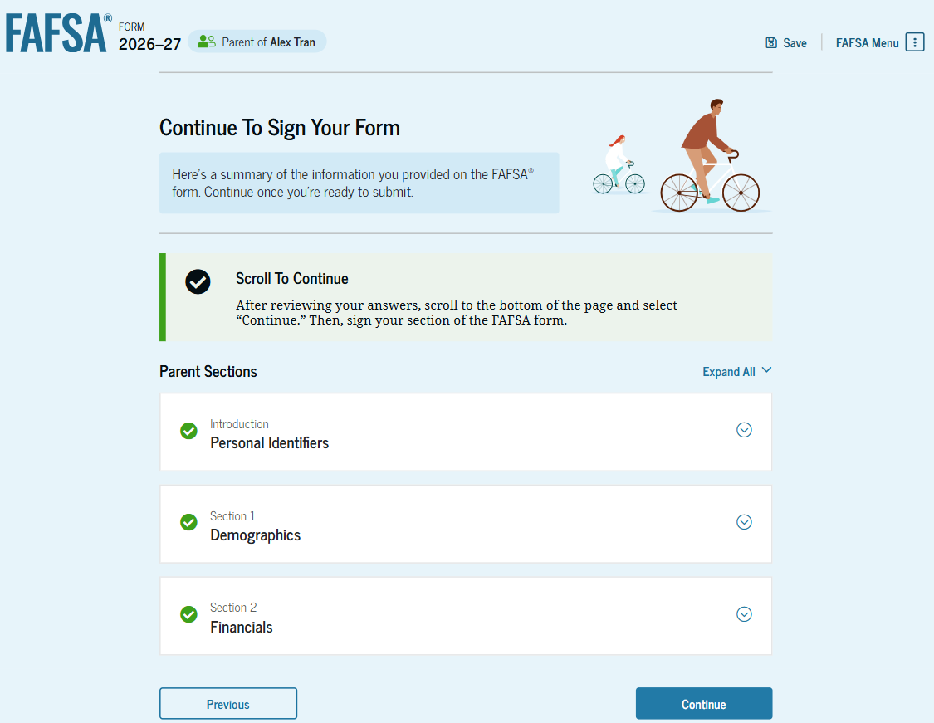
Review, Sign, and Submit
Review all entered information
Contributor agrees, signs and submits the FAFSA

Slide 37
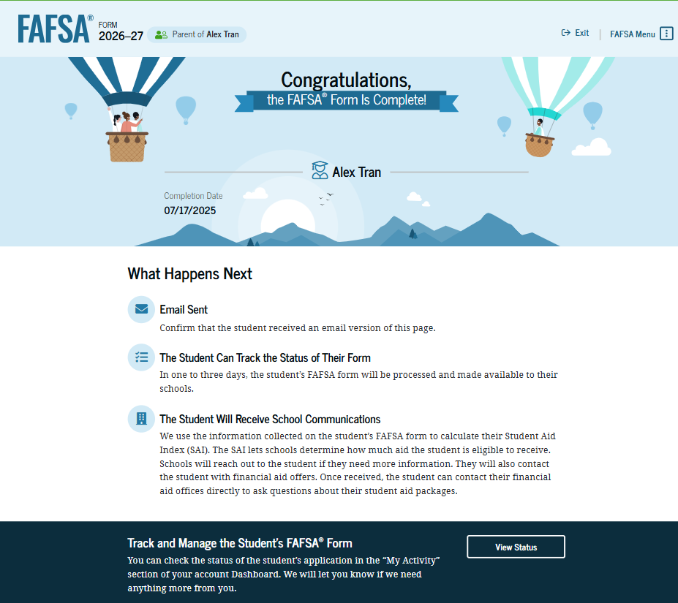
Congratulations!

Slide 38
After You Submit

Slide 39
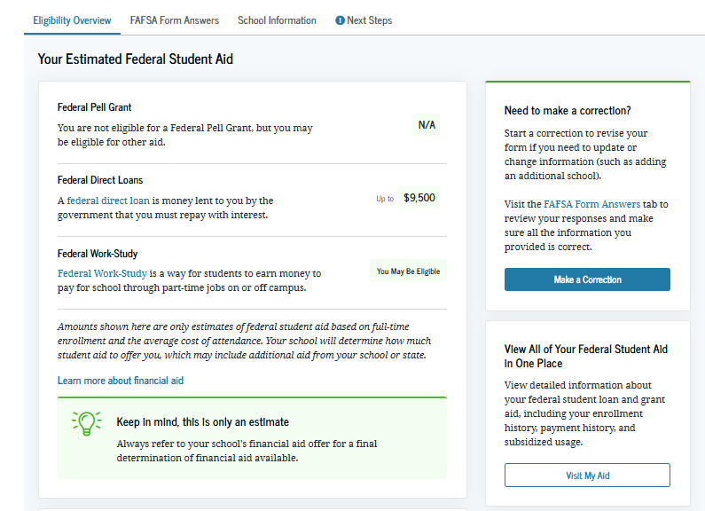
FAFSA Submission Summary
Eligibility Overview
Includes Student Aid Index (SAI)
FAFSA Form Answers
Next Steps
Correct any errors
Update school info
Make sure school has needed documents
Dependency paperwork (if needed)
Additional financial aid forms
All other aid determined by the college’s Financial Aid Office

Slide 40
Special Circumstances
Changes to your situation not represented on the FAFSA may include:
Change in employment or income status
Medical expenses not covered by insurance
Change in parent marital status
Unusual dependent care expenses
Student unable to obtain parent information
If a special circumstance occurs, contact the college’s Financial Aid Office

Slide 41
Financial Aid Offer
Each college provides a financial aid offer outlining:
Cost of attendance
Financial aid amounts (grants, scholarships, work-study, and loans)
Options to pay remaining balance
Timing and delivery of offer varies by college
What you should do:
Review costs and financial aid offers
Clearly understand your obligations
Ask questions

Slide 42
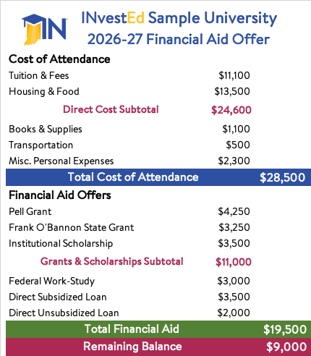
Sample Financial Aid Offer
Typical Sections
Cost
Grants and Scholarships
Work-study
Student Loans
Remaining Balance
Outside Scholarships
Out of Pocket
Payment Plan
PLUS (Parent) Loan
Private Loan

Slide 43
We’ll Help

Slide 44
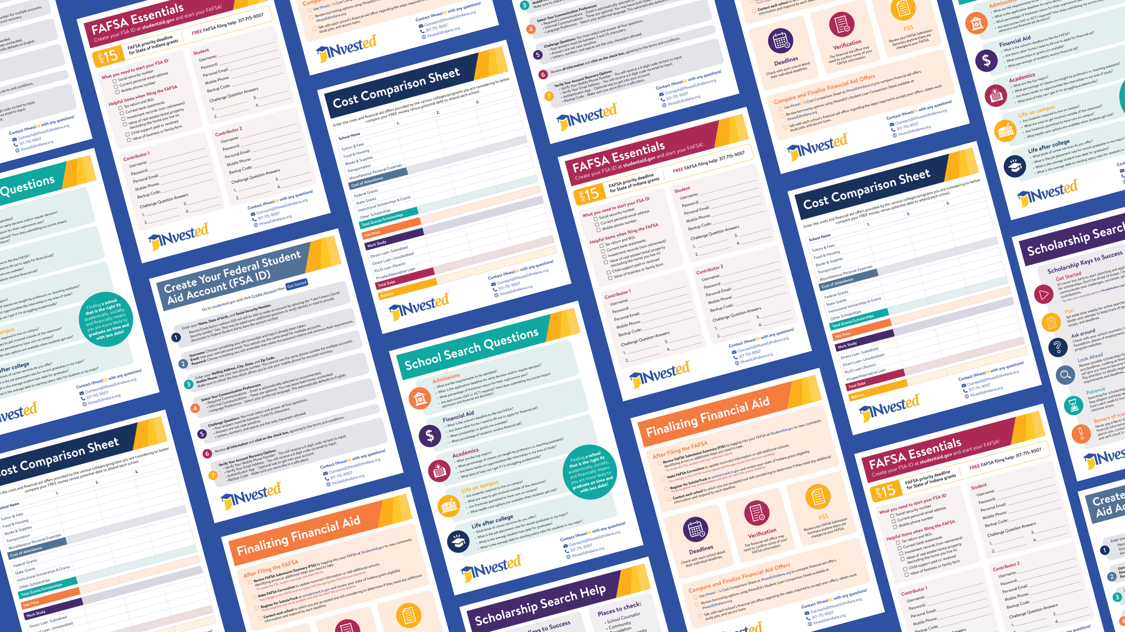
FREE Resources at:
INvestEdIndiana.org

Slide 45

The INvestEd College Planning Toolbox
College Planning Toolbox
Free resource to track college planning information for family or individual student
Tools to help:
Financial Center to track savings & costs
Calendar to set reminders
Scholarship Search Engine
INvestEdIndiana.org
Under “Resources”

Slide 46

College Goal Sunday
Free FAFSA help from financial aid professionals
Sunday, November 9th, 2025 2:00pm – 4:00pm Local Time
For more information visit:
CollegeGoalSunday.org

Slide 47








Stay Connected With Us!
317.715.9007
Outreach@INvestEdIndiana.org
www.investedindiana.org
Follow @INvestEDIndiana
Join our mailing list:
InvestEdIndiana.org/mailing-list

