Slide 1
Data Update & Breaking News

Slide 2

Topics of Discussion
From the Headlines
A Trip Down Workshop Memory Lane
Student Loan Repayment As of Today
COA and Net Price Trends

Slide 3
From the Headlines

Slide 4
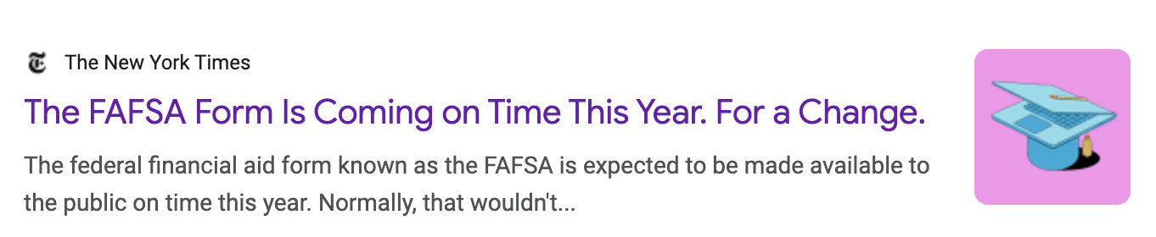
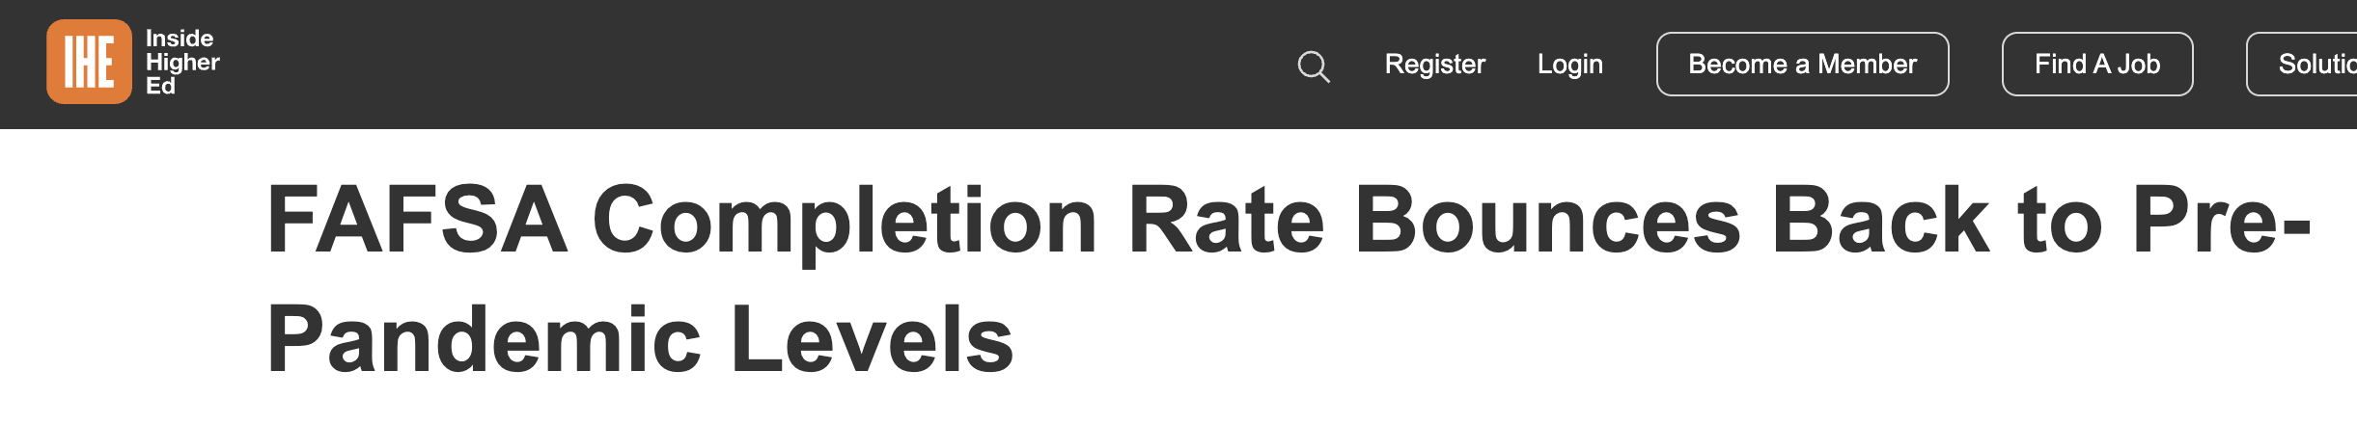
In the news…

Slide 5
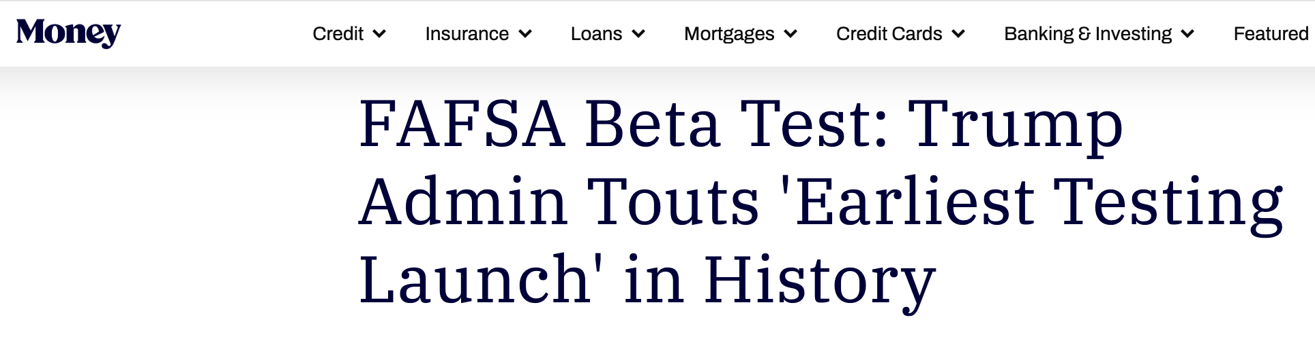
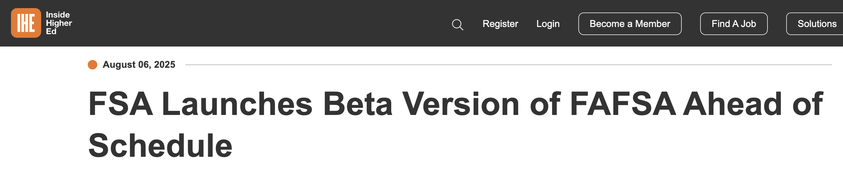
In the news…

Slide 6

College Goal Sunday
Free FAFSA help from financial aid professionals:
Sunday, November 9th, 2025
2:00pm (Local Time)
^{For more information:}
^{CollegeGoalSunday.org}

Slide 7
A Trip Down Workshop Memory Lane

Slide 8

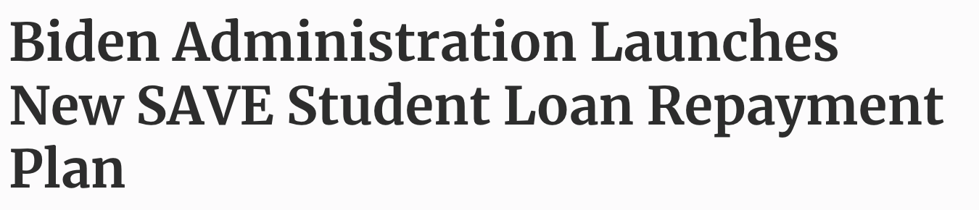
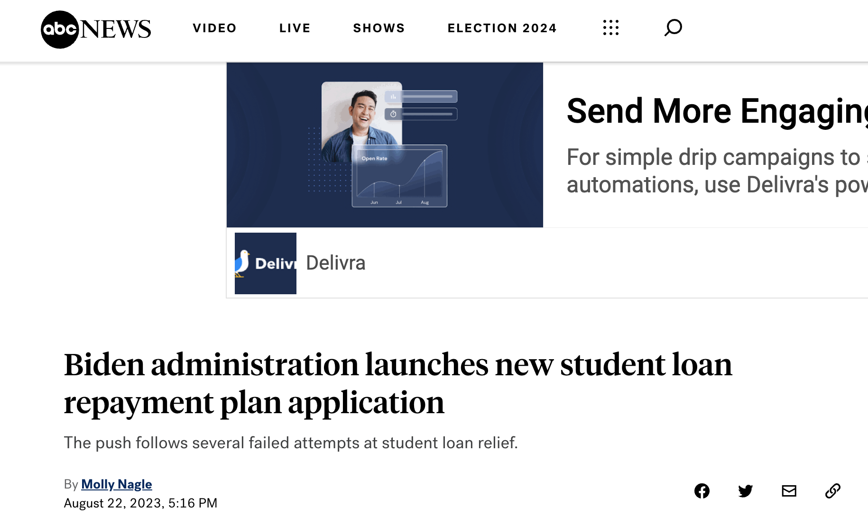

Slide 9
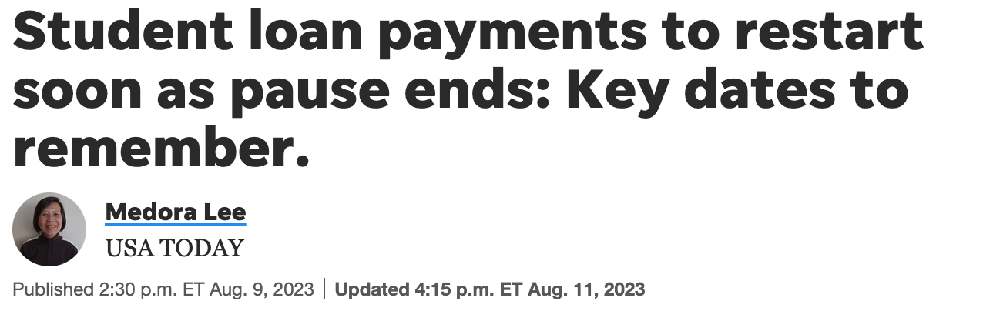

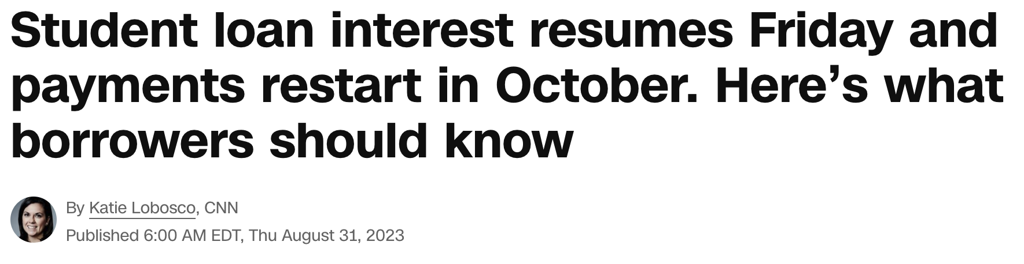


Slide 10
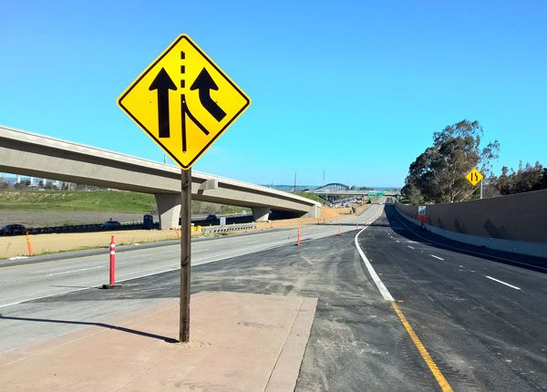
Student Loan Payments Resume
12-month “On-ramp” October 1, 2023 – September 30, 2024
Missed monthly payments during this period are not:
considered delinquent
reported to credit bureau
placed in default
referred to collections
Interest will accumulate
No progress toward loan forgiveness under IDR or Public Service Loan Forgiveness (PSLF)
Safety net

Slide 11
Student Loan Repayment As of Today

Slide 12
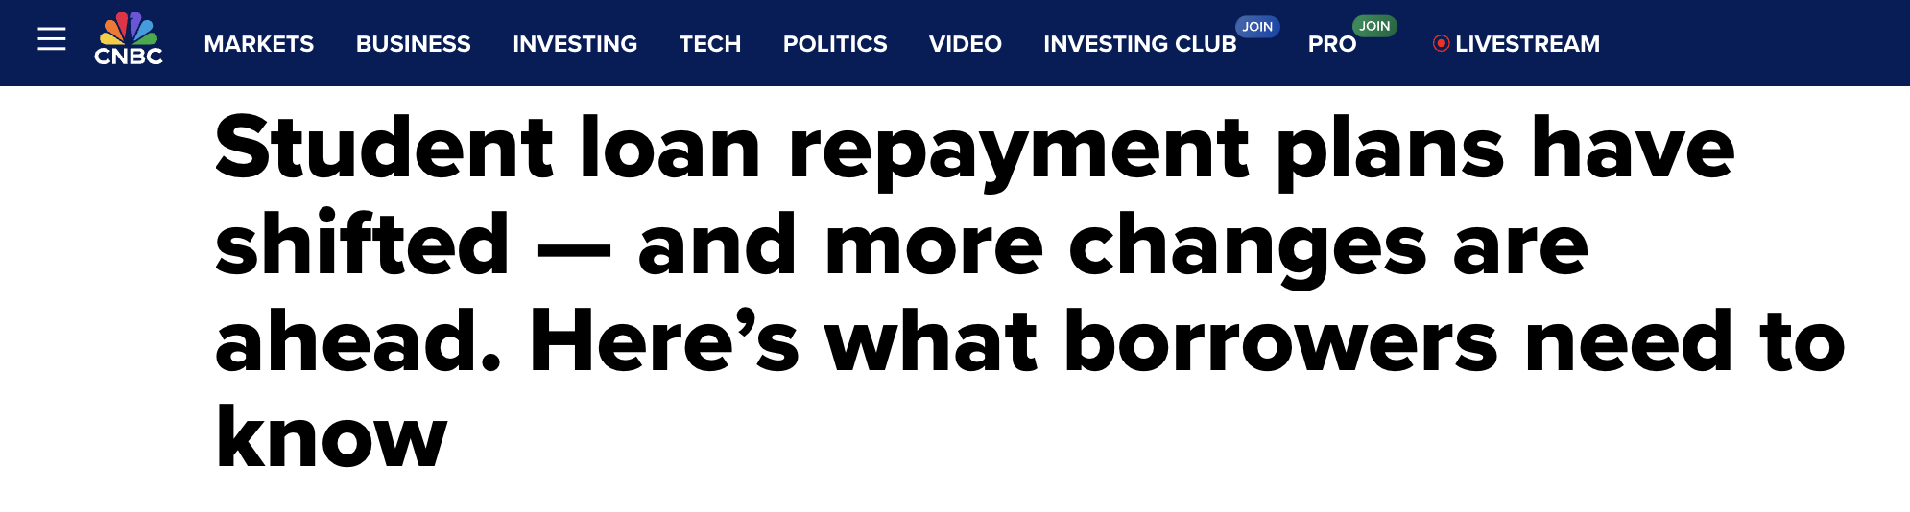
Where are we today for student loan repayment…
Student Loan Repayment Plans:
SAVE
After 7/1/26 those who borrow will only have RAP and a tweaked Standard Repayment
ICR
IBR
RAP

Slide 13
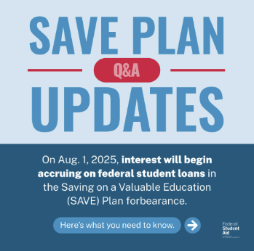
Repayment Plans
SAVE Plan – Now Unavailable
Those that enrolled are in forbearance
Congress repealed it
Interest started being charged again as of August 1 for those in payment pause
- - - - -

Slide 14
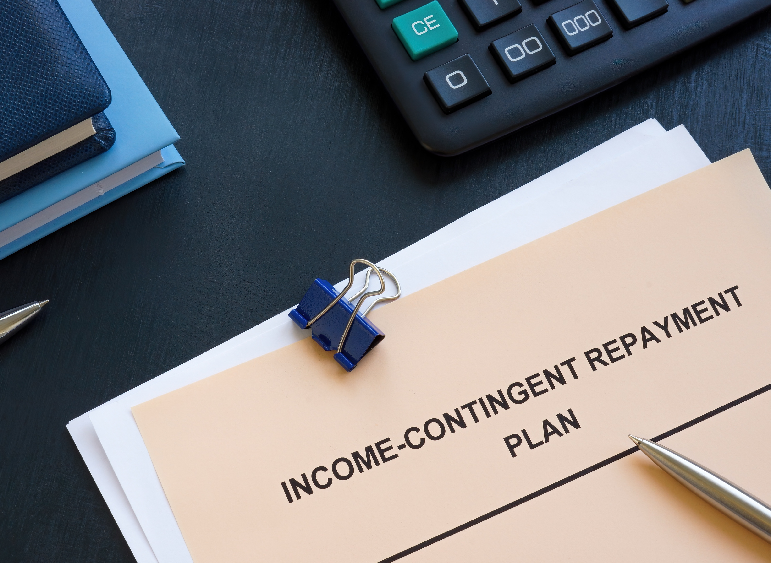
Repayment Plans
Income Contingent Repayment Plan (ICR) Plan
No longer concludes in forgiveness, same for PAYE
These plans phased out as of 7/1/28

Slide 15
Repayment Plans
Income Based Repayment (IBR) Plan – IS available
Terms are 10% of discretionary income (15% for some older loans)
Forgiveness may come after 20 or 25 years
IBR loan discharge paused during SAVE court decisions
ED working on updating eligible payment counts
Requirement to prove “partial financial hardship” to get into loan plan, now removed!
For now, borrowers still being rejected due to their income

Slide 16

Repayment Plans
Repayment Assistance (RAP) Plan
Will be available as of 7/1/26
Based on AGI (Pay 1% to 10%)
$10 / month minimum
Forgiveness after 30 years

Slide 17
COA and Net Price

Slide 18
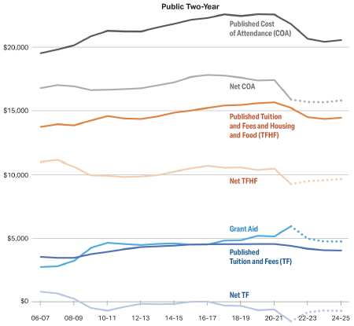
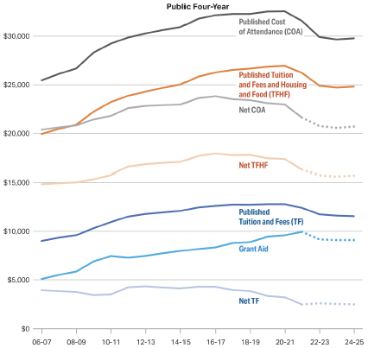
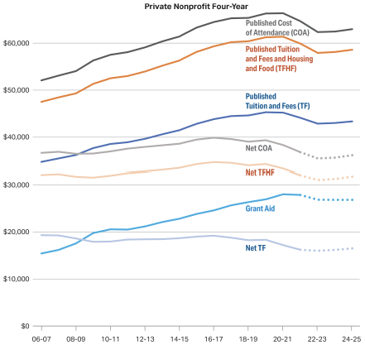
Net Price Trends
Average Published and Net Prices in 2024 Dollars, First-Time Full-Time
In-District Undergraduate Students at Institutions, 2006-07 to 2024-25

Slide 19
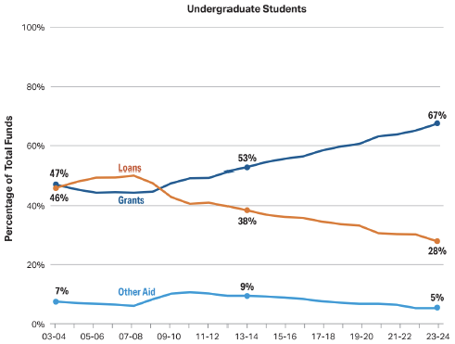
Funding Sources
Composition of Total Aid and Nonfederal Loans, 2003-04 to 2023-24

Slide 20



Thank you!
317.715.9002
wwozniak@investedindiana.org
www.ISFAA.org
William
Wozniak

