Slide 1
Federal Financial Aid
Presented by your friendly colleagues at the
Indiana Student Financial Aid Association (ISFAA)

Slide 2

Topics of Discussion
Federal Student Aid Account (FSA ID)
FAFSA 2026-27
OB3 – One Big Beautiful Bill Act
Avoiding Bumps in the Road
Notes:
While the list is short on topics, the sections are backed with goodies. Upgrades, improvements, suspense and helpful tips.

Slide 3
Federal Student Aid Account
FSA ID
Notes:
Starting point for all things FAFSA

Slide 4
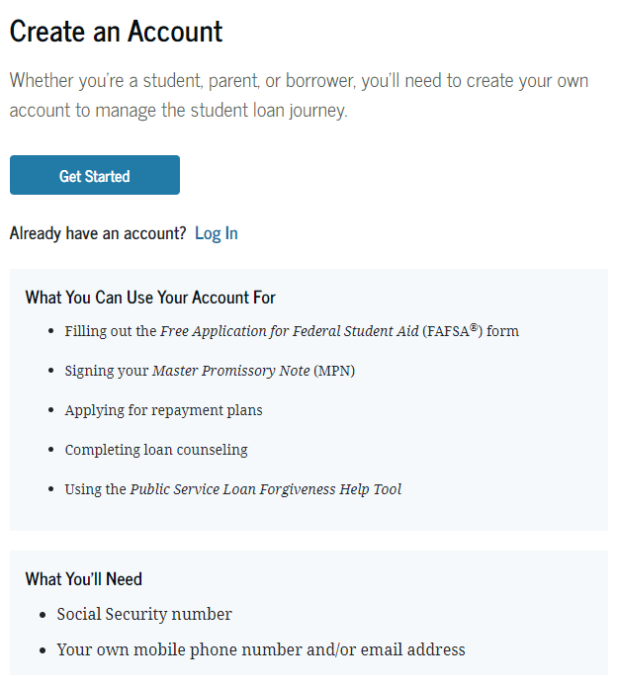
FSA ID Required
Create account at: studentaid.gov
Account required & unique to each person/contributor
Student
Parent 1
Parent 2 (if applicable)
FSA ID is required to sign in & complete the FAFSA due to the consent requirement
Notes:
Reminder that FSA ID is unique to an individual and that student needs an account as well as each contributor – parent(s)
Encourage counselors to reinforce that student needs to create their own and parent creates their own. Should never create an account for someone else
If parent has an account already, they don’t need to create a new one
We’ll discuss whether one or both parents need an ID later in presentation
FSA ID is required to sign in the FAFSA due to the new required consent. Next slide talks about update to real-time SSN match.

Slide 5
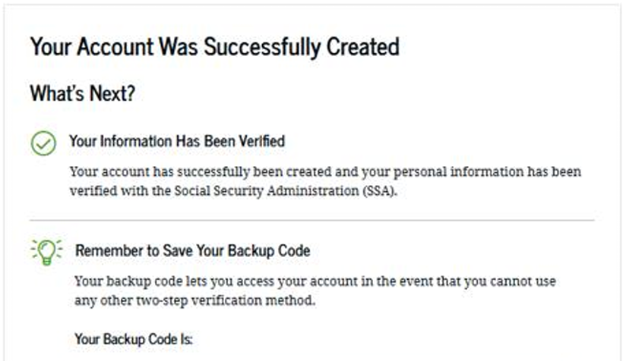
FSA ID – with SSN
New for 2025-26
Real-time match with Social Security Administration
SSN confirmed immediately
No delay in FAFSA access
Can start the FAFSA right after creating an FSA ID
Provide consent
Sign & submit the form
Notes:
Exciting update to FSA ID process. When an individual creates their account with an SSN, the match is confirmed immediately with the social security administration so that students and parents can immediately use their FSA ID to start a FAFSA and provide consent.

Slide 6
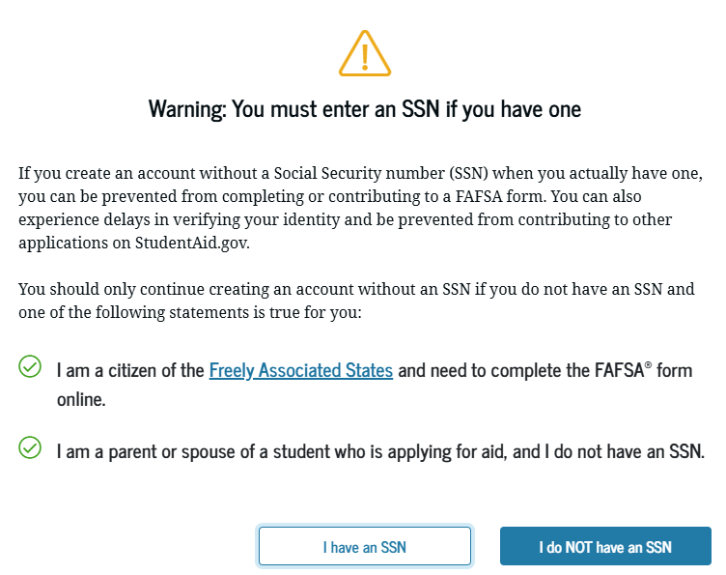
FSA ID – no SSN
Parent Contributor(s) without an SSN must still create an account (FSA ID)
Select the option “What if I don’t have a Social Security Number” and check the box
Will get a warning box to confirm no SSN
Finish FSA ID creation
Can immediately complete their contributor portion of the FAFSA
Note:
Students without an SSN still can’t file the FAFSA
Notes:
Parent(s) without an SSN must create an account. They indicate that they don’t have an SSN, provide confirmation (box on screen), and answer some additional questions. Once their FSA ID is created, they can continue with the FAFSA immediately.
Reminder at the bottom that students without an SSN cannot file the FAFSA.

Slide 7

Two-Factor Authentication
Authentication required when first created & each time account accessed.
Text
Email
Authenticator App
Reminders:
Used to retrieve forgotten usernames or to reset passwords.
Students should NOT use school email address.
Notes:
Two-factor authentication still exists and at least text or email required. Also have option for authenticator app. We strongly encourage both email and text as these are also used to retrieve forgotten usernames or to reset passwords.
Do NOT have student use their school email address.
Reminder that all identifier information (email and phone number) is unique to that individual so it can NOT be shared between family members.

Slide 8
FAFSA 2026-27

Slide 9
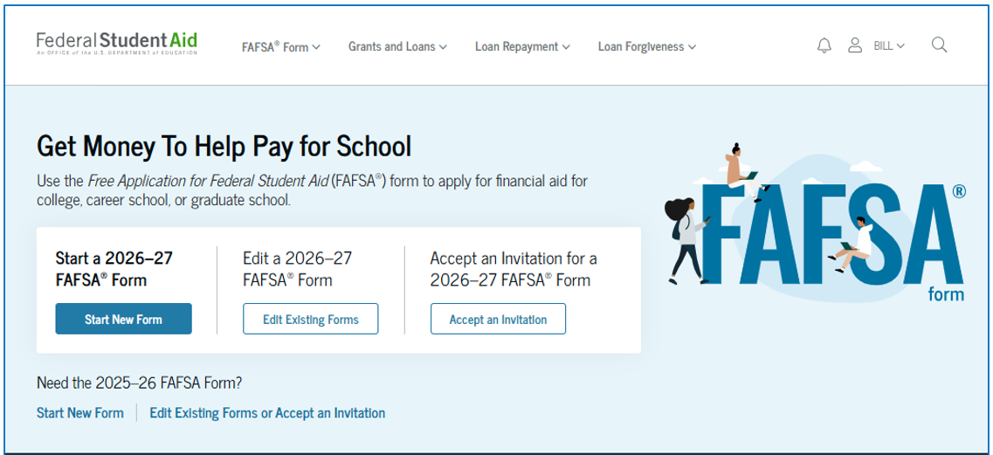

FAFSA 2026-27
studentaid.gov
Notes:
FAFSA page looks a little different for clarity (new form, existing form or to accept an invitation). All set to open Oct 1st at this point (or already did depending on when presentation given.

Slide 10
FAFSA Reminders, Upgrades & Changes
SAI (Student Aid Index) & Pell Grant
Consent is required for aid eligibility
Best way to start the FAFSA
Who is a parent?
Contributor invitation is new & improved
FADDX – what is it and is it working?
Assets – what is included this year?
Foreign income exclusion becomes inclusion
Notes:
Slide simply highlights some reminders, upgrades and changes for 2026-27. Each area discussed further as the slides progress.

Slide 11
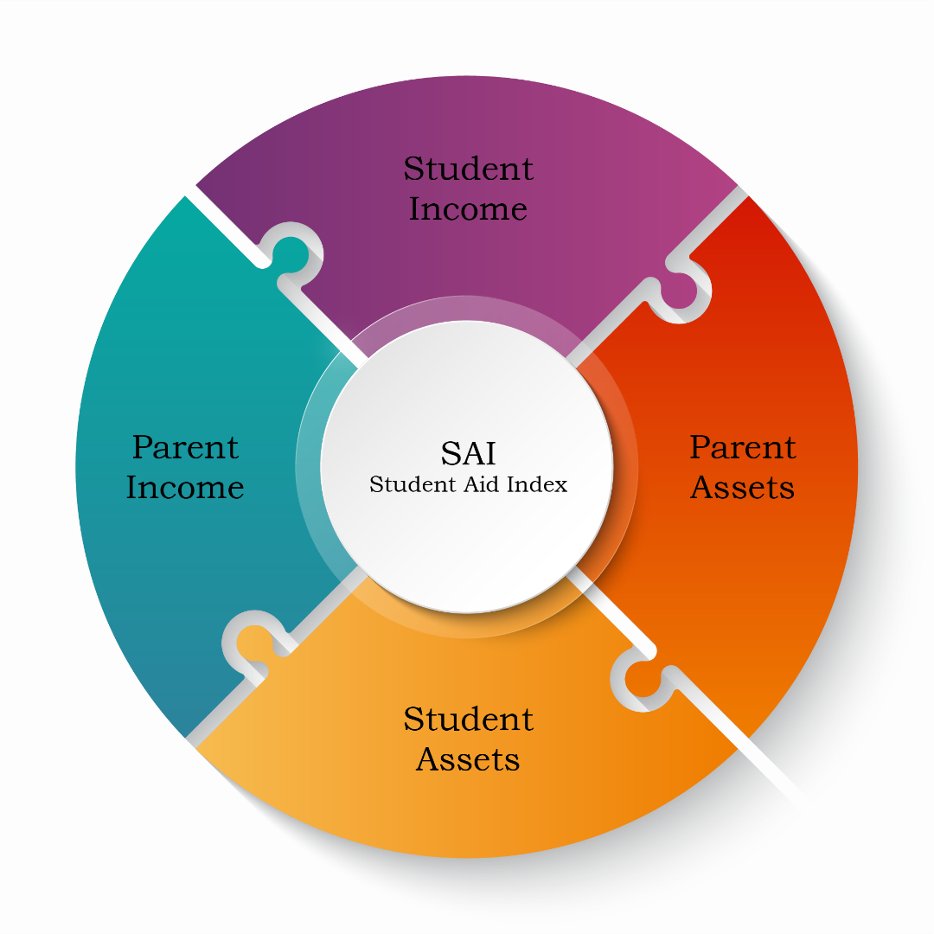
SAI
Ranges from:
-1500 to 999999
Index used by the college to determine the financial aid offer
No longer directly determines Federal Pell Grant eligibility
Notes:
SAI still determined by Parent contributor income/assets as well as student income/assets
SAI can be -1500 but this does not necessarily mean that the student doesn’t have to pay anything, simply an index used by the financial aid office to determine eligibility.
SAI is NOT directly used to indicate Pell. Next slide explains

Slide 12
Federal Pell Grant
Pell for dependent students is determined based on:
Whether the parent(s) filed a federal income tax return
The Adjusted Gross Income (AGI) of the parent(s) is less than or equal to a percentage of the poverty guidelines
Based on marital status, family size & state of legal residence
Notes:
Not meant to get in the weeds on Pell calculation, but simply to help counselors understand an SAI value does not necessarily equate to Pell eligibility

Slide 13


Pellionaire No Longer
One Big Beautiful Bill changed Pell eligibility
Student with SAI > 2 times max Pell no longer eligible
Current max Pell Grant is $7,395
SAI over $14,790 not eligible
Pellionaire
Notes:
OB3 changed the Pell Grant eligibility criteria to remove pellionaires (AGI made them eligible but large asset values). If SAI > 2x max pell then student not eligible.

Slide 14
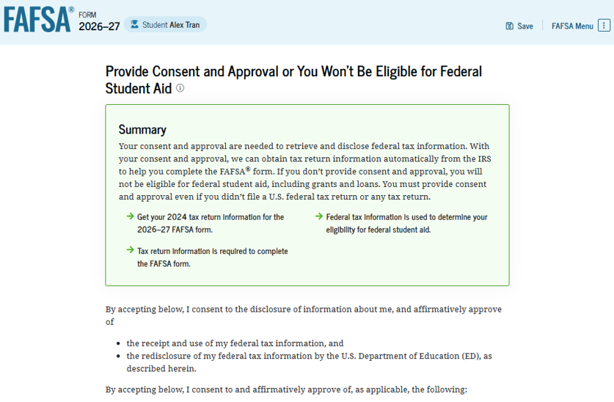
Consent is REQUIRED
Regardless of whether the student and/or parent(s) filed taxes, consent is required for everyone!
NO consent = NO federal or state financial aid eligibility
FAFSA will reject & no SAI will be calculated
Notes:
Reinforce that consent is required for federal or state aid eligibility. The exchange with IRS requires a higher level of protection of data as well as consent to even request the information.
Most institutional merit based financial aid should still be available, but that is a decision based on each institutional policy.

Slide 15

Starting the FAFSA
Strongly encourage the student to start the FAFSA
Smooth and clean process
Student invites parent contributor who completes their section & invites any further contributors as needed
Each contributor provides their own required information (including consent), signs & submits their individual section
Last contributor submits the form
Note: While a student or parent can enter information for the other person, it is NOT encouraged due to consent requirement.
Notes:
Encourages the FAFSA be started by the student for a smooth and clean process. Bullets walk high level through the steps. Invite process discussed in next slides.
On Click - Anticipating the question of whether a parent or student can enter information for the other person as was previously available, we note that while this is possible it is NOT encouraged due to the consent requirement and pulling FTI using the FADDX. Each contributor, including student would need to login, provide consent and sign their section. Best if each contributor completes only their section.

Slide 16



Who is the Parent/Contributor?
Are biological or adoptive parents married to each other?
NO
Do your parents
live together?
NO
Which parent provided more financial support the past 12 months?
YES
Do your parents file a joint tax return?
YES
Is this parent remarried?
YES
No
YES
No
1
2
2
2
1
One parent required to submit both parents’ info
Both parents required to submit their own info
Both parents required to submit their own info
These parents are required to submit their info
This parent
is required to submit only their info
Notes:
Decision tree talks about who is a Parent/Contributor and who must be on the FAFSA and submit their info.
Reiterate that the starting point is always with the biological or adoptive parents. So, grandma/grandpa, aunt/uncle, etc. can’t be a parent unless they’ve adopted the student.

Slide 17

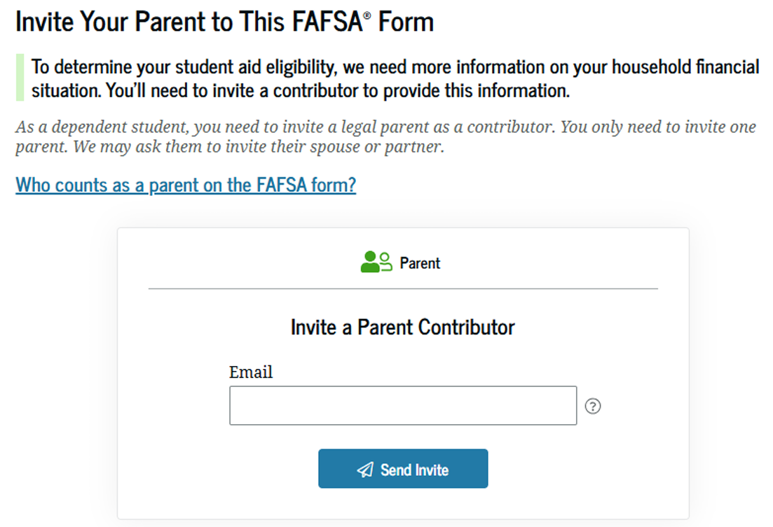
Invite Parent Contributor
Invitation process simplified!
Student simply enters an email account for parent contributor
Only needs to invite one contributor.
Email does NOT have to match the contributor’s FSA ID information.
Notes:
New and improved contributor invitation process. ED changed the process to only require an email for the parent or spouse contributor AND it does NOT have to make the contributor’s email on their FSA ID! Next slide shows invite acceptance process.

Slide 18
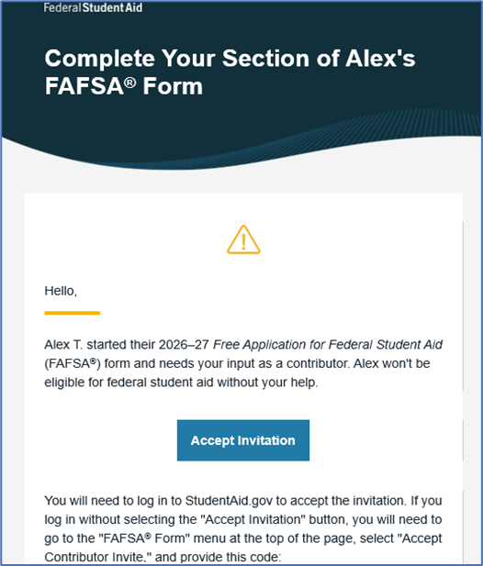
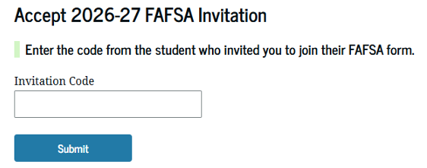
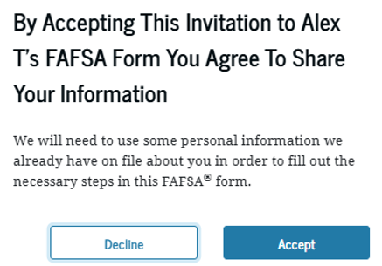
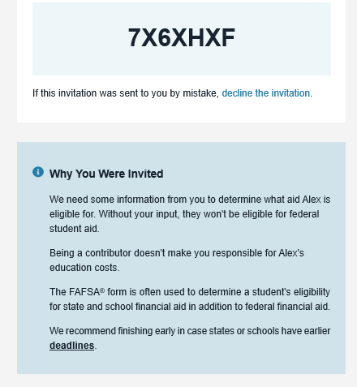
Parent Access
Contributor receives invite email
Accept invitation
Log in using FSA ID
Enter invitation code
Confirm agreement to share information on student’s FAFSA
Notes:
Once the parent receives invitation email with the access code, they click the link which takes them to studentaid.gov where they log in with their FSA ID credentials, then will be asked for the invitation code from the email. Once the code is entered, they will get the warning box (on the slide) that confirms that they are willing to share their information. The parent would then continue with their section of the FAFSA, provide consent, transfer tax info and submit their portion of the app. If needed, the parent contributor will provide an email for a spouse/contributor who would follow the same process.

Slide 19
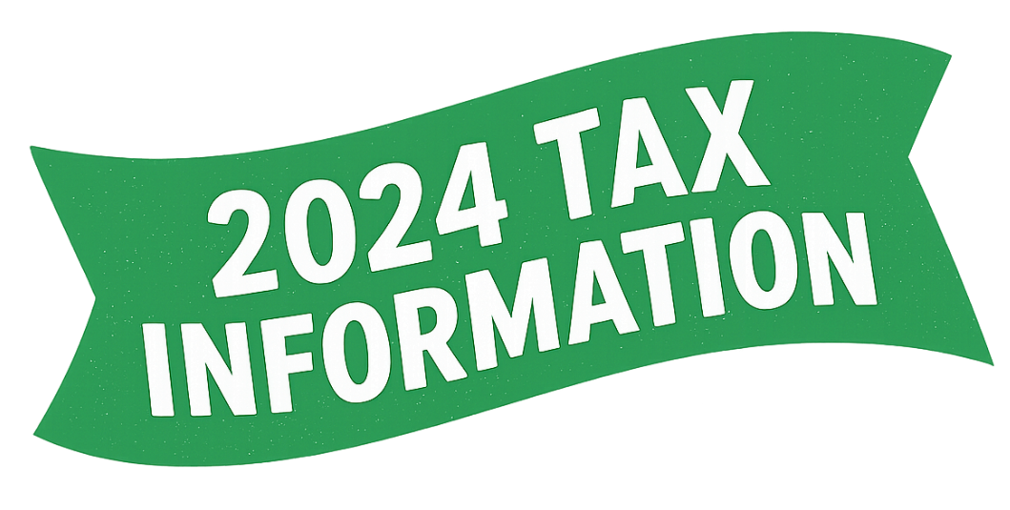
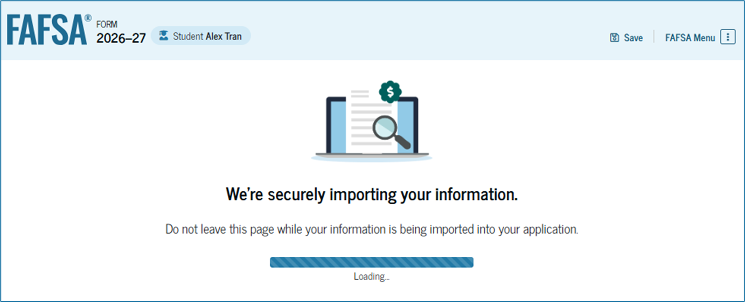

FADDX
Future Act Direct Data Exchange (FADDX)
2024 tax information pulled directly from IRS by U.S. Department of Education behind the scenes
Reminders
Process run even if no taxes filed
May see message below if no tax info found
Requires manual entry of any tax or income information
Notes:
Clarifying that the FADDX is where info is shared between IRS & ED immediately to provide tax information as long as the FSA ID is confirmed & consent is provided. Reiterate that the 2026-27 FAFSA will look at 2024 tax information. They will see the progress screen to know that the process is working. They will then receive either a completed successfully message OR the “sorry, data couldn’t be retrieved” message as shown on the screen. This will show even if the student or parent contributor didn’t file taxes. Reinforce that regardless of whether they filed taxes there may be a few financial questions to answer.

Slide 20
Assets
Clarification of what counts and what can be excluded
Child support received in the last complete calendar year
Cash, savings & checking
Net worth of investments
Real estate other than the primary residence of the family
Education savings/529 plans still counted as parental asset but ONLY if the account is designated for the student
EXCLUDE: retirement accounts: 401(k), 403(b), pensions, IRA’s, etc.
EXCLUDE: value of life insurance
Notes:
First of two Asset slides. This highlights what is included but also what assets to exclude. State how common errors are including retirement accounts and the value of their primary residence.

Slide 21

Assets
Clarification of what counts and what can be excluded
Net worth of a business or investment farms
EXCLUDE: net worth of a family-owned business with 100 or fewer full-time equivalent employees
EXCLUDE: net worth of farm on which the family resides
Note:
Net worth is the current value or market value minus the debt related to that asset
Notes:
Second asset slide to highlight how the family-owned business and family farm are again excluded due to OB3. You could mention that a new exclusion is the net worth of commercial fishing business if owned and controlled by the family. Not on slide as assumption is that this won’t impact our Indiana families much.
Clarifies the definition of net worth as well.

Slide 22

Foreign Income Exclusion
Change for 2026-27
Foreign income exclusion on FAFSA now added to adjusted gross income (AGI) in determining Pell grant eligibility.
Part of the One Big Beautiful Bill Act
Previously college financial aid offices had to determine whether to include.
Notes:
Briefly mention the foreign income exclusion and how it will be added to AGI in determining Pell grant eligibility starting 2026-27.

Slide 23
One Big Beautiful Bill Act
OB3 Impact on Financial Aid Programs
Notes:
In this section we’ll highlight some OB3 financial aid elements and give a sneak peak in to the process that determines the final impact on students, families and colleges/universities.

Slide 24

OB3 – Just for Fun
OB3 – Known as Obi-Three
Backstory
OB3 was constructed in the waning years of the Clone Wars by a group of Jedi engineers as an “Observer-class” droid, meant to safeguard Jedi history and assist with galactic exploration. After Order 66, OB3 went into hiding, wandering the galaxy and quietly gathering lost Jedi knowledge.
By the era of the New Republic, OB3 had become a mysterious figure: a droid carrying secrets of the Jedi Order, sought by both remnants of the Empire and Force-sensitive wanderers.
Notes:
Just for fun I asked ChatGPT to create a Star Wars looking figure called OB3. This is the character and backstory.

Slide 25
OB3 – Just for Fun
OB3 – Interesting traits
Appearance
Optical lenses that switch between the analytic (blue) and combat mode (red).
Etched characters along the chest plating, translating to “Knowledge is the path.”
Personality
Has a dry, sarcastic wit
Occasionally misquotes Jedi wisdom, creating unintentional humor.
Catchphrase: “Probability suggests you’ll regret this decision.”
Notes:
General notes on OB3’s appearance and personality. His catchphrase leads us into the true OB3 and its implications.

Slide 26

Negotiated Rulemaking (Neg Reg)
Negotiated Rulemaking Process
U.S. Department of Education negotiates with affected interest groups on proposed regulations
Two possible outcomes
Consensus: the rule is implemented as it was negotiated.
No consensus: the government agency determines the final rule
Notes:
Provide context around why we are sharing the next few slides. May not impact their students directly, but with items noted through out the news, we wanted to highlight a few areas where OB3 will impact financial aid and paying for college in the near future.
We don’t know all impacts yet as once the law is passed some provisions go through negotiated rulemaking to determine the wording of regulatory guidance and subsequent application of the law to real-life situations. This slide gives high-level summary of the neg reg process.
Then next two slides highlight a couple of committees and topics of discussion.

Slide 27
Two Neg Reg Committees
Reimagining and Improving Student Education (RISE) committee
Considering the changes to the federal student loan programs
Phase out of Graduate PLUS Loan program
Parent PLUS Loan annual ($20K) & aggregate ($65K) limit changes
Graduate & professional student annual ($20.5K/$50K) & aggregate ($100K/$200K) limit changes
Federal loan lifetime limits
Allowance for institutions to lower loan limits at the program level
Loan proration based on student enrollment status if less than full-time
New standard & new income-based repayment plans
Adjustments to loan rehabilitation, deferment and forbearance options
Notes:
First Neg Reg committee – RISE
Not meant to be a detailed slide but rather to simply highlight some of the issues this committee is reviewing from OB3.

Slide 28
Two Neg Reg Committees
Accountability in Higher Education & Access through Demand-Driven Workforce Pell (AHEAD) committee
Considering institutional & program accountability, Pell Grant program, & other changes to Title IV programs
Institutional accountability regarding academic program earning outcomes
Program eligibility requirements for new Workforce Pell Grant
Review Pell Grant eligibility
Student with other scholarships/grants that cover their cost of attendance
Students with high SAI that exceeds twice the maximum Pell Grant award
Inclusion of foreign tax exclusion in AGI
Notes:
First Neg Reg committee – AHEAD
Not meant to be a detailed slide but rather to simply highlight some of the issues this committee is reviewing from OB3. May want to note that the last 2 sub bullets we’ve already mentioned as being implemented but may still be part of neg reg

Slide 29

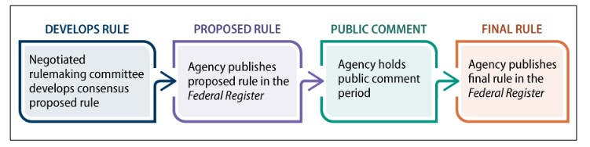
End Results?
The outcomes & impact won’t be known for a while
Steps after the committees complete negotiations
U.S. Department of Education publishes a proposed rule
Public allowed to provide comments
Department reviews comments & publishes final rule
Timing of final rule determines when the regulations go into effect
Notes:
Summary slide to basically indicate that the rules may take a while to go into effect. Walks through the basic steps of the process (see graphic). Can provide general framework that depending on timing some rules may go into effect on July 1, 2026, while other not until July 1, 2027, or later. Basically, the results are TBD (To Be Determined).

Slide 30
Avoiding Bumps in the Road
Notes:
A few tips, suggestions and recommendations that will help students avoid common bumps in the road down the financial aid process

Slide 31
Avoid Bumps in the Road
Unsubsidized loan question
Only answer yes if parent(s) unwilling to provide info & no unusual circumstances exist
“Yes” answer means student eligible for an unsubsidized student loan only
Encourage families to have their tax info available when filing
If FADDX doesn’t find information, then taxes will need entered manually
Incorrect or missing tax information can delay processing by colleges
Notes:
The unsubsidized loan question can create issues if answered incorrectly. If not being asked to provide a parent contributor, this question is sometimes the culprit. Bullet points provide some context
Second bullet – having tax info available when completing the FAFSA will help a family in case they do need to enter something manually. Hope they aren’t needed, but better to be safe than sorry.

Slide 32
Avoid Bumps in the Road
Only enter tax information manually if required
Manually entered data supersedes the IRS transferred data, which can cause conflicting information & processing delays.
Have homeless or unusual circumstances documentation ready
Student will be given a provisional independent status but will need to work with college financial aid office for appropriate documentation
Accurate family size is important
Assumed based on 2024 tax exemptions; if different enter it on the FAFSA
May get selected for verification, but better to have it accurate
Notes:
First bullet – Only enter financial info/taxes if requested. Anything manually entered overwrites the FADDX and could create situations where colleges have to request additional information which also means possible delays in financial aid processing.
Second bullet – Reminder about unaccompanied homeless youth and unusual circumstances (can’t get parent info or risk too high for student to obtain). Student receives provisional independent status and will need to work with the financial aid office regarding appropriate documentation and next steps.
Third bullet – Another good reason to have the taxes as it shows exemptions which the FAFSA uses to determine family size. If unsure, enter the family size on the FAFSA but understand that the family may have to provide documentation to verify that number.

Slide 33
Avoid Bumps in the Road
Encourage student to track FAFSA status under “My Activity” tab
Student can log into studentaid.gov site to confirm required contributors have completed and submitted their section
Confirming submission ensures deadlines are met & maximizes eligibility for scholarships & grants
Review the FAFSA Submission Summary to see if there are any errors or issues once the application is processed
Ask questions!
If unsure about any part of the FAFSA or financial aid process, simply ask!
Notes:
Encourage students to take ownership of the process and track the FAFSA status. Sub bullets outline key benefits for students to track the status.
Lastly is to simply ask questions. Students, families, counselors are all welcome to ask questions. ISFAA membership of local colleges/universities are always happy to answer questions and help through the process. Better to ask questions now and reduce the risk of additional documentation and process delays.

Slide 34
Questions?

