Slide 1
Indiana Commission for Higher Education Updates
2025 ISFAA Counselor Workshops
September and October 2025

Slide 2
Overview
Who is CHE?
ScholarTrack
Data Dashboards
Best Practices and Support
FAFSA and Financial Aid Program Updates
Program and Initiative Updates

Slide 3
Indiana Commission for Higher Education
The Indiana Commission for Higher Education (CHE, Commission) is a fourteen-member public body created in 1971 to:
  Plan for and coordinate Indiana's state supported system of postsecondary education;
  Review appropriation requests of state educational institutions;
  Make recommendations to the governor, budget agency or the general assembly concerning postsecondary education; and
  Administer state financial aid programs.
Notes:
The Commission is not a governing board, but a coordinating agency.

Slide 4
ScholarTrack

Slide 5
ScholarTrack.in.gov
ScholarTrack is a one-stop shop for all state financial aid information for
Hoosier students.
Students with user accounts can (some require a full user account to complete):
  Apply for state financial aid
  Complete Scholar Success Program activities
  Check the status of FAFSA, college credit completion, and more
  See what financial aid is being offered to students from the state
  Submit and view appeals
  Access additional college and career success resources

Slide 6
ScholarTrack users
You must have a School Admin or School User account in ScholarTrack to:
  Submit graduation details;
  View FAFSA filing status for students, as well as FAFSA edits;
  Verify ScholarTrack rosters;
  Monitor enrollment for 21st Century Scholars; and more.
Contact your Outreach Coordinator or schools@che.in.gov if you do not have an account.
If you are a School Admin, review the accounts affiliated with your school and contact schools@che.in.gov to have former staff accounts deactivated.

Slide 7
ScholarTrack Rosters
School Admin Users can create and approve new staff and community partner accounts to access rosters and reports.
CHE can create new staff member accounts by emailing schools@che.in.gov.
Community Partners need permission from high/middle schools to be given access by CHE.
  Schools must email CHE at schools@che.in.gov with explicit permission for community partner employees to receive access.
  Email addresses should never be personal emails.

Slide 8
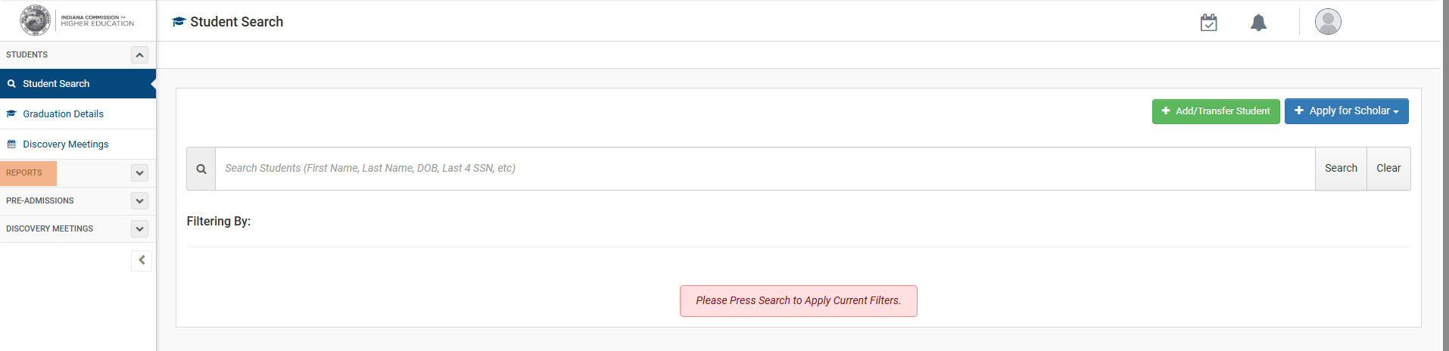
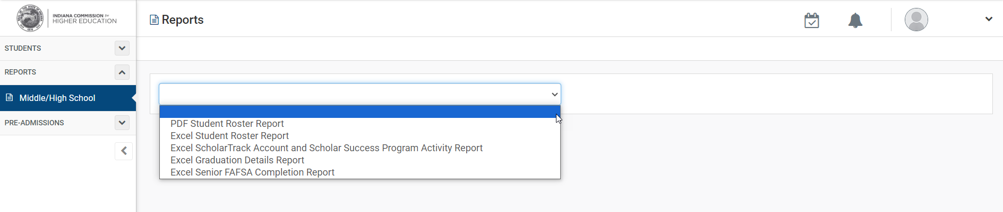
ScholarTrack Reports

Slide 9
CHE Program Updates

Slide 10
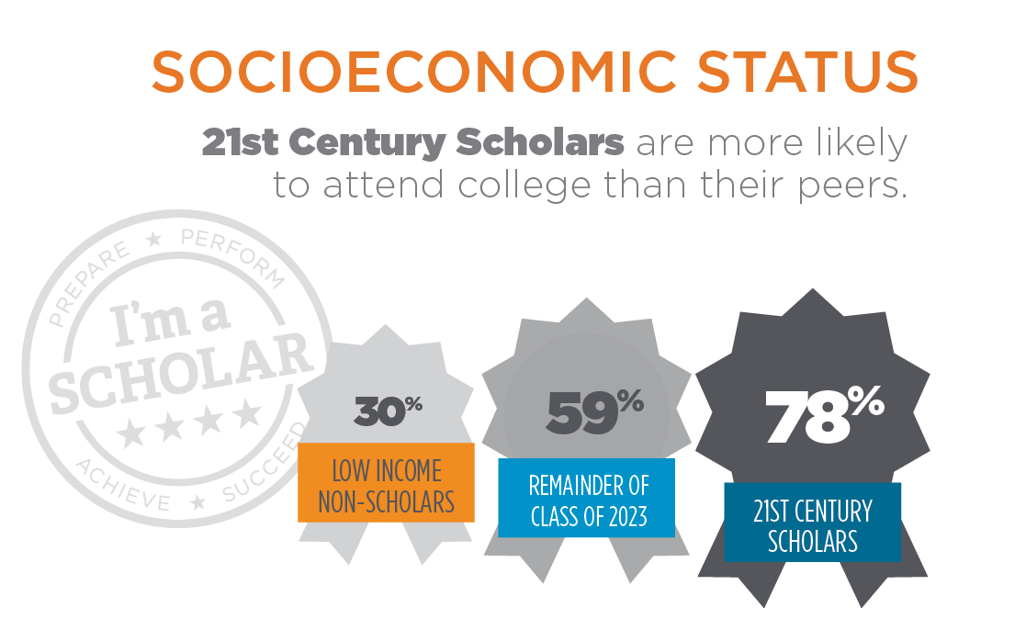
21st century scholars program
The program was established in 1990 to increase Hoosier students’ aspirations for and access to higher education.
Income-eligible students are automatically enrolled or must apply in 7th or 8th grade.
Scholars who fulfill the Scholar Pledge earn up to four years of paid tuition at an Indiana college.

Slide 11

21st Century Scholars AWARD
Pays up to four years full tuition at Indiana public colleges.
  Included: Tuition and regularly-assessed fees
  Not Included: Room and board, books, transportation, and miscellaneous expenses
Pays partial tuition at approved Indiana private or proprietary colleges.
  Private: Pays average cost of 4-year public colleges ($9,516)
  Proprietary: Pays equivalent cost of Ivy Tech Community College ($5,154)
Many colleges offer supplemental scholarships/incentives.

Slide 12
21st Century Scholars Eligibility requirements
Be an US citizen or eligible non-citizen and Indiana resident
Be automatically enrolled or apply in 7th or 8th grade
Agree to the Scholar Pledge
Graduate with a 2.5 cumulative Grade Point Average (GPA) on a 4.0 scale
Graduate with at least a Core 40 high school diploma or the new Indiana Diploma (Readiness Seals will not be required, but are encouraged)
Complete the Scholar Success Program (SSP) in ScholarTrack
Meet financial means testing upon filing the Free Application for Federal Student Aid (FAFSA) by April 15 senior year of high school

Slide 13
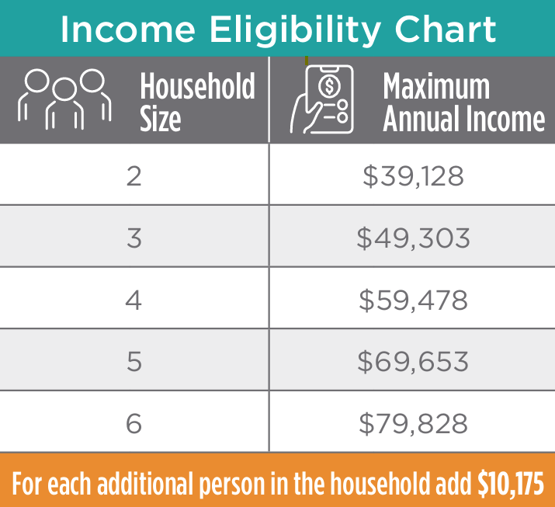
21st Century Scholars Enrollment
Students who are enrolled in the Free and Reduced Lunch program will be automatically enrolled in 7th or 8th grade.
If a student is not enrolled in the Free and Reduced Lunch Program but meets the income guidelines, they can still apply. Applications must be received by June 30 of the student’s 8th grade year.

Slide 14
Automatic Enrollment
Class of 2029 has been automatically enrolled and notified by mail.
Cadence for automatic enrollment: October, March, and June.
Notification letters will be sent to 8th grade students (class of 2030) in Spring and Summer 2026 before entering high school.
Questions? Contact your regional Outreach Coordinator at learnmoreindiana.org/contact.

Slide 15
21st Century Scholars pledge
Complete the Scholar Success Program in high school and college.
Graduate from an Indiana high school with a minimum of a Core 40 diploma or the Indiana Diploma, and a cumulative GPA of at least 2.5 on a 4.0 scale.
File the FAFSA by April 15 as a high school senior and each year while attending college.
Apply to an eligible Indiana college as a high school senior and enroll as a full-time student within one year of high school graduation.
Do not use illegal drugs, commit a crime or delinquent act, or consume alcohol before reaching the legal drinking age.

Slide 16
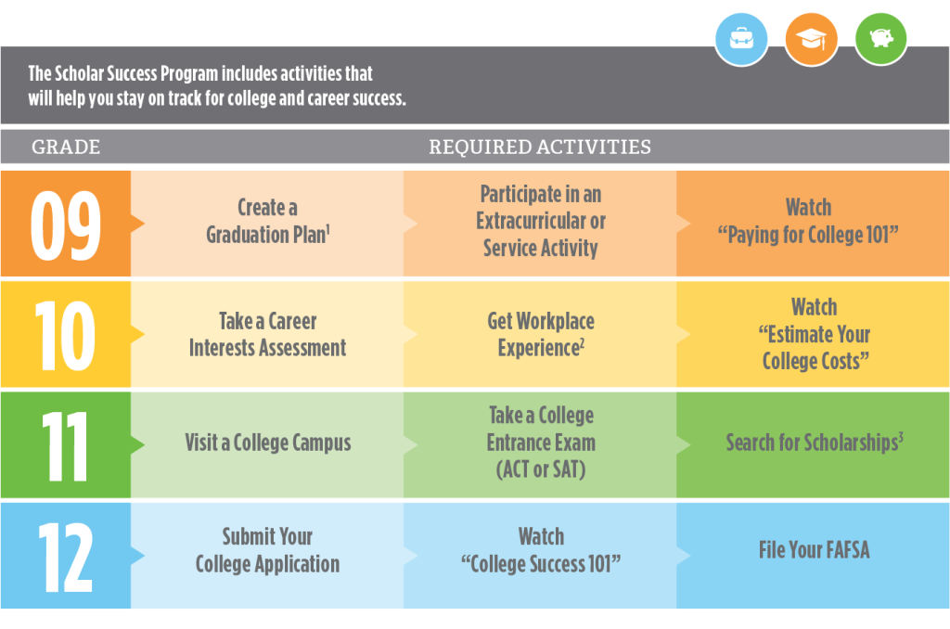
Scholar success program

Slide 17
Financial Means Testing
The financial means test (FMT) is based on annual household income.
To qualify for the scholarship, Scholars must be a member of a household with
an annual income equal to or below 400% of the Federal Poverty Level (FPL).
  This is equal to double the amount to qualify for the Federal Reduced Lunch Program and initially enroll in the 21st Century Scholars program.
FMT takes place prior to the first year of college enrollment.
CHE uses the guidelines that correspond to the FAFSA to set the limit and income reported on the Scholar’s FAFSA to determine eligibility.
Please refer to our FMT one-pagers for additional information on the Learn More Indiana website.

Slide 18
Appeals
Appeals can be filed for a variety of reasons: enrollment deadline, FAFSA deadline, GPA, diploma type, SSP completion and financial means testing.
  Foster students who are unable to reach a 2.5 GPA due to enrolling during high school
  Students with an Individualized Education Plan (IEP) that prevents them from taking required classes to earn a Core 40 diploma
Filing an appeal is not a guarantee that it will be approved.
Appeals are submitted through ScholarTrack and questions can be addressed to awards@che.in.gov.
NOTE: Missed Enrollment Deadline should be addressed by the end of student’s freshman year.

Slide 19
Pledge Violations
It is the responsibility of a Scholar and the parent(s)/guardian(s) to report pledge violations to CHE as soon as they become aware of the violation.
School officials, case managers, and others may report pledge violations. CHE requires documentation of a conviction or suspension/expulsion that results from a pledge violation.
Pledge violations should be reported to CHE via scholars@che.in.gov.

Slide 20
College Success Program
CHE is re-implementing the College Success Program (CSP) for Scholars and any college student interested in engaging.
2025-2026 is a pilot year for participating colleges.
CHE is currently working to identify college partners to test this program.

Slide 21

Indiana Pre-Admissions: Your Path to college
Indiana Pre-Admissions: Your Path to College offers students the chance to be pre-admitted to select Indiana colleges and universities using the cumulative GPA through junior year, SAT score, and/or diploma type.
Indiana Resident Admissions (SEA 448) allows students graduating with the Indiana Diploma with the Enrollment Honors Plus Seal to be admitted to all Indiana public colleges and universities and any private colleges that have opted in to participate.

Slide 22
Class of 2026
456 high schools have opted in to participate for the class of 2026.
42 participating campuses have provided CHE with cut scores for SAT and/or GPA or will use the Enrollment Honors Plus Seal.
CHE sends letters to students and their parents in September of student’s senior year, notifying them of the institutions to which the student have been "pre-admitted" based on institutional cut scores.
For more info, visit learnmoreindiana.org/preadmit.

Slide 23
Enrollment Ready campaign
The Enrollment Ready campaign is designed to highlight key tasks and checkpoints in high school to prepare students for receiving Pre-Admissions letters their senior year.
For September 2025, Enrollment Ready letters are sent to students in grades 9-11 at high schools who opted into Pre-Admissions.

Slide 24
*NEW* College connections tool
CHE has entered into Data Share Agreements with 47 Indiana colleges
and universities to share mailing address information of students who are interested in their academic programs through the new College Connections tool.
Students will log in to ScholarTrack.IN.gov and complete the College Connections questionnaire to receive personalized information about the colleges and programs that they are interested in.
Students can change their preferences and opt-out of communications with colleges and universities at any time.

Slide 25
Career Discovery Meetings
Career Discovery Meetings (CDMs) are commonly known as the “30-minute meetings”
which were created by HEA 1002-2023.
  High school juniors and seniors in a school maintained by a school corporation or charter school are required to participate in CDMs.
  Colleges/universities, intermediaries, employers, and labor organizations conduct the CDMs.
There are several opt-out provisions available.
  For example, a student who receives career coaching services from a recipient of the Career Coaching Grant is exempt from CDMs.
This will not impact a student’s ability to graduate.
*NEW* Career Discovery Meeting Webpage and Frequently Asked Questions (FAQs) Webpage
Career Discovery Meetings Memo

Slide 26
FAFSA and Financial Aid Program Updates

Slide 27
Free Application for Federal Student aid (FAFSA) Updates
April 15, 2026 – Indiana’s State Financial Aid Deadline
Indiana reached 60% of high school seniors who filed a FAFSA for the 2025-2026 form.
Updates to the 2026-2027 FAFSA form:
  Contributor Invite Flow
    Only contributor email(s) are needed – Generates a 7-digit code sent to the contributor.
    Students can also see the code on the pending submission page that they can give the contributor.
  Real Time SSN Matching while creating their StudentAid.gov account (formerly FSA ID).

Slide 28
SEA 167-2023
This act makes the Free Application for Federal Student Aid (FAFSA) is required
for high school seniors.
Broad opt-out provisions are included for parents/guardians and emancipated students.
Additionally, a school can waive the requirement for a student after April 15 so long as at least two communications about filing the FAFSA have been sent to the parents/guardians.
2026-2027 FAFSA waiver will be released on October 1, 2025.
Waivers should be reported before the end of the 2025-2026 academic year in ScholarTrack through the Graduation Detail Widget or through Bulk Uploading for a cohort.
  Waivers cannot be submitted until after April 15, 2025.

Slide 29
State Financial Aid
Updates
Visit Learn More Indiana’s Scholarships page for updates to state financial aid programs.
2026-2027 Frank O’Bannon Grant Chart will be released in early Spring.
Mitch Daniels Early Graduation Scholarship
  The 2026-2027 application opens November 1.
    Early graduates that will be graduating at least one year early with Cohort 2026.
  School staff will need to request Outreach Coordinators to adjust and lock student’s cohort in ScholarTrack.
Next Generation Hoosier Educators Scholarship
  School staff will need to verify academic information.

Slide 30
Indiana Aid Program | Who Qualifies? | How Much?
21st Century Scholars Program | Income-eligible Hoosier students, must apply or be enrolled during 7th or 8th grade year | Four years of up to 100% tuition at an eligible Indiana college
Adult Student Grant | Hoosier adults who are starting or completing an associate degree, bachelor’s degree, or certificate | A renewable award of up to $2,000
Child of Veterans and Public Safety Officers (CVO) | Students whose parent is a disabled military veteran or deceased or disabled public safety officer | Up to 100% of tuition at a public Indiana college and $5,000 at a private Indiana college
Earline S. Rogers Student Teaching Stipend for Minorities | Any student from an underserved county* who will be participating in student teaching during the upcoming academic year | The amount varies based on student need and available funds
EARN Indiana | Students enrolled in an Indiana high school or college interested in work-base learning. College students must file a FAFSA and demonstrate financial need | Varies, but all internships are paid at least federal minimum wage
Frank O’Bannon Grant | Full-time college students with financial need | $400 to $10,600, depending on your college and your financial need
Indiana National Guard Supplement Grant | Students who are active members of the Indiana Air or Army National Guard | Up to 100% of tuition at a public Indiana college and up to$5,000 at a private Indiana college

Slide 31
Indiana Aid Program | Who Qualifies? | How Much?
Mitch Daniels Early Graduation Scholarship | Students who graduate from a public high school at least one year early | A one-time award of up to $4,000
Next Generation Hoosier Educators Scholarship | High-achieving high school and college students who plan to teach in Indiana for at least five years after graduation. Additional aid may be available for students residing in or graduating high school from an underserved county. | Up to $10,000 per year for four years
Student Teaching Stipend for High-Need Fields | Students who plan to teach in a high-need field where there is a shortage of candidates | The amount varies based on student need and available funds
Transition to Teaching Scholarship | Hoosier students who possess a bachelor’s degree, are employed or volunteer at a school, have financial need, and plan to teach for at least five years after earning their credential | A one-time award of up to $10,000 at an eligible Transition to Teaching Program
William A. Crawford Minority Teacher Scholarship | Students who currently reside in or resided in an underserved county* majoring in education who plan to teach in Indiana for at least three years after graduation | The amount varies based on student need and available funds
Workforce Ready Grant | Students who enroll in a high-demand certificate program at Ivy Tech Community College, Vincennes University, or another approved training provider | Up to 100% of tuition at Ivy Tech, Vincennes, or another approved training provider

Slide 32
Data dashboards

Slide 33
Data dashboards
SSP DASHBOARD
  Tableau dashboard showcasing ScholarTrack Account Creation and SSP progress for Scholars
FAFSA COMPLETION DASHBOARD (2025-2026)
  Tableau dashboard that shows FAFSA filing rates by school, county, and region for the 2025-2026 FAFSA.
    2026-2027 Dashboard to be released this fall

Slide 34
Best practices
& reminders

Slide 35
How to support your students
Invite CHE’s Outreach Coordinators to help create ScholarTrack accounts, complete
SSP activities, and file the FAFSA.
  Freshman cohorts = ScholarTrack account creation and early intervention (GPA, classes, diploma track, etc.)
  Senior cohorts = FAFSA filing by April 15 and completing all SSP activities by June 30
Have ScholarTrack School User or School Admin accounts for the staff tasked with supporting Scholars in your school.
  Community Partners can have access with School Admin user approval.
Participate in Indiana Pre-Admissions: Your Path to College initiative.
  Ensure your Scholars know what Indiana colleges and universities are excited and ready to welcome them into their freshman classes.
Encourage the pursual of Readiness Seals for the new Indiana Diploma.

Slide 36
reminders
April 15 – Indiana’s State Financial Aid Deadline
College GO! 2025 – September 22-26
Scholars must create ScholarTrack accounts to accept their pledge.
  Students will show “Approved Pending Student Pledge” then will switch to “Approved”
Graduation Details Collection – January 31 and June 30 of every year
  Final cumulative GPA and diploma type due for graduating 21st Century Scholars (January 31 and June 30)
  Preliminary GPA and diploma type for junior 21st Century Scholars (June 30 only)
  Schools must report/confirm final graduation details to CHE or award distribution may be impacted.

Slide 37
School resources & support

Slide 38
resources
LearnMoreIndiana.org
  Materials Library – helpful flyers and handouts
  FAQs of the 21st Century Scholars Program
  State Financial Aid information
CHE.IN.gov
  State Financial Aid information
  Appeals information
  Data and Research page contains various reports and dashboards

Slide 39
Additional resources
ScholarTrack Counselor Manual – email your Outreach Coordinator for a copy if you do not have one.
Learn More Indiana YouTube Page
  Find past webinars and trainings on various topics including:
    21st Century Scholars Automatic Enrollment
    FAFSA
    Pre-Admissions
    Graduation Details Collection
    Indiana College Core
    Career Discovery Meetings

Slide 40
Upcoming Webinars
Indiana Pre-Admissions, Indiana Resident Admissions, and Enrollment Ready Initiatives
2026-2027 FAFSA Updates

Slide 41
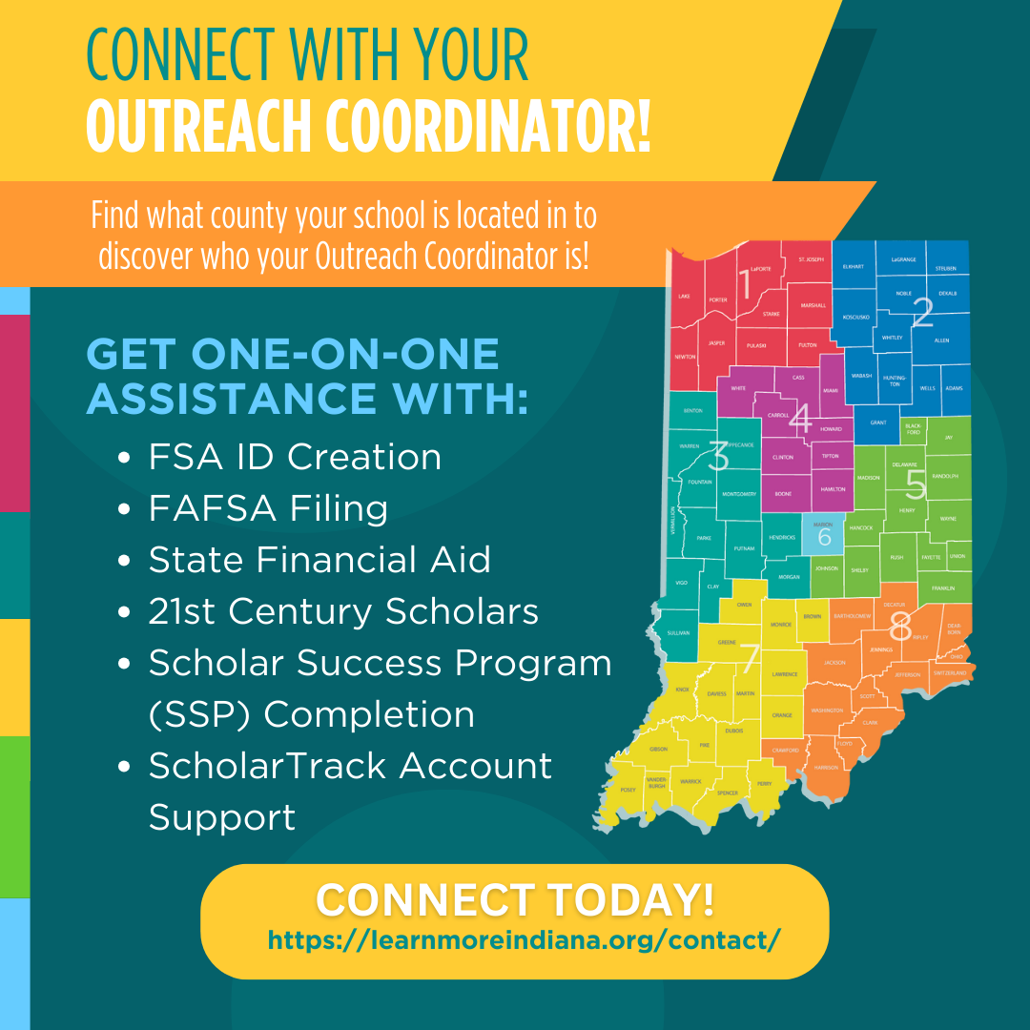
Contact us
LearnMoreIndiana.org/contact
  Connect with your region’s Outreach Coordinator
schools@che.in.gov
Financial Aid Support Center
  (888) 528-4719

Slide 42
CHE email inboxes
21st Century Scholars: scholars@che.in.gov
Career Discovery Meetings: CDM@che.in.gov
Career Scholarship Accounts: CSA@che.in.gov
Career and Technical Education: CTE@che.in.gov
Grants: grants@che.in.gov
Indiana College Core: ICC@che.in.gov
Indiana Pre-Admissions: Your Path to College: preadmissions@che.in.gov
Next Generation Hoosier Educators Scholarship: NextTeacher@che.in.gov
State Financial Aid: awards@che.in.gov

Slide 43
Stay Connected
Join our listservs to get general CHE updates, notices, and press releases.
Subscribe for Updates

