Slide 1
2025 ISFAA Counselor Workshops
Welcome!

Slide 2

Today’s Agenda
9:00 am - 9:10 am ISFAA Welcome
9:10 am - 10:10 am CHE Legislative and State Financial Aid Updates
10:10 am - 10:40 am Federal Financial Aid Update Pt. 1
10:40 am - 10:55 am Break and Networking
10:55 am - 11:25 am Federal Financial Aid Update Pt. 2
11:25 am - 11:45 am Data Update and Breaking News

Slide 3

Workshop Survey
https://forms.gle/kvUXM7ZpZhSHfrAE9

Slide 4
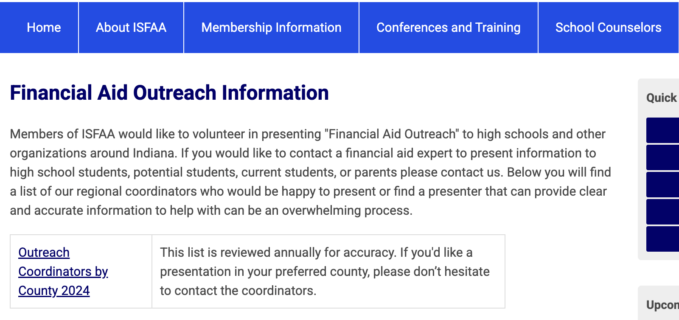
Financial Aid Nights
ISFAA.org

Slide 5

College Goal Sunday

