Slide 1
Preparing for Postsecondary Education
Saving Time & Money Through Effective Planning
Notes:
Introduce self and INvestEd

Slide 2
We’ll Help You Understand
  Benefits of Continuing Your Education
  Choosing Your Career Path
  Types of Financial Aid
  FAFSA
  Managing Costs
  Impact of Social Media
  We’ll help

Slide 3
Benefits of Continuing Education

Slide 4
Value of Higher Education
(Source: Current Population Survey, U.S. Department of Labor, U.S. Bureau of Labor Statistics)

Slide 5

Higher Education Debt
61% of graduates have college-related debt
Averages
    Student loan debt $40,681
    Monthly payment $460
Total Student Loan Debt
    Student loan debt over $1.73 trillion
      Credit Card debt totals over $1.14 trillion
    43 million people have student loan debt
Source: https://educationdata.org/

Slide 6
Choosing Your Career Path

Slide 7
Choosing a Career Path
Finding the right fit
  What are your interests & strengths?
  What are your goals?
Gain experience
  Job shadowing
  Volunteering
  Internships
Check out FREE resource & tools at:
INvestEdIndiana.org/Choosing

Slide 8

Career Research

Slide 9
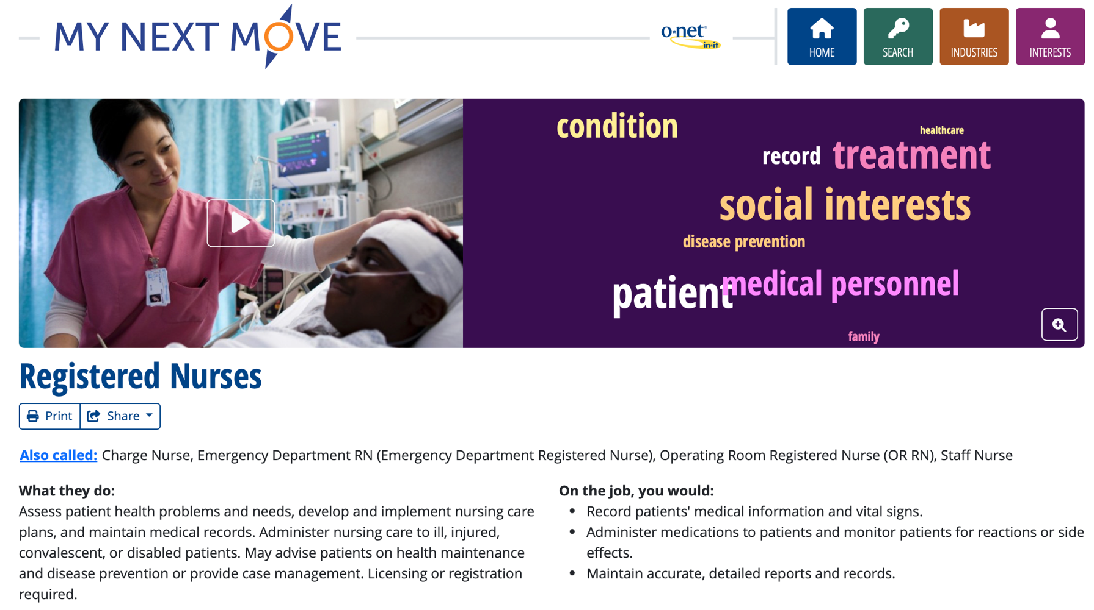
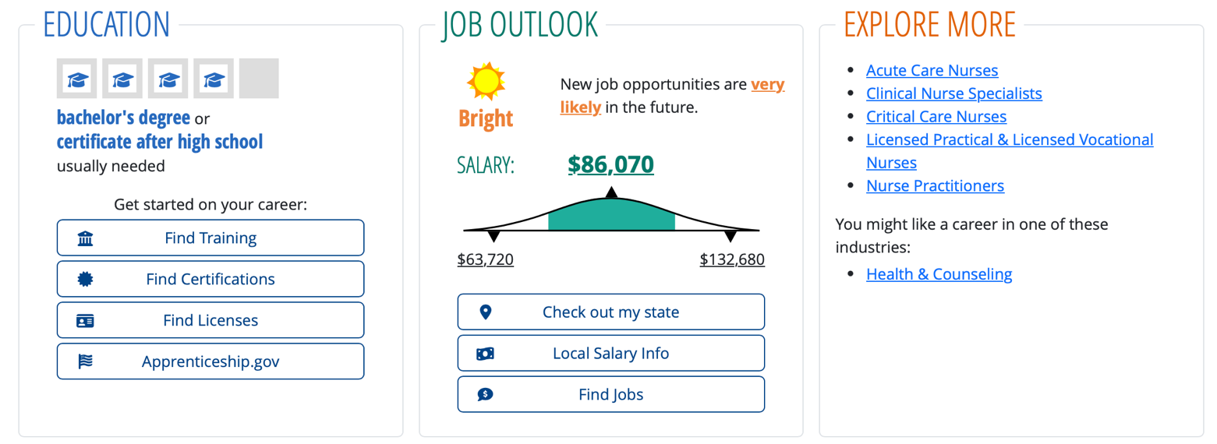
Career Research

Slide 11

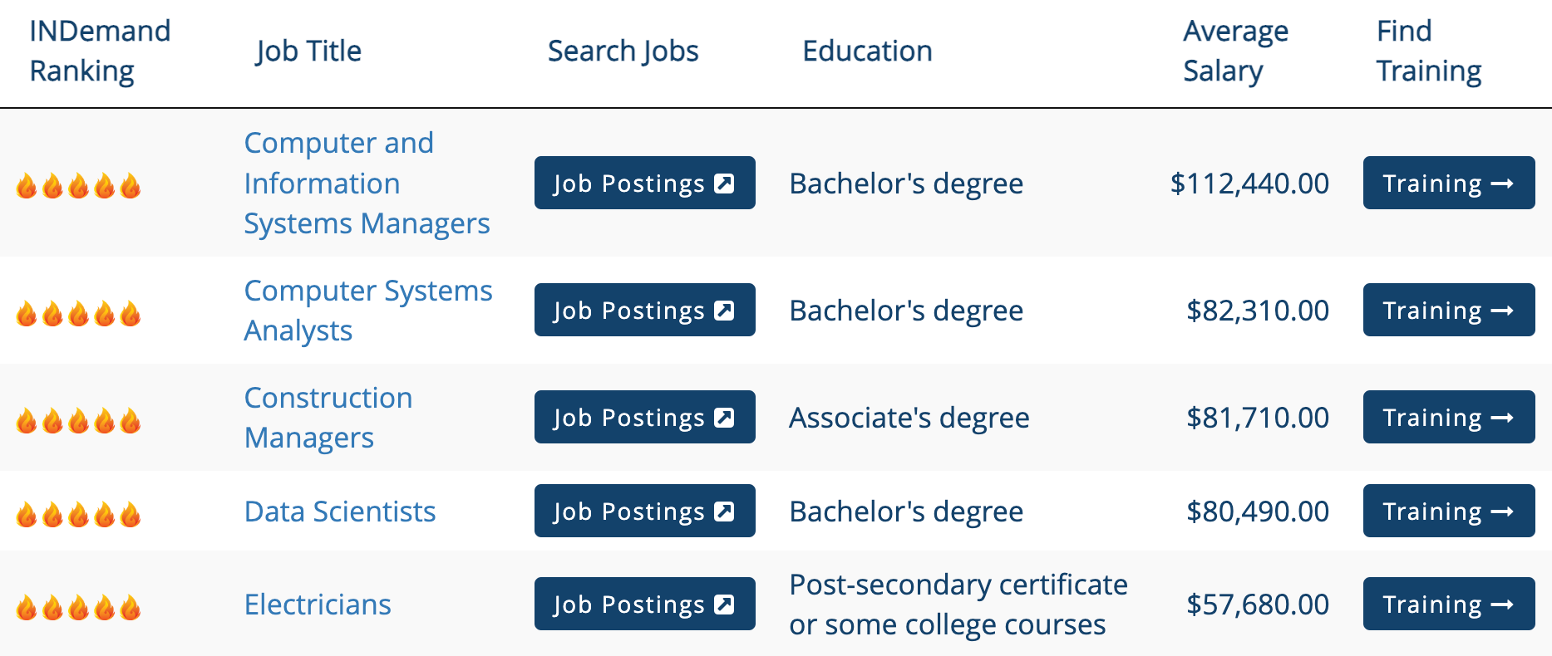
Indiana High Demand Jobs
Sort options by:
  Demand Outlook • Education Level
  Salary Level • Career Cluster

Slide 12


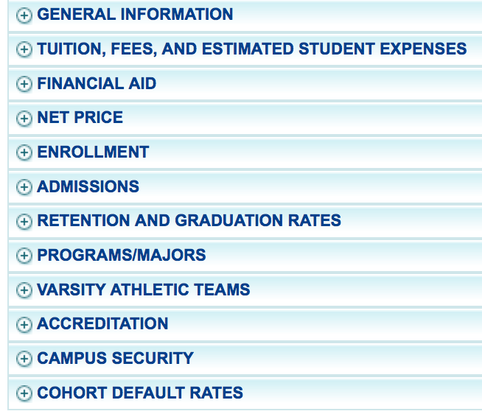

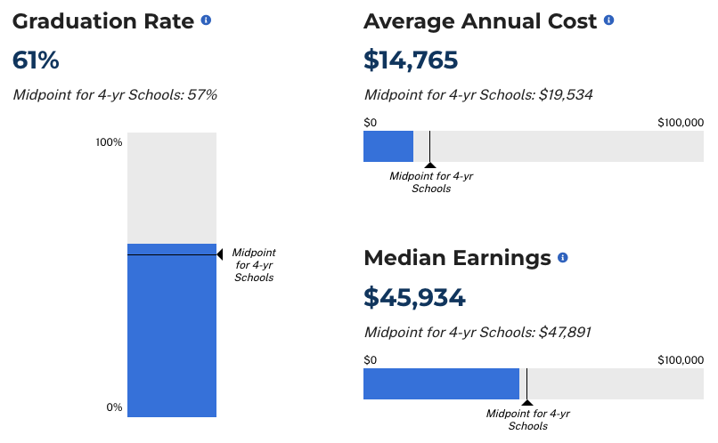
Choosing Your Program/College
Research your options
  Length of program
  Compare key elements
  Location & size
  Visit campus/facility
Online tools available at INvestEdIndiana.org/Choosingcollege

Slide 13
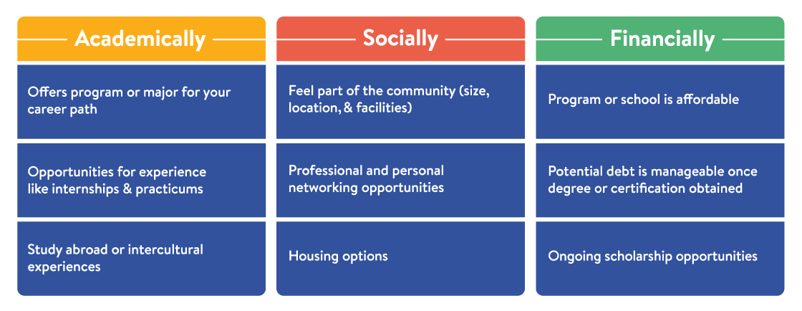
Find the Right Fit
Changing majors, programs or schools may add
  Extra time to complete degree
  Increased cost & student loan debt

Slide 14
Credit Completion
Complete credit hours each year to maintain maximum grant eligibility & graduate on time.
12 Credits – Fall
12 Credits – Spring
15 Credits – Fall
15 Credits – Spring
12 Credits – Fall
12 Credits – Spring
15 Credits – Fall
15 Credits – Spring
On Time
Full Time
12 Credits – Fall
12 Credits – Spring
15 Credits – Fall
15 Credits – Spring
12 Credits – Fall
12 Credits – Spring
15 Credits – Fall
15 Credits – Spring
12 Credits – Fall
12 Credits – Spring

Slide 15
Types of Financial Aid

Slide 16
Types of Financial Aid
Gift Aid
Grants
Scholarships
Self-Help Aid
Savings
Student Employment
Loans

Slide 17
Grants
Federal
  Pell Grant (Max: $7,395)
  Supplemental Educational Opportunity Grant (SEOG) ($100 to $4,000)
  TEACH Grant ($3,772)
State of Indiana
  21st Century Scholars
  Frank O’Bannon Grant
  William A. Crawford Minority Teacher Scholarship
  Workforce Ready Grant
Visit INvestEdIndiana.org/Grants

Slide 18
Scholarships
Need Based vs Merit Based
Where to look for scholarships:
FREE National Search Sites
College/University
Local/Community
        School Counselor
        Community Foundation
        Business & Employer
        Church & Civic Organizations
Visit INvestEdIndiana.org/Scholarships for more information

Slide 19

Scholarship Tips
Create scholarship resume
  Be compelling not just competitive
  Quality not necessarily quantity
  Demonstrate initiative not simply participation
Write sample essays
  Tell your story
  Answer the question
  Concisely communicate challenges, successes, goals, and contributions
  Write, read, edit, and repeat

Slide 20
Scholarship Tips
Scholarships take time
  Spend time each week
    Balance between searching, applying, and working on essays
    Look locally but also at national options
  Don’t miss deadlines
Have fun
  All kinds of scholarship options
  Have a scholarship party

Slide 22
Self-Help Aid

Slide 23

Saving for Education
Monetary Gifts
Job Earnings
529 Direct Savings Plan
    20% tax credit up to $1,500
    Account owner can change beneficiary
Coverdell Education Savings Account (ESA)
    After-tax investment with tax free withdraws
    Annual maximum contribution $2,000

Slide 24
Student Employment
Benefits
  Earn money to pay for college & minimize student loans
  Job & interview experience
  Build time management skills
Options
  Federal Work-Study
  Working Part-time
  Internships

Slide 25
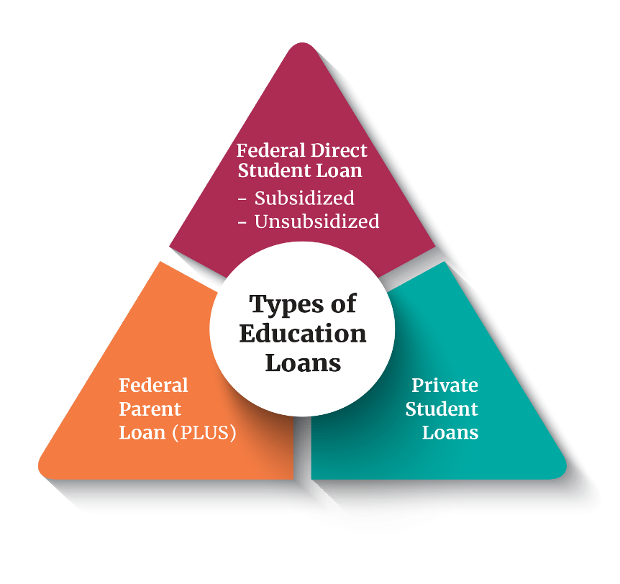
Education Loans
Federal Direct Loans Rate: 6.39% and Fee 1.057%
  Student’s Loans
  Subsidized & Unsubsidized
  Annual Limits
Federal Direct PLUS Loans Rate: 8.94% and Fee 4.228%
  Parent’s Loans
  Eligibility impacted by adverse credit
Private Student Loans Rate: Varies and Fee None
  Student and Cosigner’s loan
  Eligibility based on credit score and income

Slide 26
FAFSA

Slide 27
FAFSA
Free Application for
Federal Student Aid
  Annual application for most types of fin. aid
  Basis for determining:
    Federal Funds
      Grants
      Work-study
      Loans
    State of Indiana Grants
    Some Institutional funds
      Calculate Student Aid Index
    Visit studentaid.gov
2025-26
2025-26
2025-26
2025 - 26

Slide 28
Student Aid Index
Student Income
FAFSA calculation
Based on income, assets & family data
Used by the college to calculate your financial aid offer
Parent(s) Income
SAI
Parent(s) Assets
Student Assets
Visit INvestEdIndiana.org/FAFSA

Slide 29
FAFSA
Opens on October 1st each year
Uses completed tax data (prior/prior)
Know deadlines
State of Indiana priority deadline – April 15th
Colleges–Ask them
OCTOBER
1st
APRIL
15th

Slide 30
Managing Costs

Slide 31



Managing Costs
Ways to limit college costs
  Advanced placement (AP) & dual credit courses
  Commuting versus living on campus
  Summer and/or online courses
Estimate your financial aid & costs using a Net Price Calculator
Cost of Attendance
(tuition & fees, room & board, books & supplies, transportation & miscellaneous personal expenses)
FREE Money
(Grants & scholarships)
Net Price
(Remaining cost covered by: Outside scholarships, student employment, savings/out of pocket, or loan programs)

Slide 32

Net Price Calculator Example
Student Demographics
  Middle/low income
  Above average GPA & test scores
Results
  Cost = $27,900
  Net Price = $16,900
  Remaining Cost = $8,400
  For a link to any college’s calculator visit:
INvestEdIndiana.org/NPC

Slide 33
Impact of Social Media

Slide 34
Professional Online Presence
Appropriate social media profiles
john.smith@gmail.com
Jsmith24
Promote Yourself
Be engaging and personal
Tell your story
Be mindful
Remove inappropriate material
Anything that may be misinterpreted

Slide 35







People Review Your Social Media
Scholarship Reviewers
  58% review to determine if applicant demonstrates good judgement
  33% denied winner based on review
College Admissions
  36% consider during admissions process
  32% say review demonstrated a negative impact
Employers
  90% consider social media accounts during hiring decisions
  79% rejected candidates based on posts
Sources: https://themanifest.com/digital-marketing/5-personal-branding-tips-job-search
  https://www.kaptest.com/blog/press/2020/01/13/kaplan-survey-percentage-of-college-admissions-officers-who-visit-
  applicants-social-media-pages-on-the-rise-again/ &

Slide 36



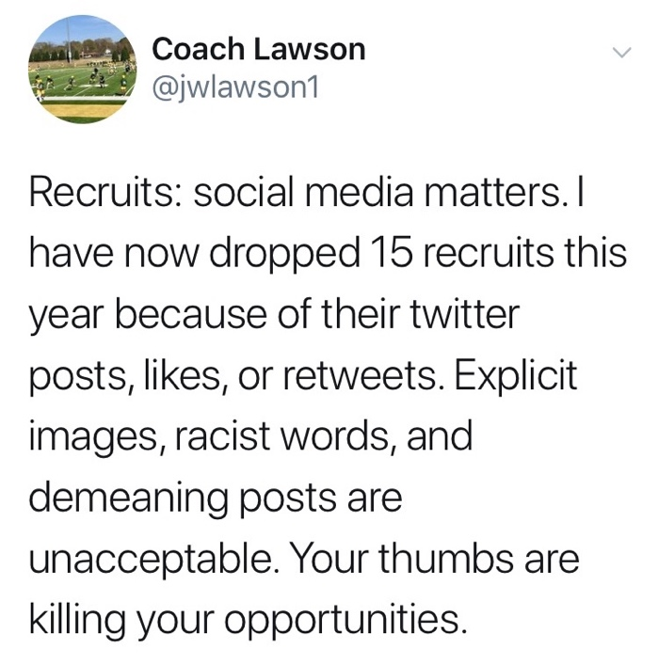
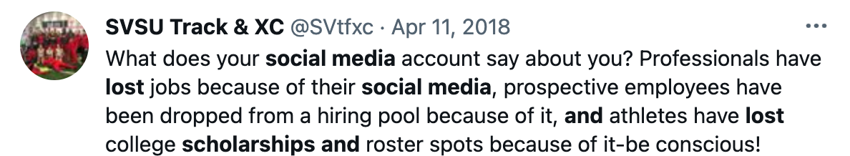

Do Social Media Decisions Make A Difference?

Slide 37
We’ll Help!

